Slide 1



Living and Working Well with a Disability: What’s Health Got to Do with It?
The University of Montana Rural Institute
Tracy Boehm

Slide 2
Acknowledgements
Independent Living Centers and their consumers
Vocational Rehabilitation Offices
Disability and Health Team– NCBDDD
National Institute on Disability and Rehabilitation Research (NIDRR)
Centers for Disease Control

Slide 3


Slide 4
Questions I will try to answer:
Where do I come from?
Why health promotion for people with disabilities?
What is Living Well and Working Well with a Disability?

Slide 5


Slide 6
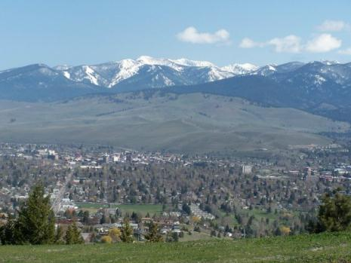
Introduction
Rural Institute
University Center of Excellence
RTC: Rural
CDC Disability and Health Team

Slide 7
What’s health got to do with disability?
Medical model vs. social model
Paradigm shift
WHO defines health as:
“A state of complete physical, mental and social well-being and not merely the absence of disease or infirmity.”

Slide 8
People with disabilities CAN be healthy!
It isn’t true that you are either healthy or unhealthy.
Someone with arthritis can have excellent overall health despite having joint pain.

Slide 9

Health is …..
A MEANS to an end, NOT the end itself!
We work hard to be healthier so we can experience the things we enjoy and that give us meaning in life.

Slide 10
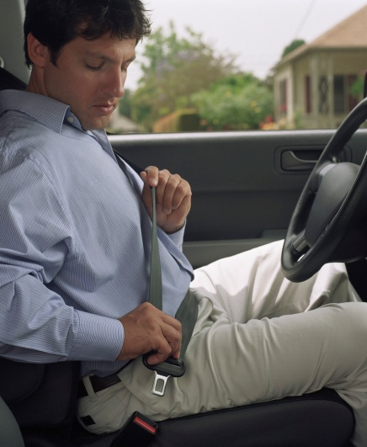
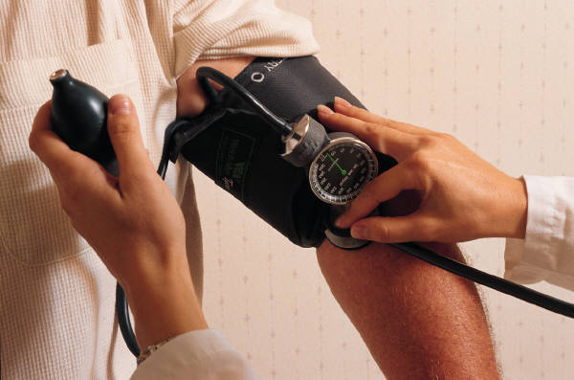
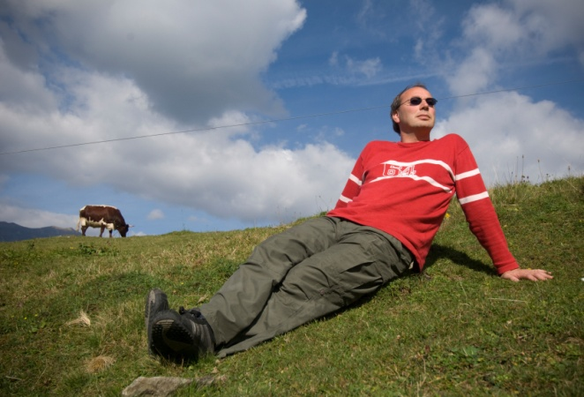
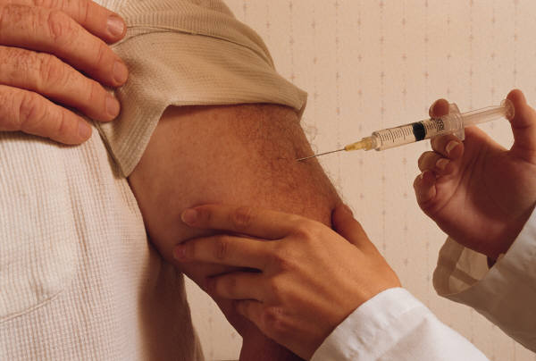
What is Health Promotion?
Health promotion involves facilitating people’s efforts to change behavior in healthy ways.

Slide 11
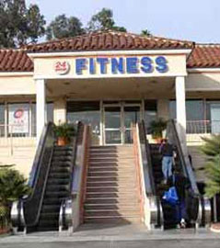
Why health promotion for people with disabilities or permanent injuries or impairments?

Slide 12
Health Disparities
Health disparities are differences in the incidence, prevalence, mortality, burden of diseases and other adverse health conditions or outcomes that exist among specific populations.

Slide 13
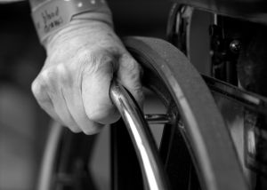
Secondary Conditions
"Those physical, medical, cognitive, emotional, or psychosocial consequences to which persons with disabilities are more susceptible by virtue of an underlying condition, including adverse outcomes in health, wellness, participation, and quality of life" (Hough, 1999)

Slide 14
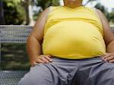
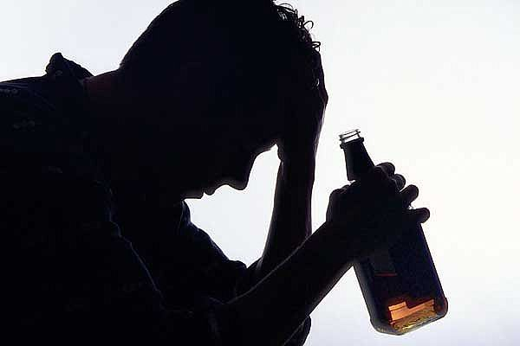
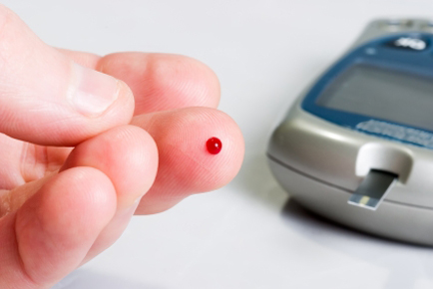
Secondary Conditions Research
Research about secondary conditions
14 secondary conditions annually
Most problematic conditions related to lifestyle

Slide 15
Top Ten Secondary Conditions
Problems with mobility
Joint/muscle pain
Physical conditioning problems
Fatigue
Chronic Pain
Arthritis
Difficulties with access
Sleep disturbances
Contractures
Depression

Slide 16

Why is this important?
Secondary conditions:
  Affect experiences in daily living, participation, work, and maintaining life balance and maintenance.
  Influence quality of life

Slide 17
Access to Health Promotion
Haves
  Adults with private insurance
  Full-time workers in small and large enterprises
  Urban Workers
Have nots
  Adults with public insurance (Medicaid/Medicare)
  Part-time workers and rural workers
  People who are not employed

Slide 18
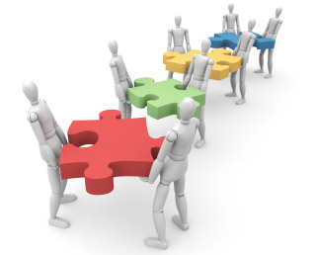
Building Capacity for Health Promotion
A need for two programs
  Living Well with a Disability
  Working Well with a Disability
Centers for Independent Living
Vocational Rehabilitation

Slide 19
Living and Working Well with a Disability
Promote healthy independent living
Goal development
Healthy & balanced lifestyle
Improvements in outlook, lifestyle, heath & community participation

Slide 20

Living Well Format
Typically a 10-week workshop
Groups of 8-10 led by facilitator
Groups meet 2 hours per week
Facilitator guides group through10 chapters of a self-help workbook

Slide 21

Living Well Program Content
Goal-setting
Problem-solving
Healthy Reactions
Beating the Blues
Healthy Communication
Information Seeking
Physical Activity
Nutrition
Advocacy
Maintenance

Slide 22
Is Living Well helpful?
Consumers report:
Fewer symptoms & 20% reduction in limitation from secondary conditions
More healthful behavior
10% decline in spending for medical services

Slide 23
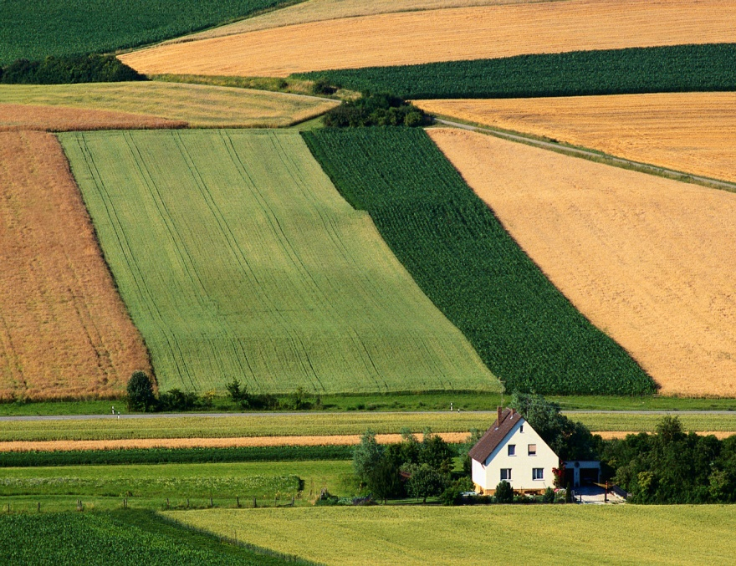
Approaches to Goal Setting
The past - My Favorite Things
The present- The House of Living Well
The future- Storyboarding
Maintaining Balance

Slide 24

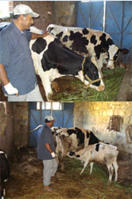

Workshop Exercises
My Favorite Things
The House of Living Well
Imagining my Future

Slide 25
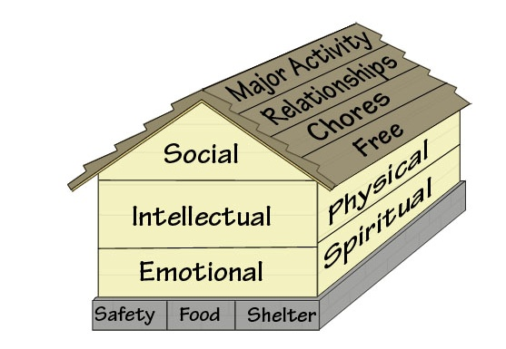
The House of Living Well

Slide 26
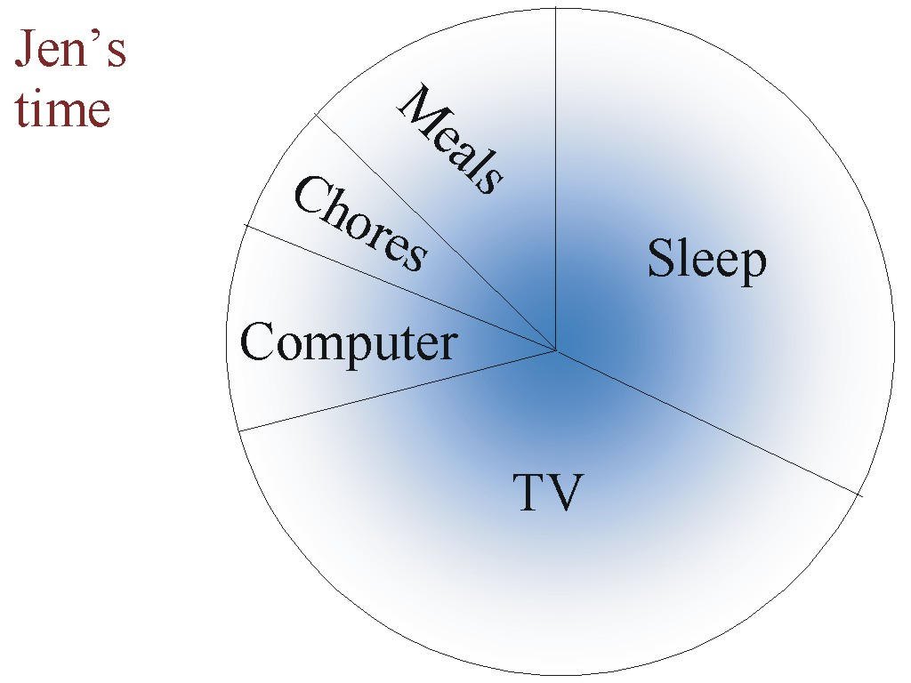
The Time Wheel

Slide 27
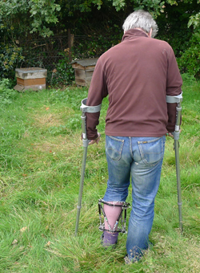
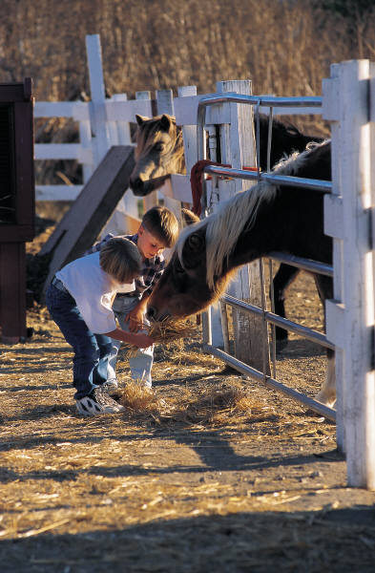
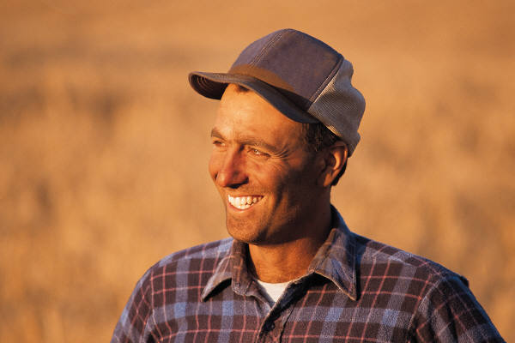
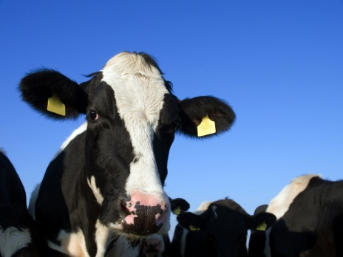
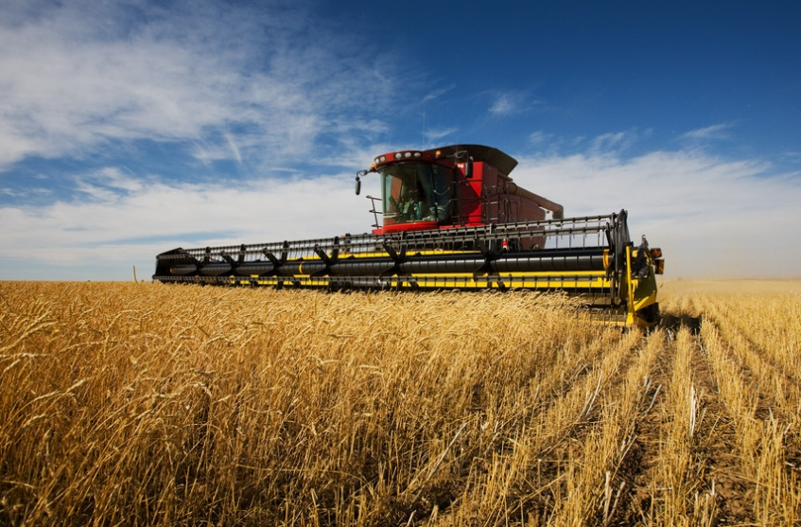
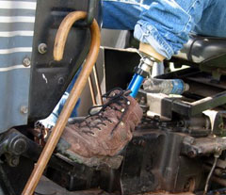
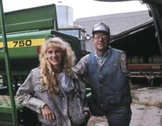

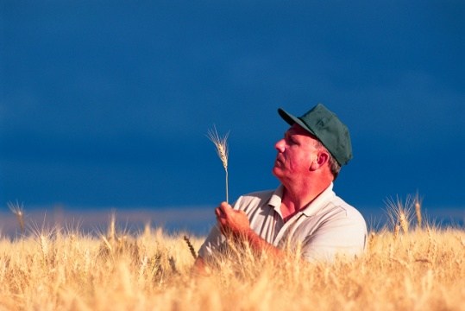
Imagining My Future

Slide 28

Working Well with a Disability
Modified from Living Well with a Disability
  Meaningful life goals as the impetus for making healthy lifestyle changes
Working Well with a Disability
  Life balance – personal values as impetus for making lifestyle changes
  6-7 week program, 2 hours weekly
  Facilitators (peers) guide groups of 6-10

Slide 29
Secondary Conditions and Employment
  Associated with worse employment outcomes
  Amenable to change through improved health behaviors
    Worksite literature (Pelletier, 1999, 2001, 2005)
    Living Well with a Disability

Slide 30
Working Well Research
VR clients recruited
n = 291
Control group
n = 130
Intervention group
n = 161
Did not attend (WW=0)
N = 88
Attended
1 to 5
(WW=1-5)
N = 23
Attended
6 to 10
(WW=6+)
N = 50

Slide 31
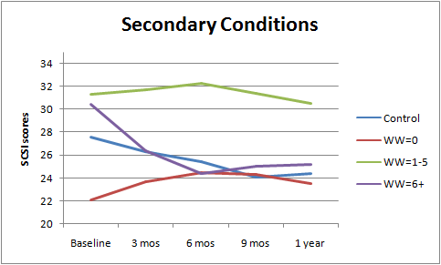
Results

Slide 32

Working Well
Maintaining or building healthy behaviors when employed is a balancing act.
Working Well is about finding creative ways to maintain balance across important life areas.
Physical health is essential to long-term balance and sustained employment.

Slide 33
The House of Working Well

Slide 34
The House of Working Well

Slide 35
Time Timeline

Slide 36
The Rest of Working Well
Identifying obstacles, seeking information, problem solving and planning a pathway
Stress management
  Reframing negative thoughts, relaxation techniques
Advocating to get needs met
  Sending clear messages, active listening, writing a persuasive letter, asking for a meeting, etc.
Physical activity and nutrition
  Adapted exercise and resources, eating on the run
Maintaining balance
  Motivators, reassessment, discipline, and tracking.

Slide 37
Working Well Benefits
  Improved health and capacity to work
  Peer support & reduced isolation
  Supportive environment to examine health and lifestyle issues
  Opportunity to commit to self-improvement through self-management
  Develop friendships that may last beyond the workshop.

Slide 38
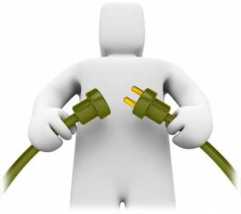
Program Implementation
  Training
  Program Delivery
  Capacity building

Slide 39
Training
Facilitators trained primarily via the internet or teleconference
Intensive in-person training also available
Currently over 800 LWD facilitators trained in 43 states
Peer co-facilitation highly recommended

Slide 40
Program Delivery
  Centers for Independent Living
  Mental Health services
  Public Health Plans
  Vocational Rehabilitation Centers
  Job Service
  Employment networks

Slide 41
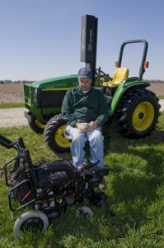
Capacity Building
  Community members with disabilities
  Adult Disability Resource Centers
  Health Departments
  YMCAs
  AgrAbility

Slide 42
Resources
LWD & WWD Program and Training information:
www.livingandworkingwell.org
Research and progress reports:
http://rtc.ruralinstitute.umt.edu

Slide 43
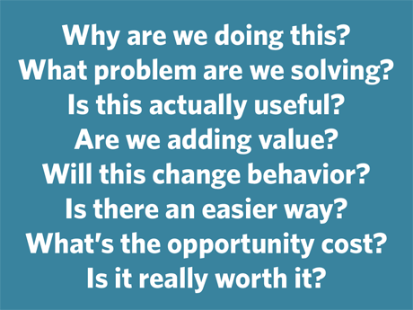
Q & A
  Content
  Process
  Training
  Funding
  Delivery mechanisms

Slide 44
Contact Information
RTC: Rural, University of
Montana
52 Corbin Hall
Missoula, MT 59812
Tracy Boehm, MPH
406-243-5741
boehm@ruralinstitute.umt.edu
Craig Ravesloot, PhD
406-243-2992
Craig.Ravesloot@umontana.edu
Catherine Ipsen, PhD
406-243-4562
ipsen@ruralinstitute.umt.edu

