Slide 1

Universal Design
Take it to the Barn!
    Kent McGuire - Ohio AgrAbility Program Coordinator
    Ohio State University

Slide 2
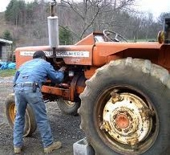
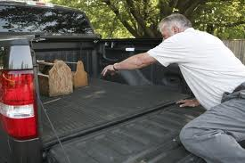
Have you ever?
Found it awkward to complete or perform a task?
Had trouble reaching for something?

Slide 3
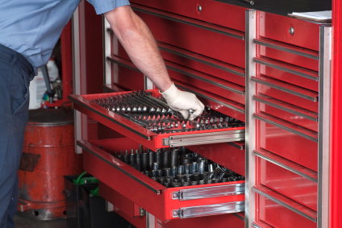
Have you ever?
Had trouble locating the right tool?
Had trouble completing chores?

Slide 4
Common Problems!
Some causes of common problems associated with completing tasks on the farmstead.
Individual
Disability / Health Condition
Limited mobility
Limited lifting or flexibility
Limited gripping
Limited vision
Limited height
Youth
Environment
Uneven terrain
Tight travel paths
Limited workspace
Dark work areas
Not user friendly
Changing weather conditions
Working around animals
Historically outdated
Notes:
In the agricultural setting where there is both household and occupational operations occurring simultaneously, and where multiple household members are affected by modifications, universal design tries to accommodate all individuals involved.

Slide 5
What is Universal Design?
Universal Design is the creation of products and environments meant to be usable by all people, to the greatest extent possible, without need for adaptation or specialization.
Notes:
The primary focus of universal design has revolved around elements of the home and development of user-friendly products. Many homes, offices, and public buildings have undergone simple transformations that enable access to all persons; this re-design of an environment can range from small gadgets to fairly extensive transformations.

Slide 6
The 7 Principles of Universal Design
PRINCIPLE ONE: Equitable Use
The design is useful and marketable to people with diverse abilities.
PRINCIPLE TWO: Flexibility in Use
The design accommodates a wide range of individual preferences and abilities.
PRINCIPLE THREE: Simple and Intuitive Use
Easy to understand, regardless of the user’s experience, knowledge, language skills, or current concentration level.
PRINCIPLE FOUR: Perceptible Information
Communicates necessary information effectively to the user, regardless of conditions or the user’s sensory abilities.
Notes:
Equitable use= anti fatigue matting
Flexibility in use= multi height workbenches
Simple / intuitive use = lever style door handles
Perceptible info= signs with words and pictures

Slide 7
The 7 Principles of Universal Design
PRINCIPLE FIVE: Tolerance for Error
Minimizes hazards and the adverse consequences of accidental or unintended actions.
PRINCIPLE SIX: Low Physical Effort
Can be used efficiently and comfortably and with a minimum of fatigue.
PRINCIPLE SEVEN: Size and Space for Approach and Use
Appropriate size and space is provided for approach, reach, manipulation, and use regardless of user’s body size, posture, or mobility.
Notes:
Equitable use= anti fatigue matting
Flexibility in use= multi height workbenches
Simple / intuitive use = lever style door handles
Perceptible info= signs with words and pictures

Slide 8
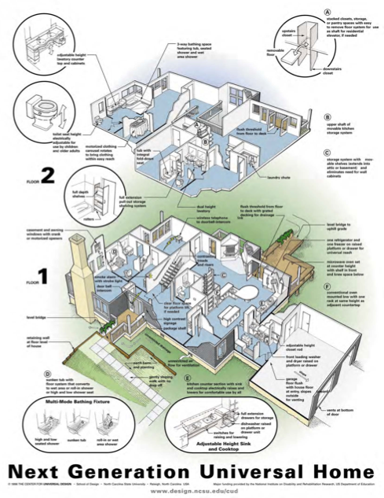
Universal Design For the Home
Multiple recommendations, concepts, and products for Universal Design in the home.
New home construction
Older home renovations
Household products
Ergonomic Designs
Notes:
Equitable use= anti fatigue matting
Flexibility in use= multi height workbenches
Simple / intuitive use = lever style door handles
Perceptible info= signs with words and pictures

Slide 9
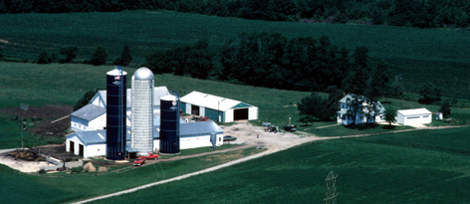
Extending Universal Design on the Farmstead.
Many of the same concepts can easily be transferred to the farmstead.
Garage
Farm shop
Barn
Feed lot
Machine storage
Livestock facilities
Notes:
Applying universal design techniques throughout the entire farmstead can maximize safety for all individuals and promote independence for those with physical or mobility limitations.

Slide 10
Universal Design for the Farmstead.
Goals of using Universal Design concepts for existing farmstead:
- It is not intended to entirely redesign the farmstead
- Make a range of changes to the farmstead based on the specific type of farming operation.
Make more user- friendly to all members of the operation.
Produce a more comfortable environment.
Increase efficiency to the operation.
Provide a safer place to live and work.
Notes:
10

Slide 11
Universal Design for the Farmstead.
Universal Design and Assistive Technology working together:
Same purpose
  To reduce the physical and attitudinal barriers between people with and without disabilities.
Universal Design
  Strives to integrate people with disabilities into the mainstream.
Assistive Technology
  Attempts to meet the specific needs of individuals.
Notes:
11

Slide 12
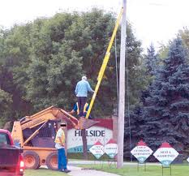
Universal Design for the Farmstead.
Standard measurements.
Light switches: 42”-48” above floor
Elect. Outlets / Controls: 18”- 48” above floor
Door handle / Grab handles: 32” – 54” from floor
Work Surfaces: At least one 28” from floors w/ clear opening
Storage: most frequent used 18”- 54”
Tool storage: 6” – 54” above floor
Notes:
Compacted stone, asphalt, concrete

Slide 13
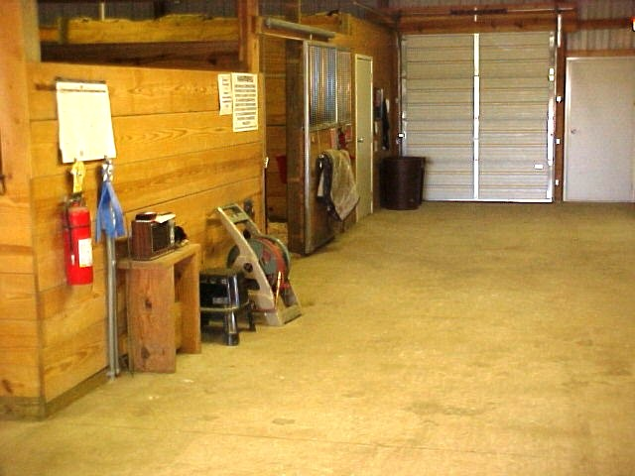
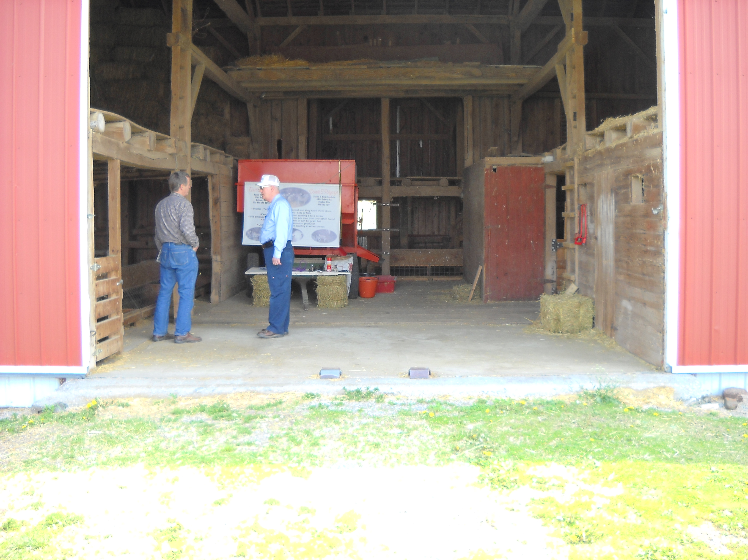
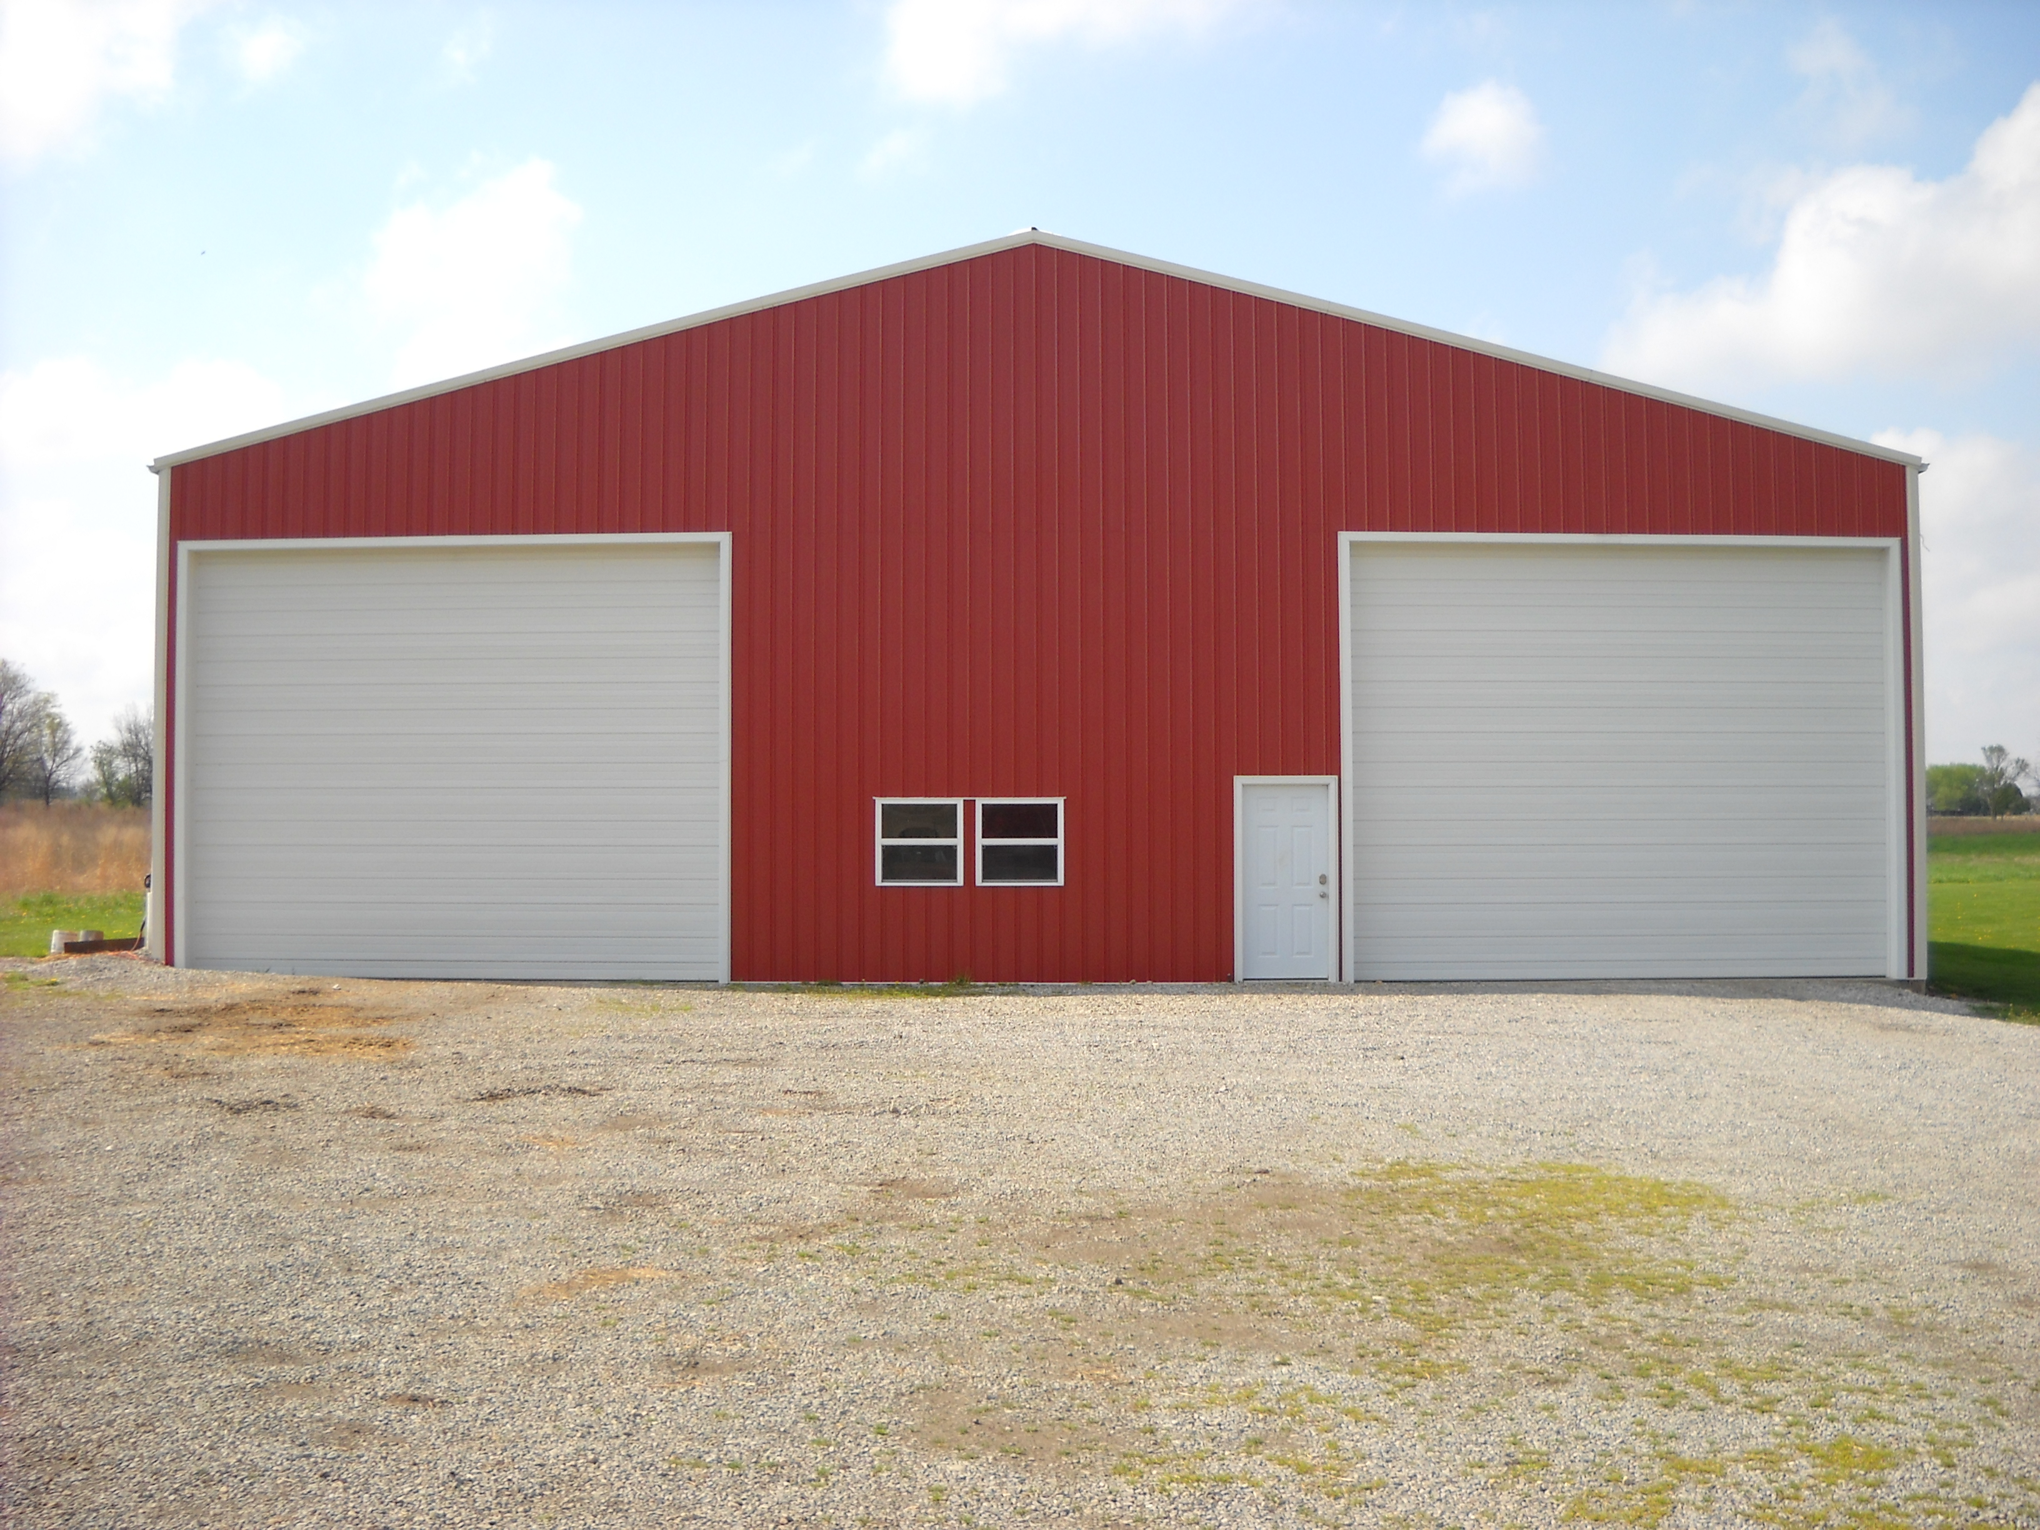

Universal Design for the Farmstead.
Entryways and travel surfaces.
solid travel surfaces
non slip surfaces
smooth transitions at doors
sloped sidewalks
lever style door handles
wide doors
floor markings
Notes:
Compacted stone, asphalt, concrete

Slide 14
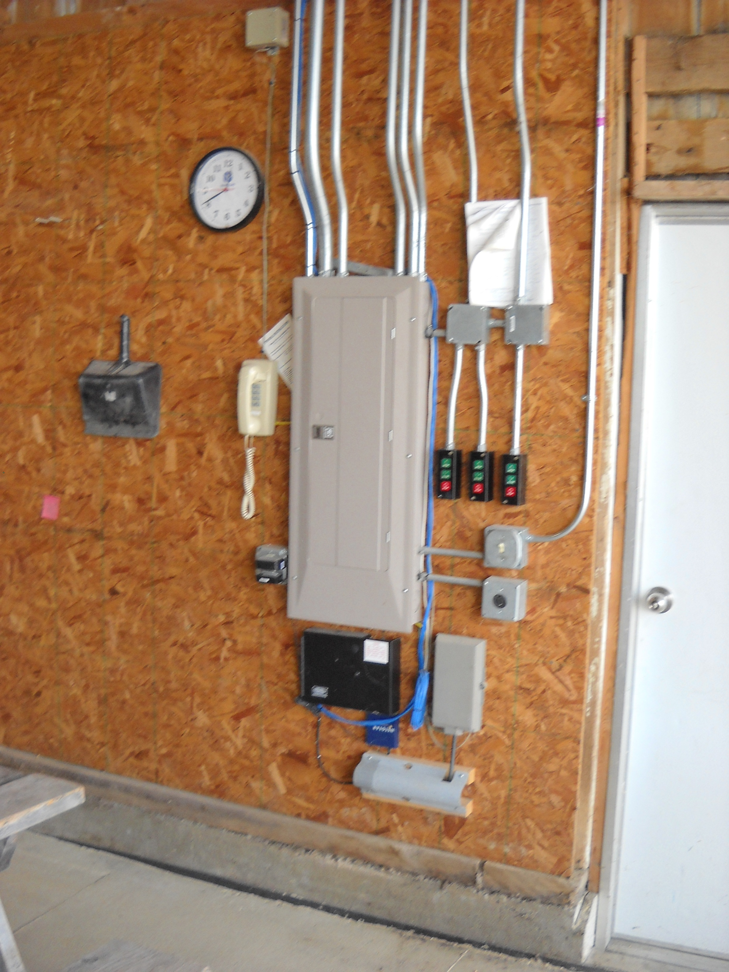
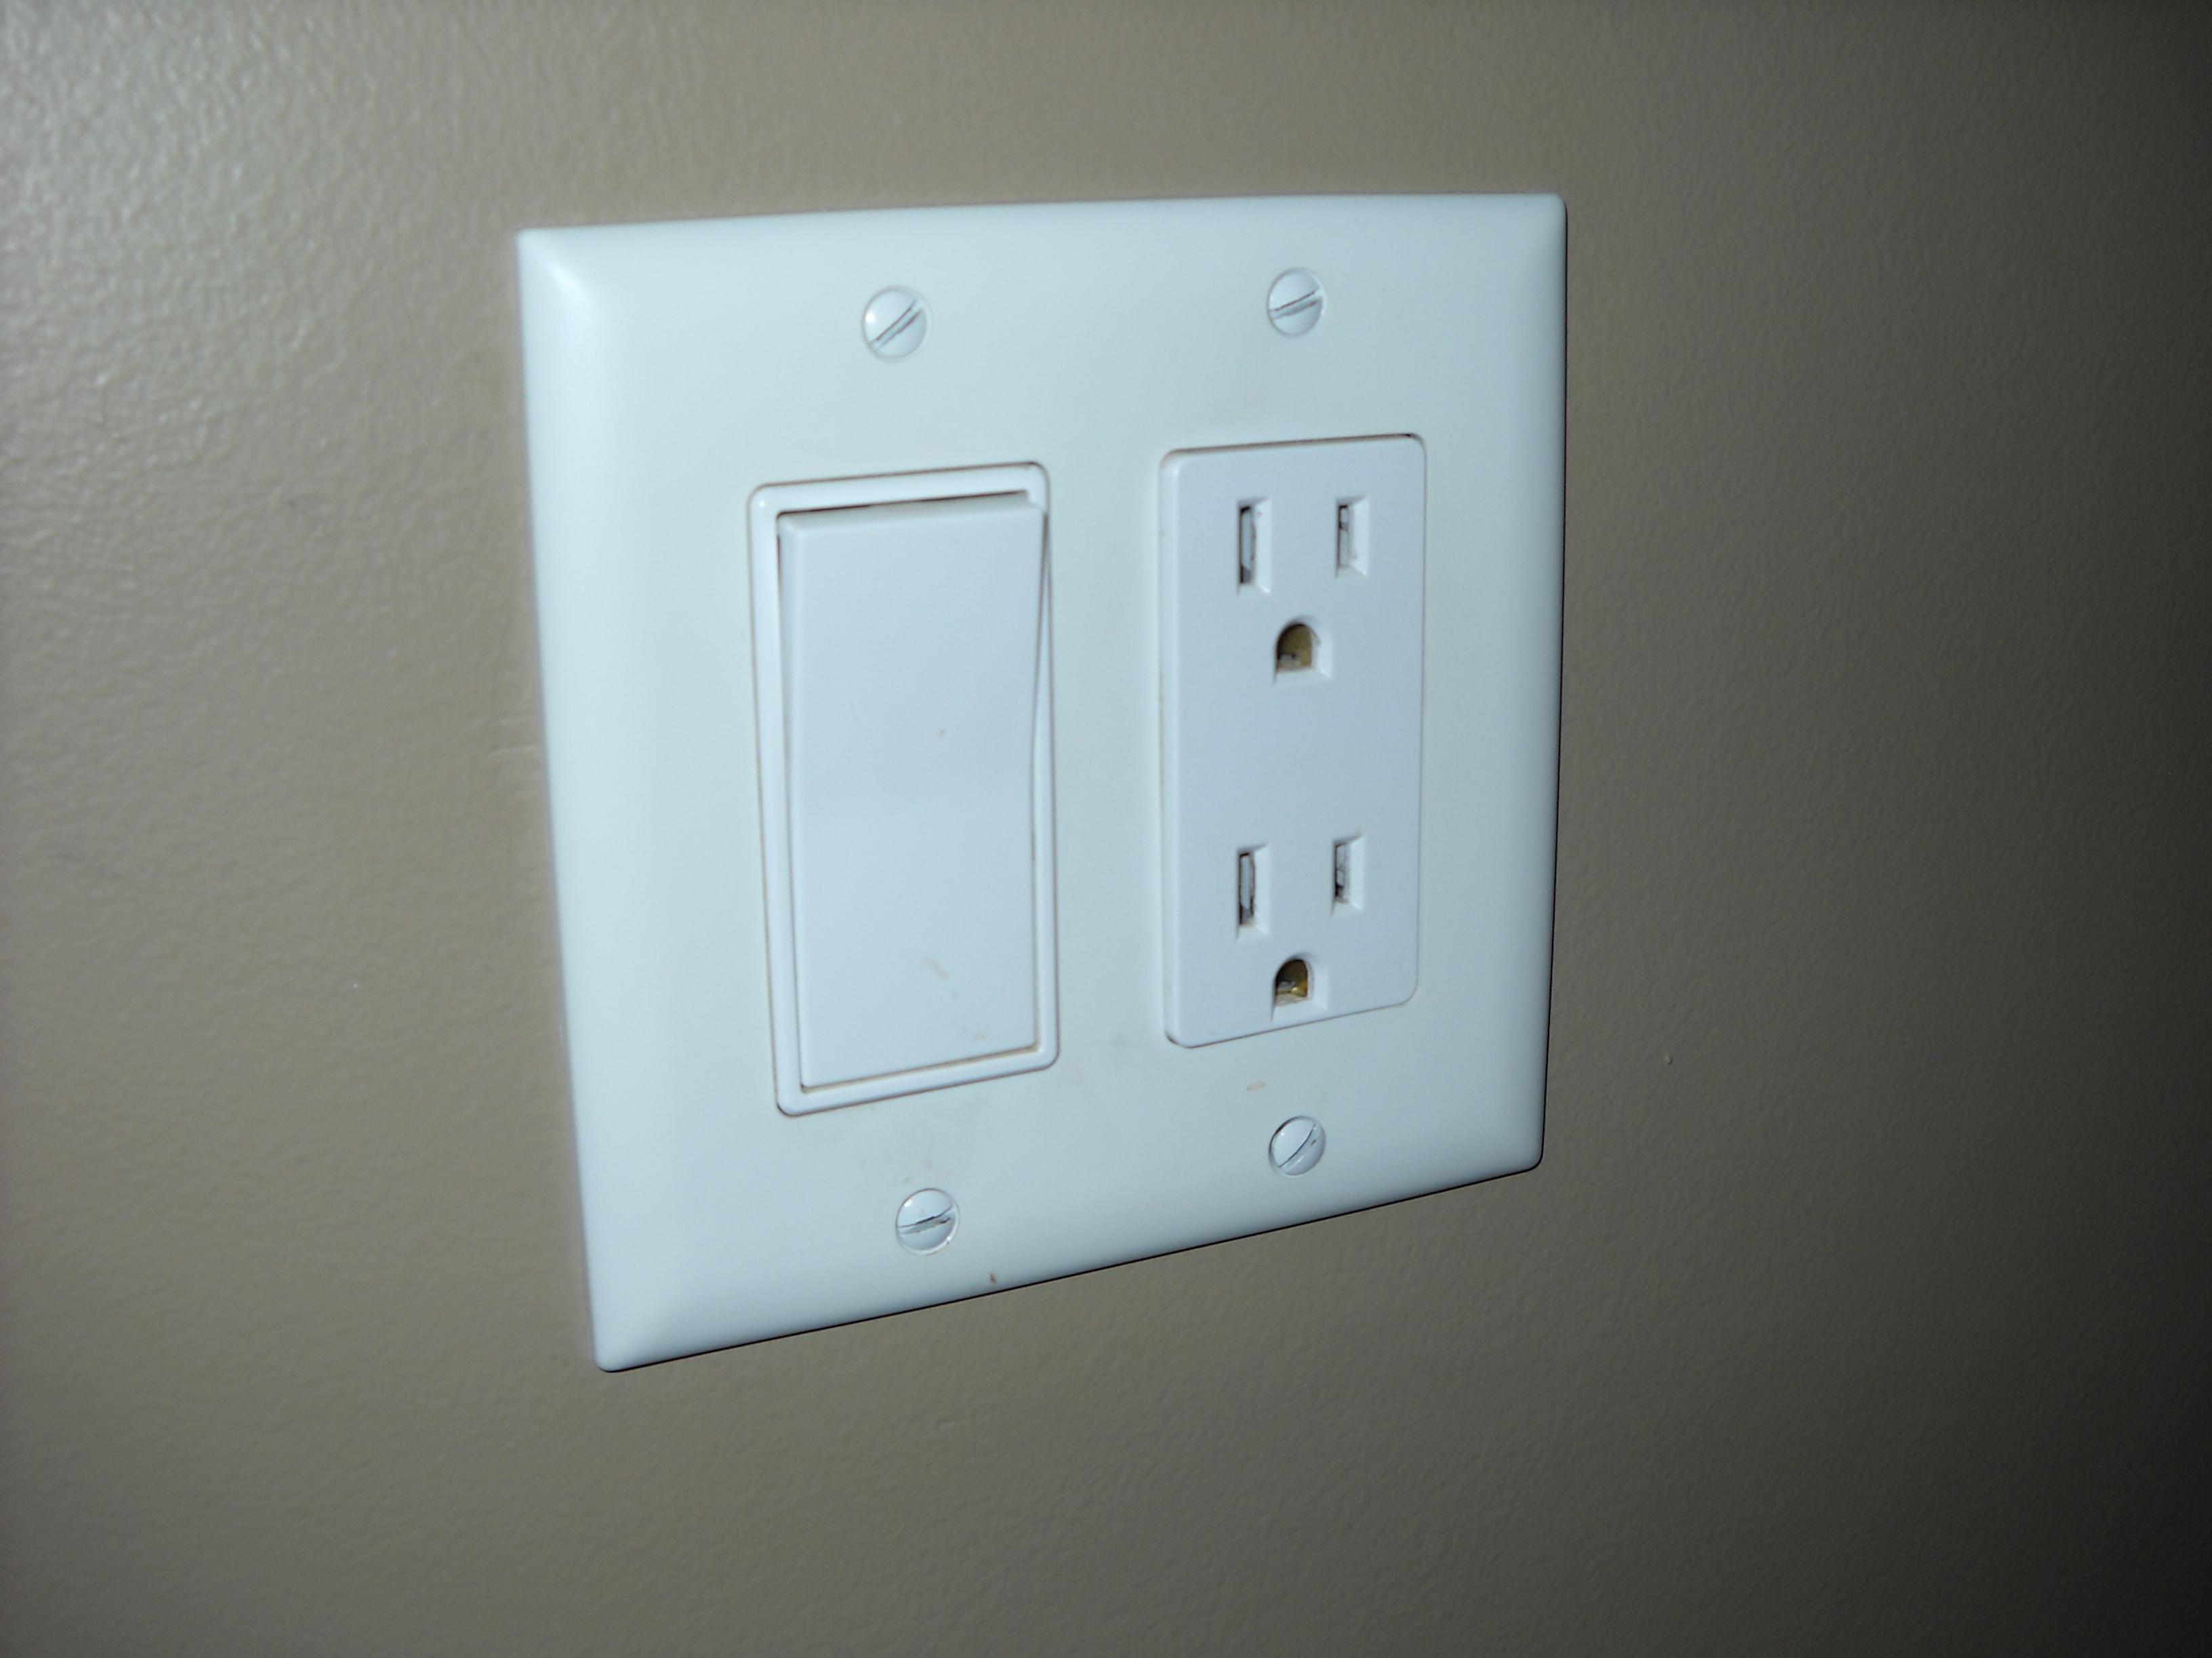
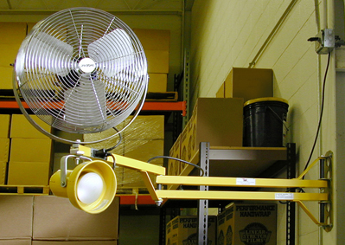
Universal Design for the farmstead.
lighting / electrical:
Accessible controls
Easy to use switches
Switches and outlets at the front of workbenches
Task - lighting
Under - cabinet lighting
Motion sensitive
Outdoor accessible

Slide 15
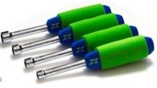
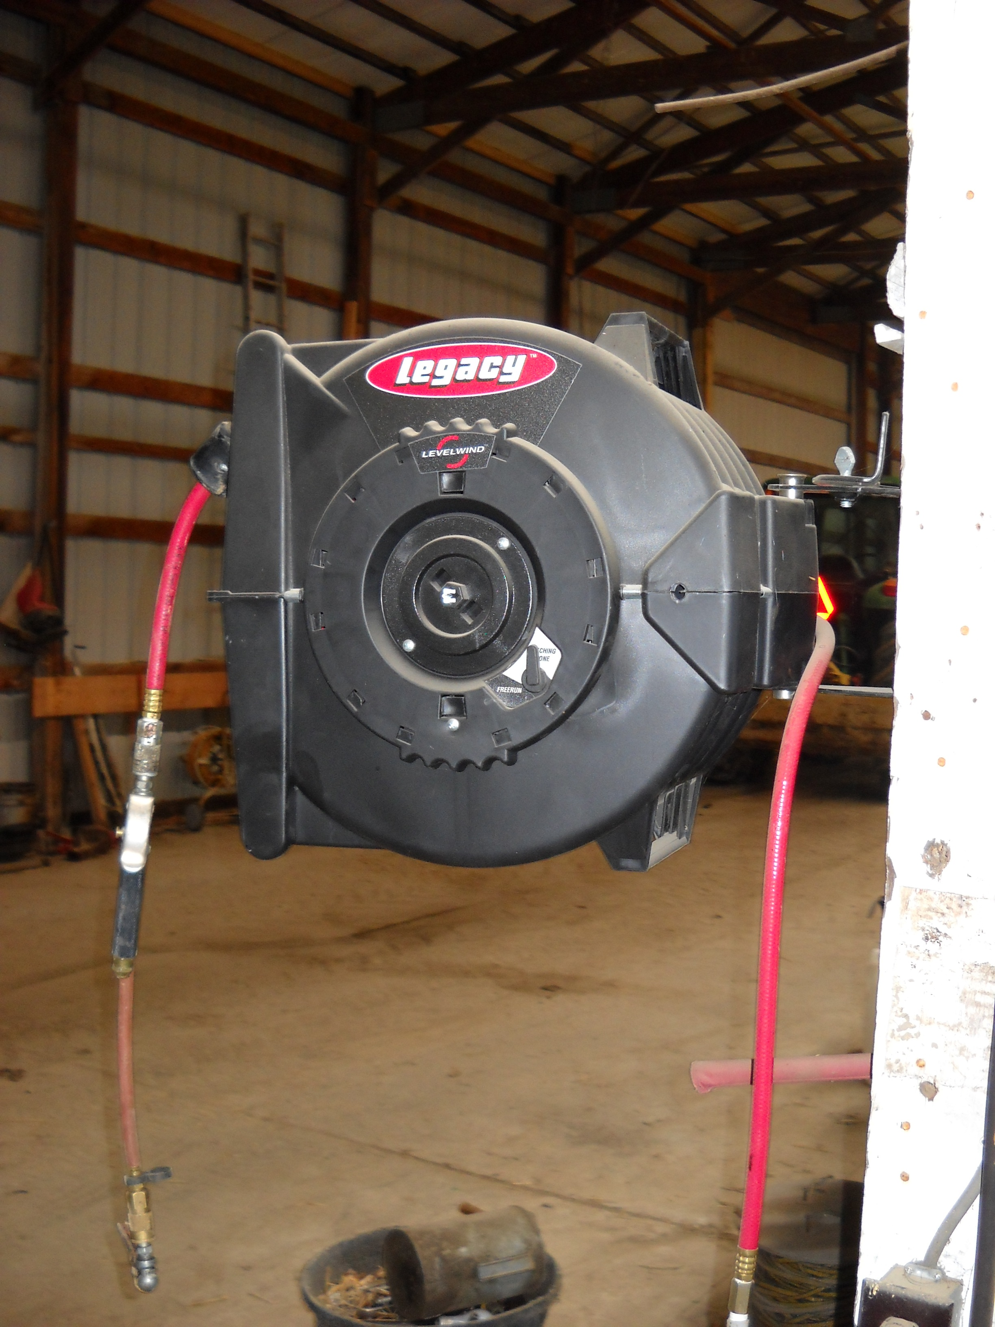
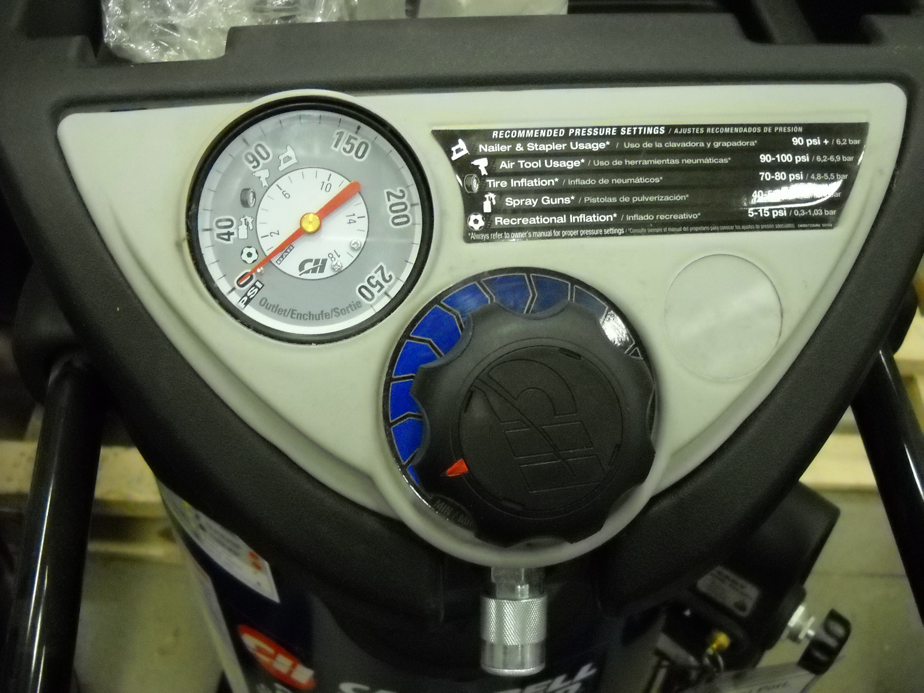
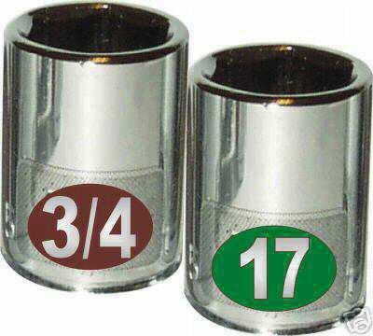
Universal Design for the Farmstead.
Universal design tools / hardware / equipment
Larger handles
Cushioned handles
Ergonomic grips
Easy to use on / off switches
Large digital display or dials
Color coded
Larger knobs
Front Controls

Slide 16
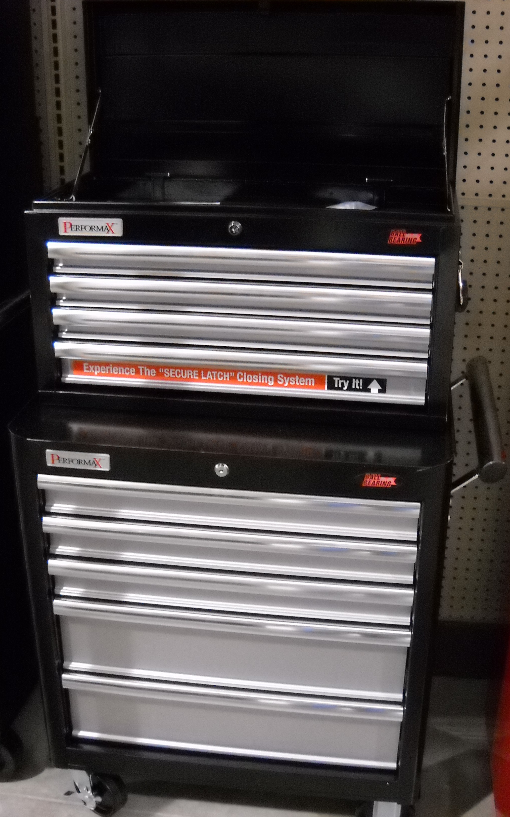
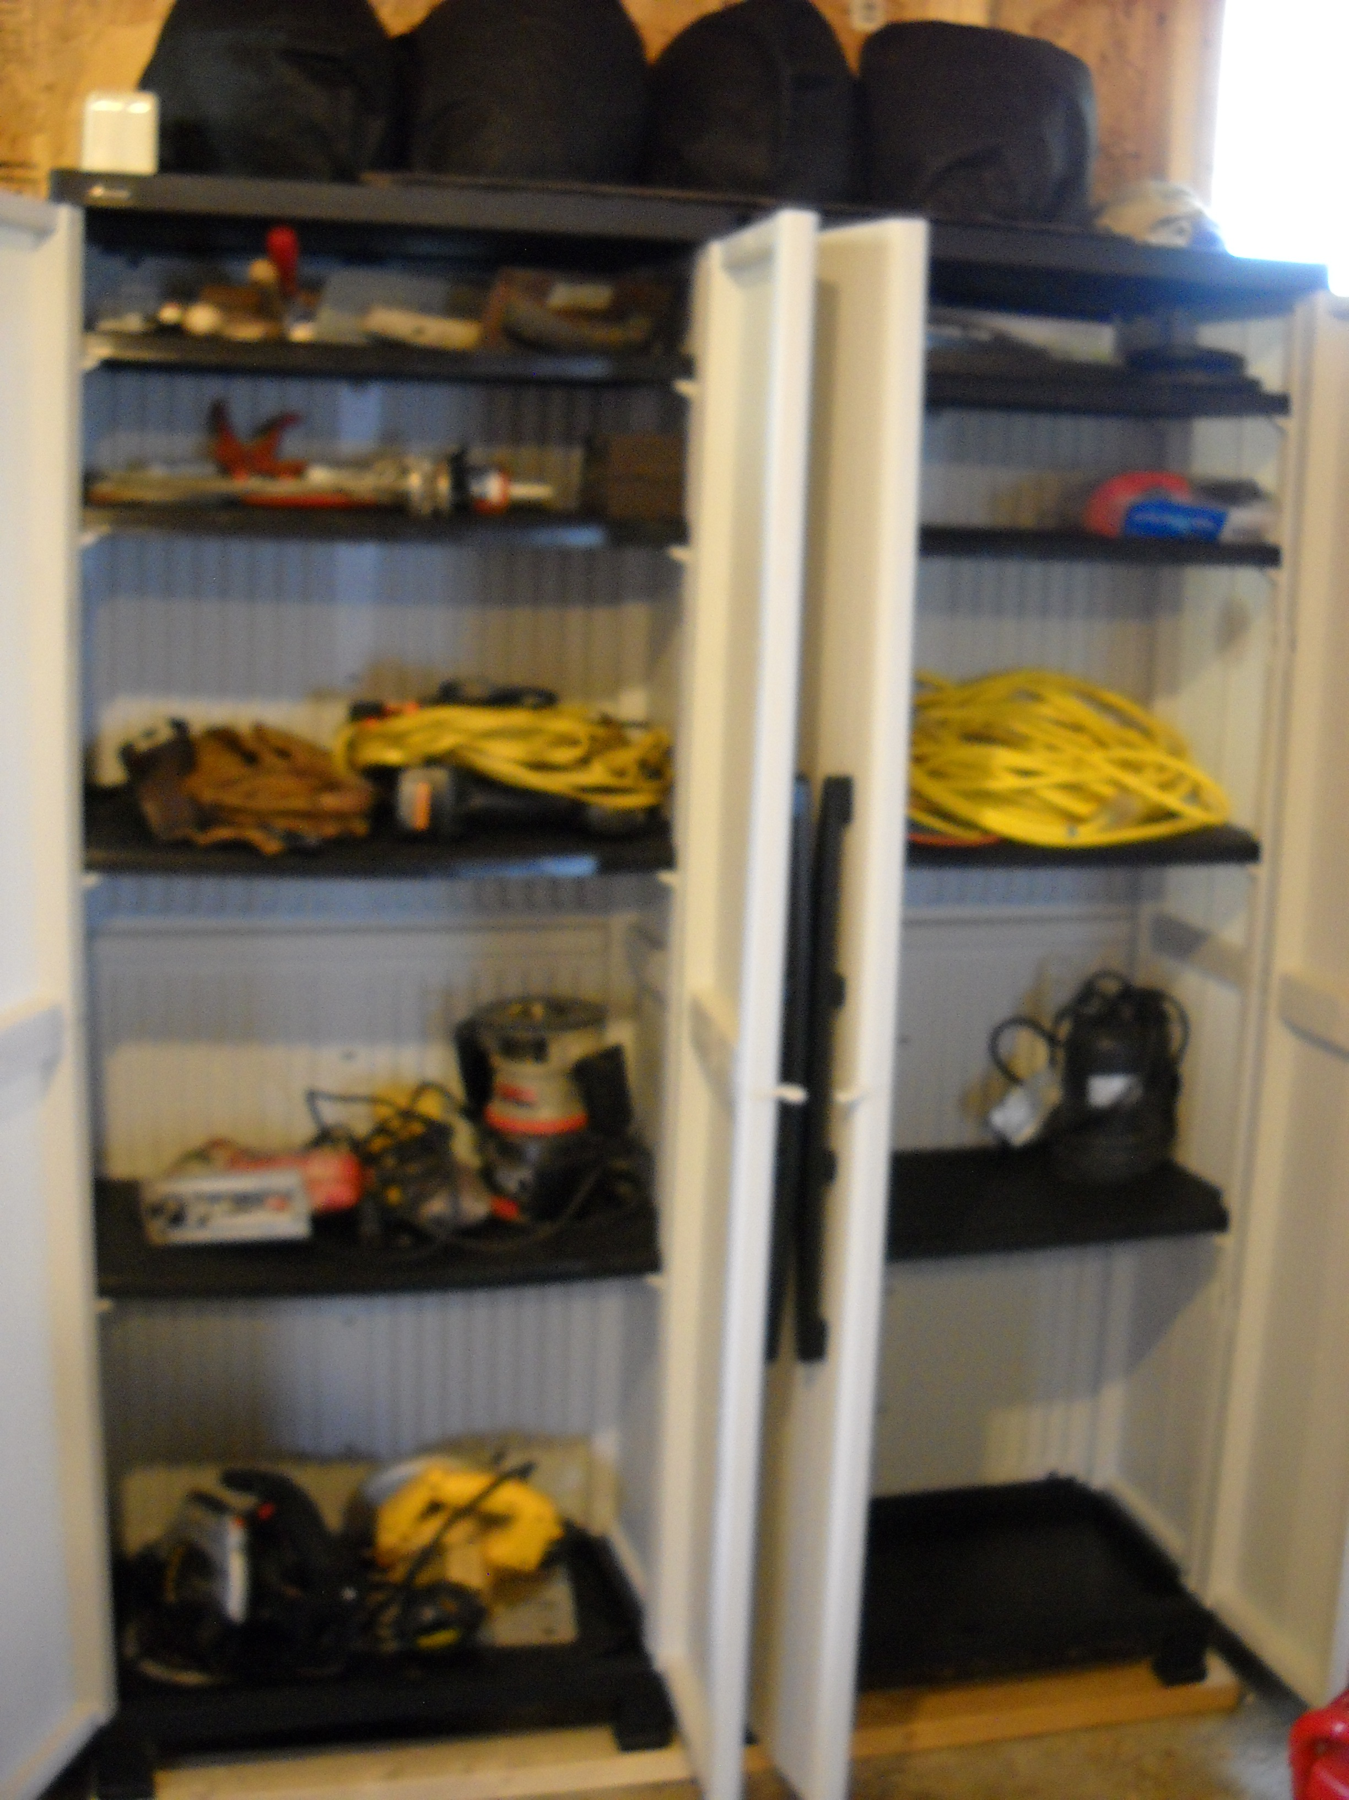
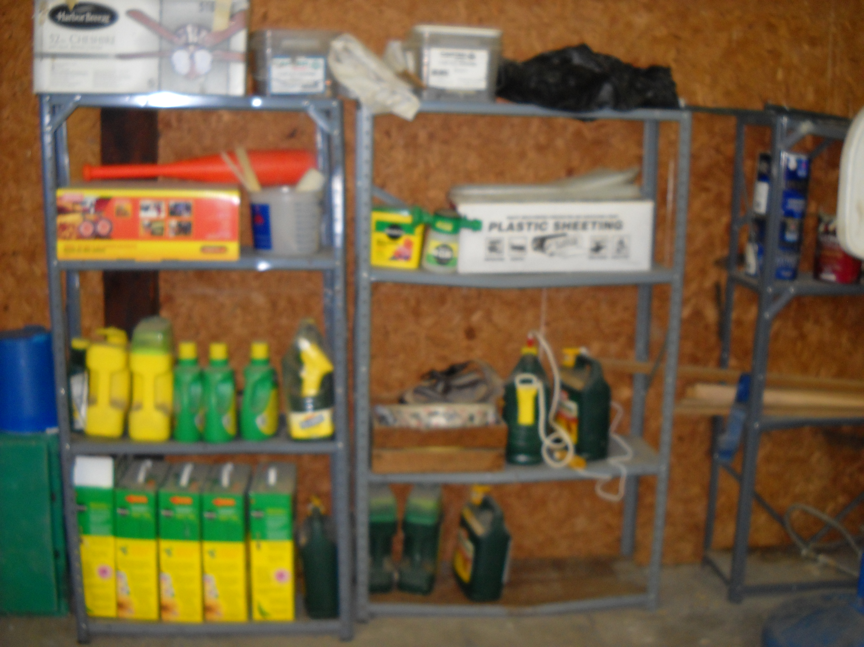
Universal Design for the farmstead.
Storage:
accessible
adjustable shelving
multi - levels
organizational
mobile/ rolling cabinets
most frequent items lower / less frequent items higher
Notes:
Adjustable height shelving and cabinets for storage areas – no overhead storage that takes access from stairs or ladder. At least 36 inches between rows of shelving or storage bins.
Most frequently used items are 18 to 48 inches above floor in storage areas, to least used items on higher shelves, and rolling or mobile items are on the floor.
Mobile tool storage is no less than 6 inches from the ground and no higher than 48inches from ground level.

Slide 17
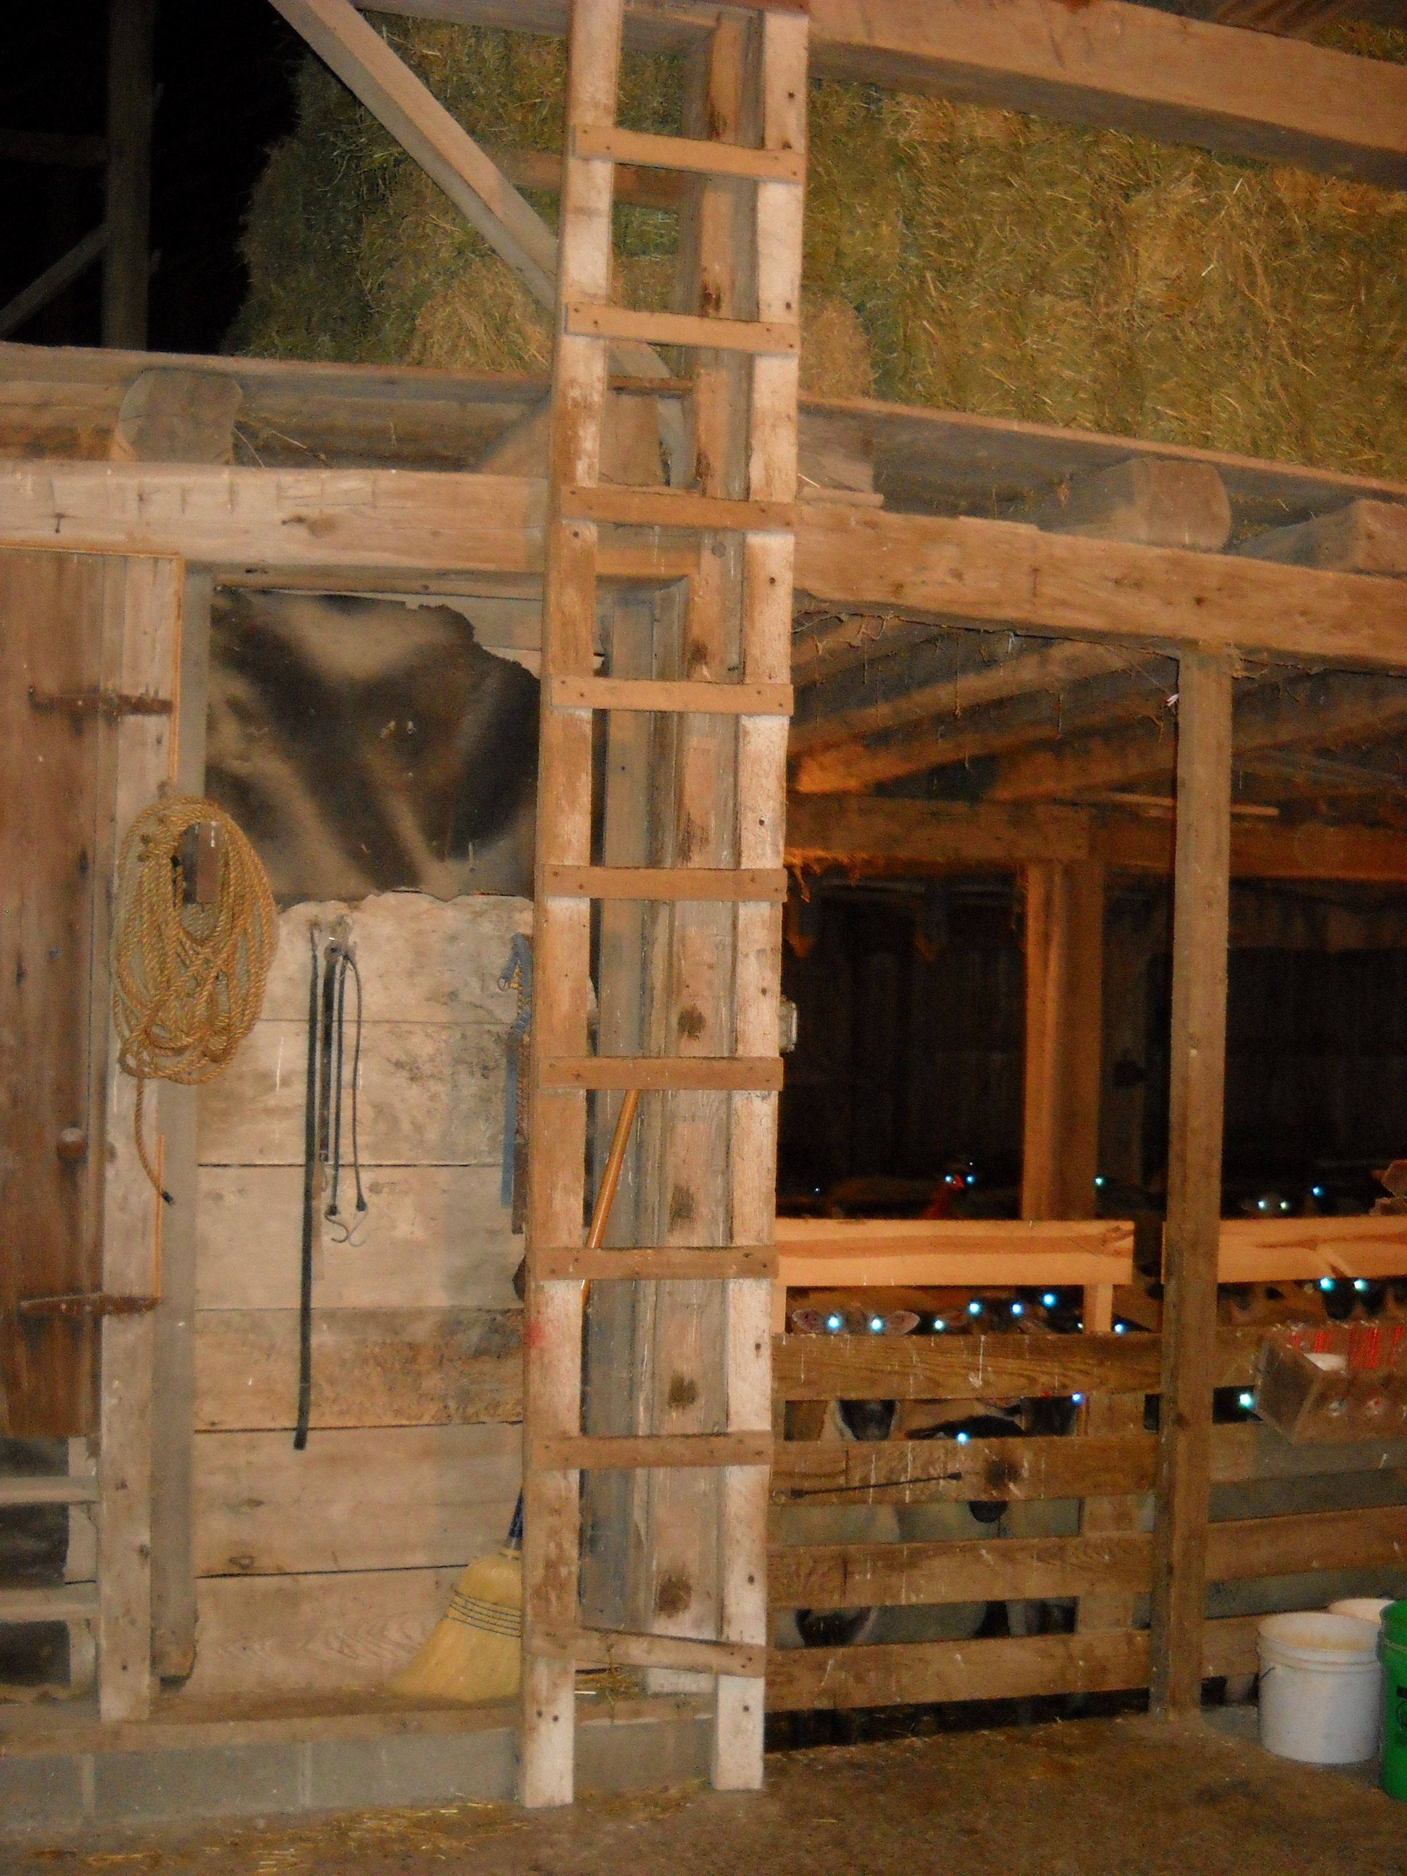
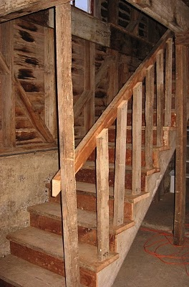
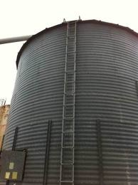
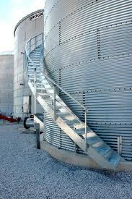
Universal Design for the farmstead.
Elevated areas:
Ladders vs. Steps
  May not accommodate all individuals.
  Need to accommodate majority.
  Safety issues?
  Other mechanical means?
Notes:
Adjustable height shelving and cabinets for storage areas – no overhead storage that takes access from stairs or ladder. At least 36 inches between rows of shelving or storage bins.
Most frequently used items are 18 to 48 inches above floor in storage areas, to least used items on higher shelves, and rolling or mobile items are on the floor.
Mobile tool storage is no less than 6 inches from the ground and no higher than 48inches from ground level.

Slide 18
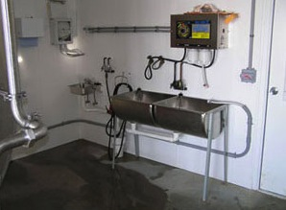
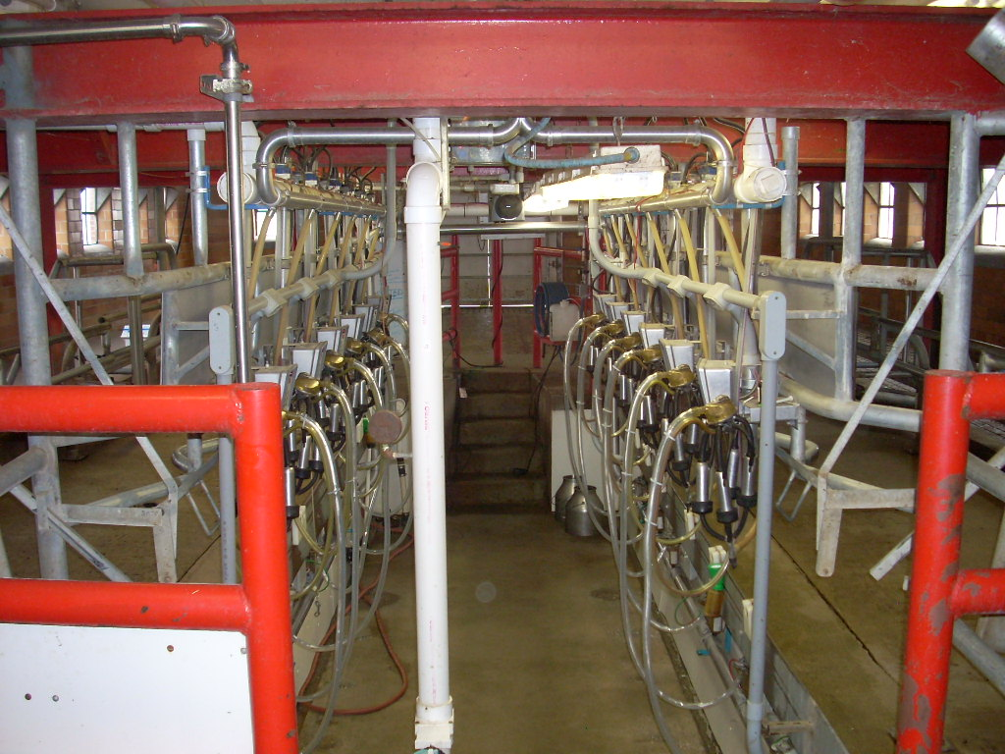
Universal Design for the Farmstead.
Wash / Cleaning areas
accessible sinks
lever handles on fixtures
grab bars / hand rails
smooth transitions
slip resistant floors
additional lighting
Notes:
Wash down areas, milk parlors etc…

Slide 19
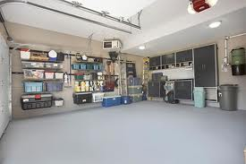
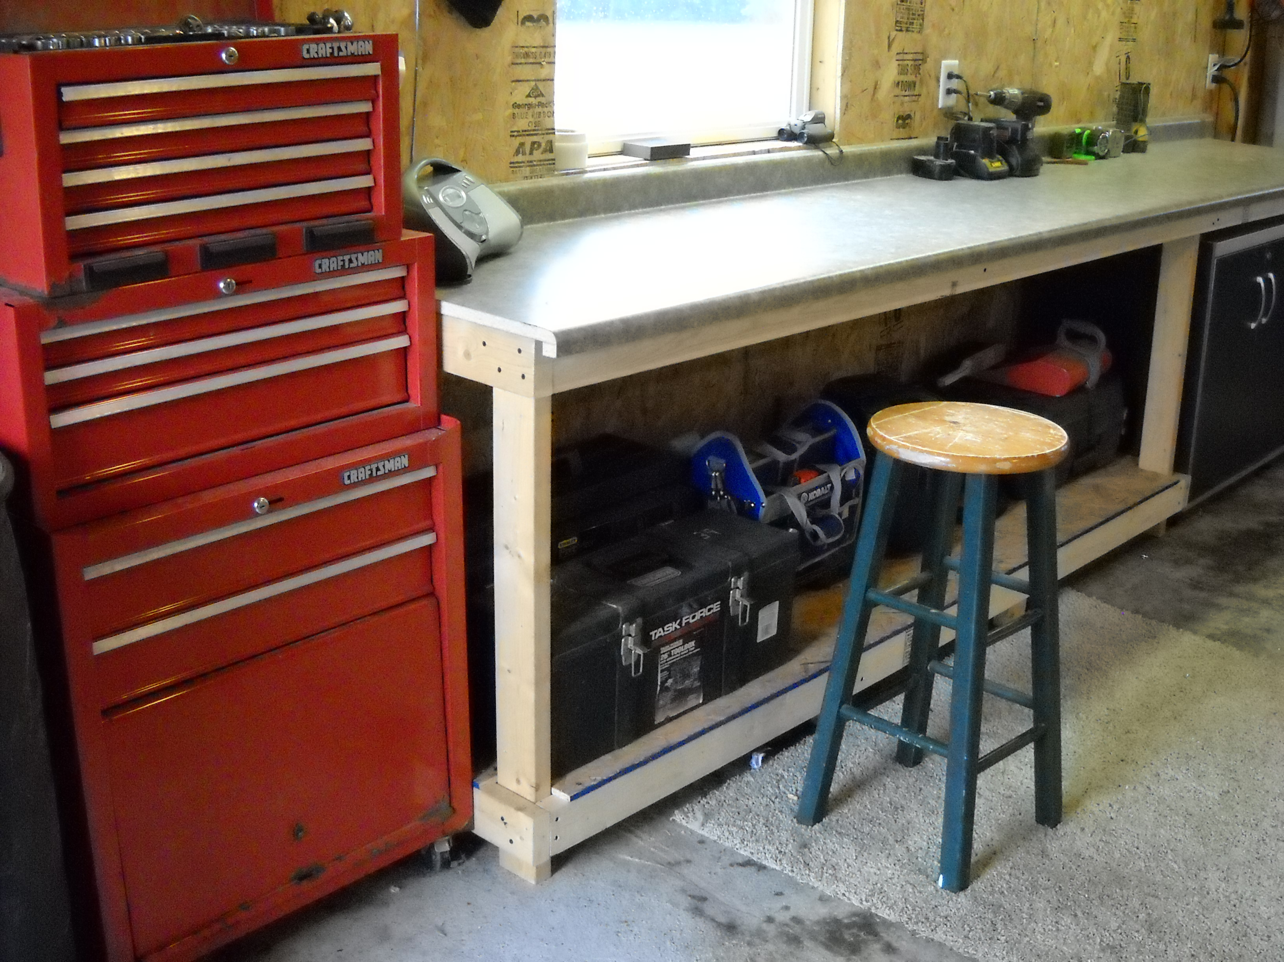
Universal Design in the Garage.
Accessible
Various work heights
Adjustable storage
Task lighting
Lever handles
Accessibility to tools
Universal design tools
Notes:
Notice: 1. Anti- Fatigue matting and stools / higher chairs to accommodate long periods of work in one spot.
2. Open, accessible, and adjustable storage.
3. Wider door, smooth transition into house.

Slide 20
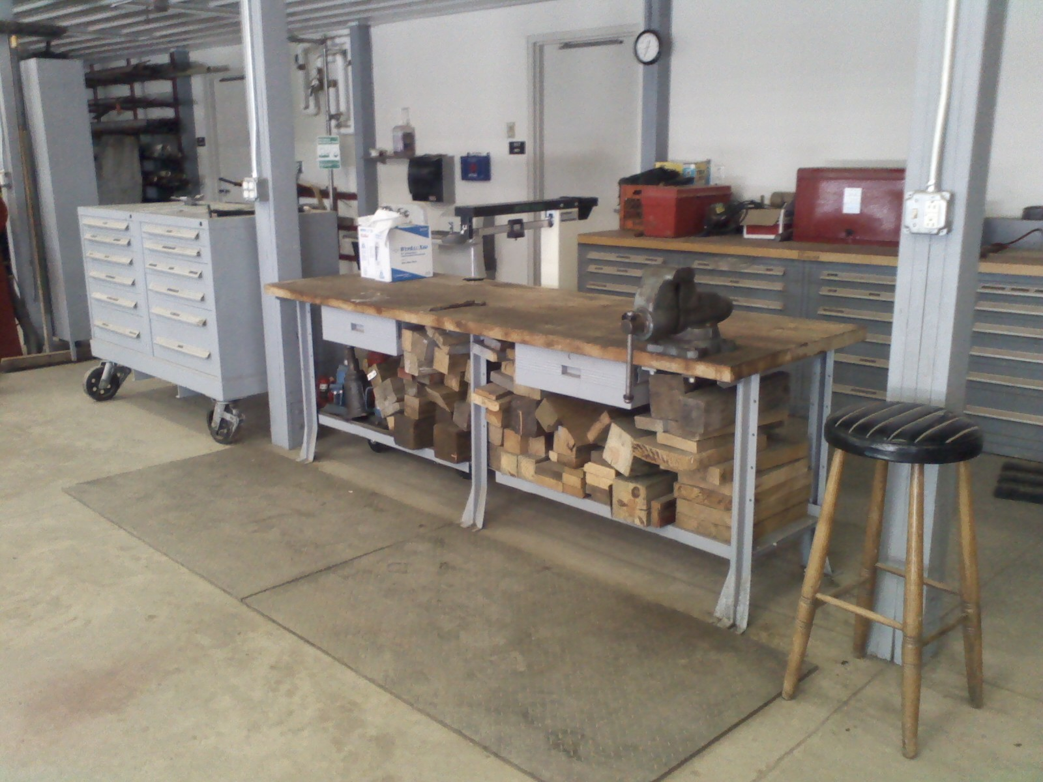
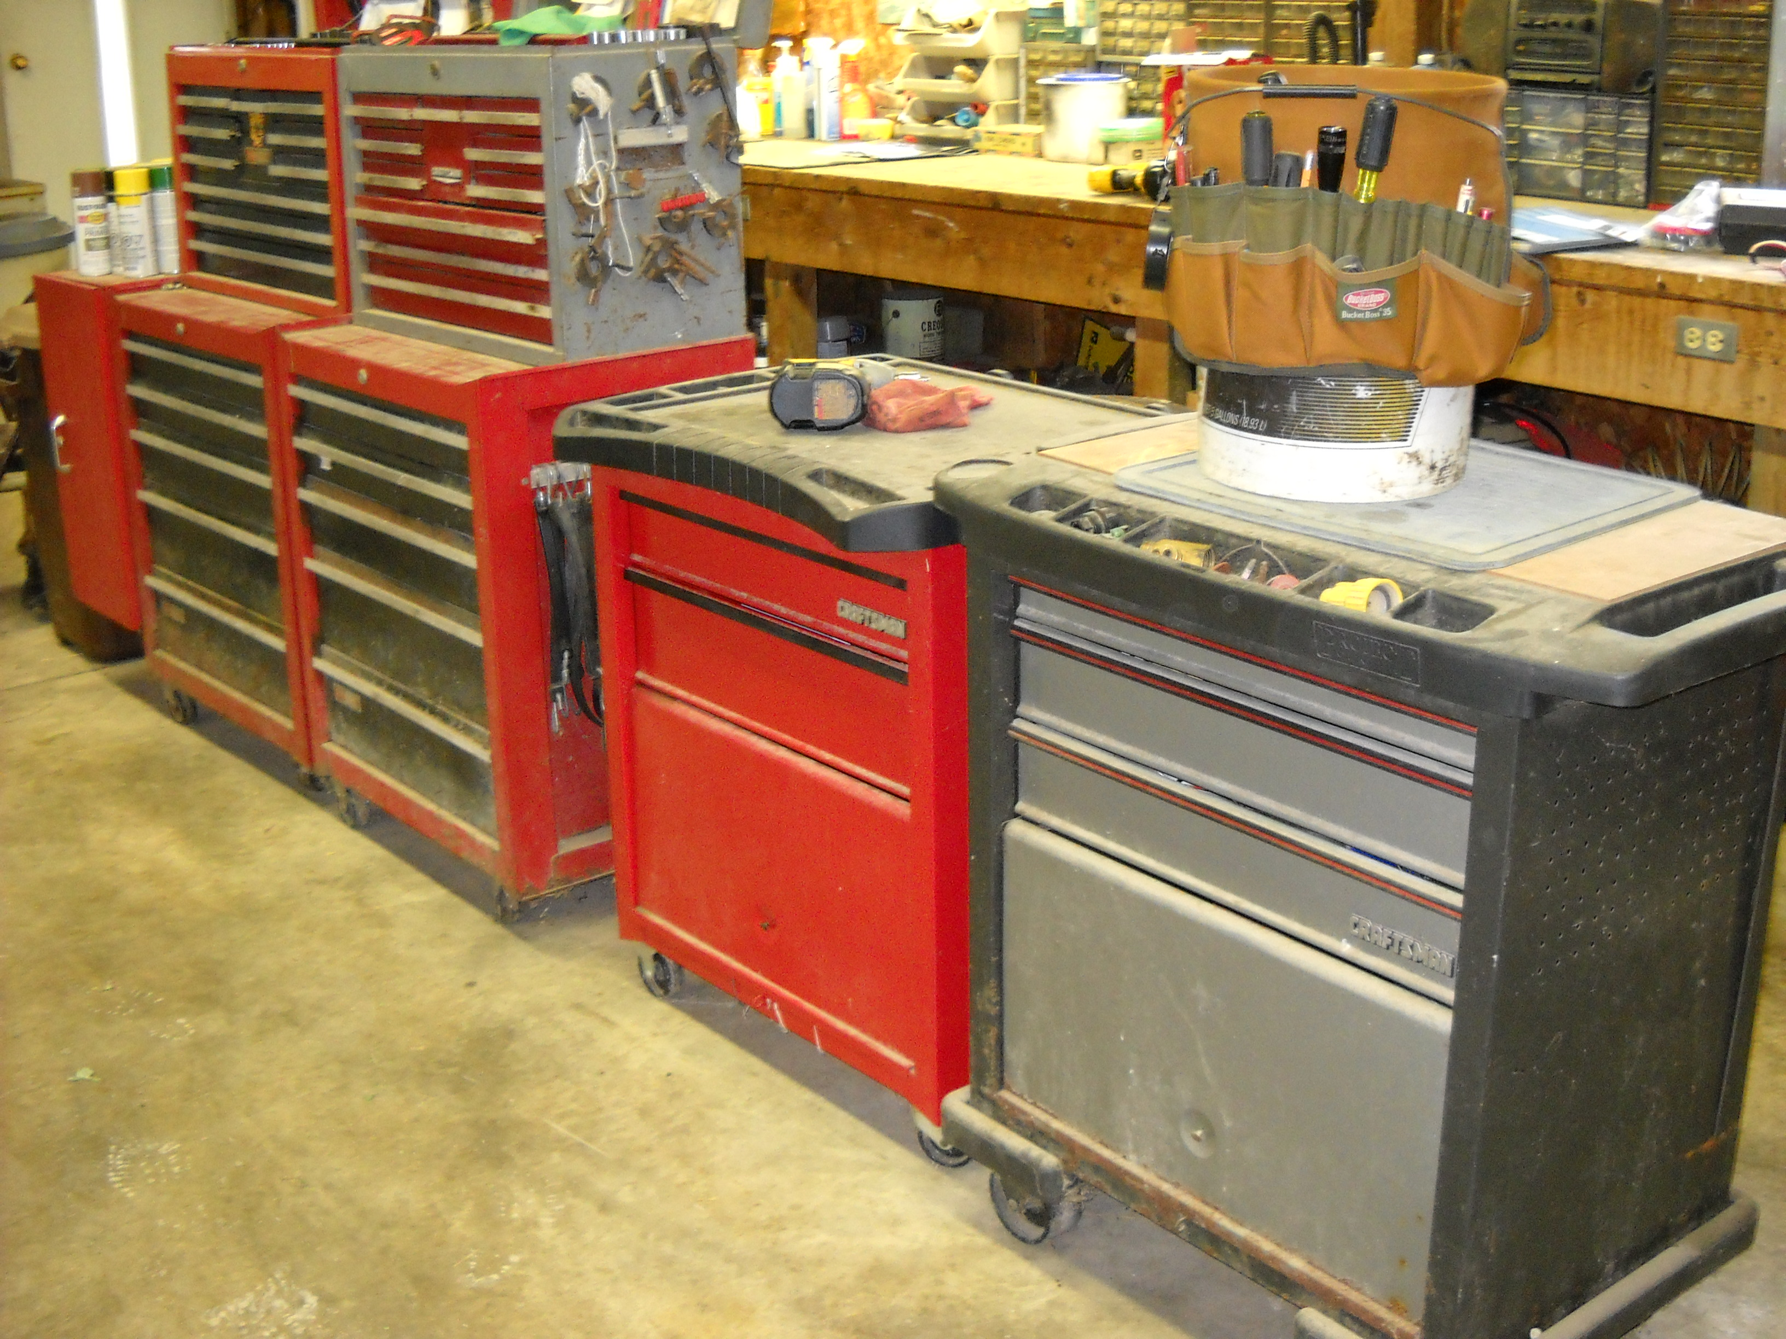
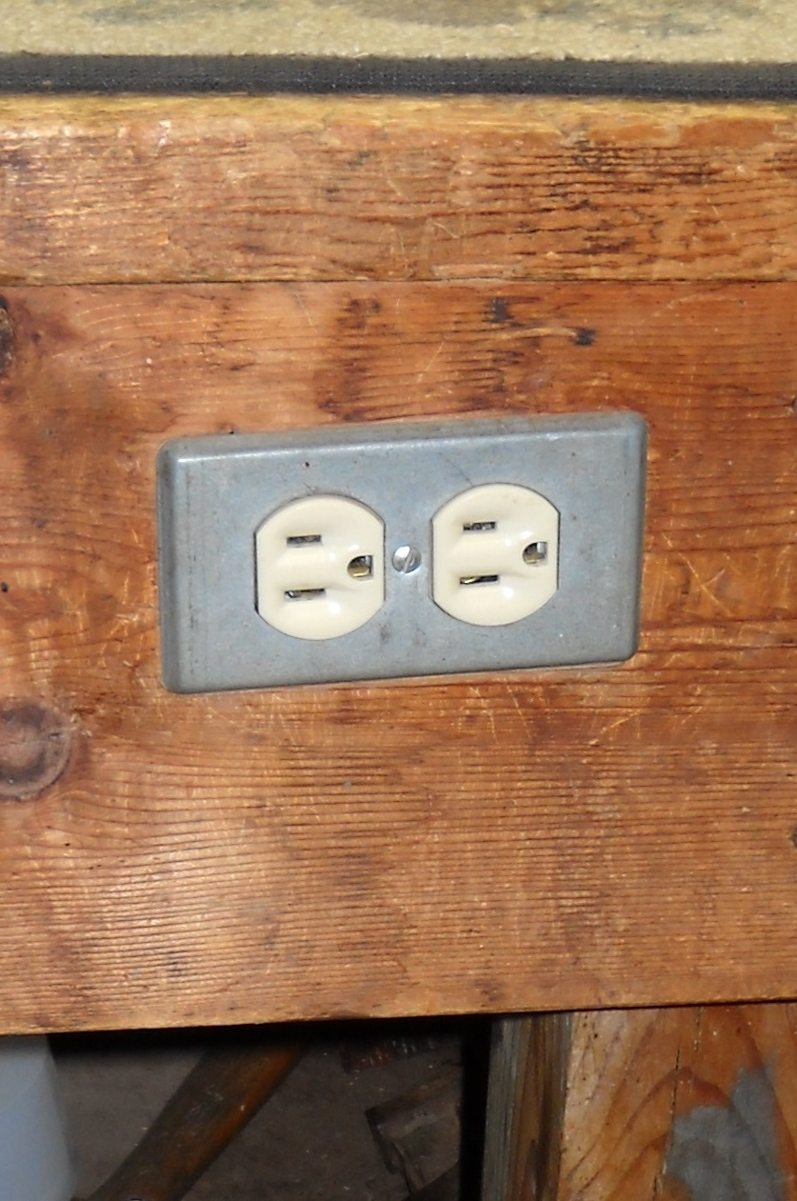
Universal Design in the Farm shop.
Accessible /open space
Various work heights
Slide out equipment storage
Accessible tool storage
Task lighting
Lever handles
Universal design tools
Front controls on shop equipment
⬅
Notes:
Notice: 1. Space to maneuver around storage.
2. Outlets on the front of workbench

Slide 21
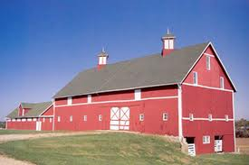
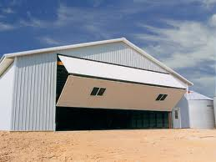
Universal Design in the Barn.
- Accessible /open space
Smooth travel surfaces
Easy to use doors
  Sliding
  Hinged
  Overhead
Easy grip latches
Main and task lighting
Lever handles
Flexible storage
Notes:
Notice: 1. Smooth transition areas from compacted stone base to concrete
2. Feeding can be done from outside the pen / stall

Slide 22
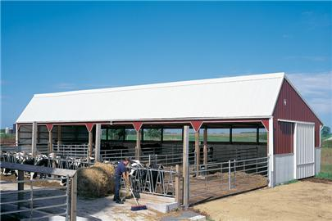
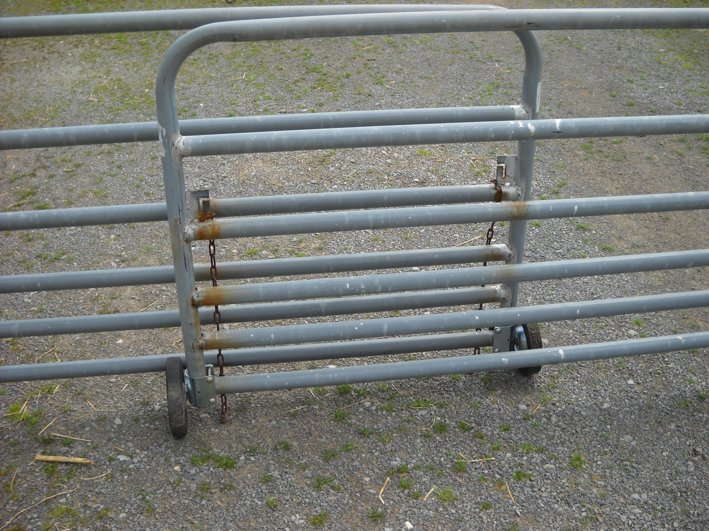
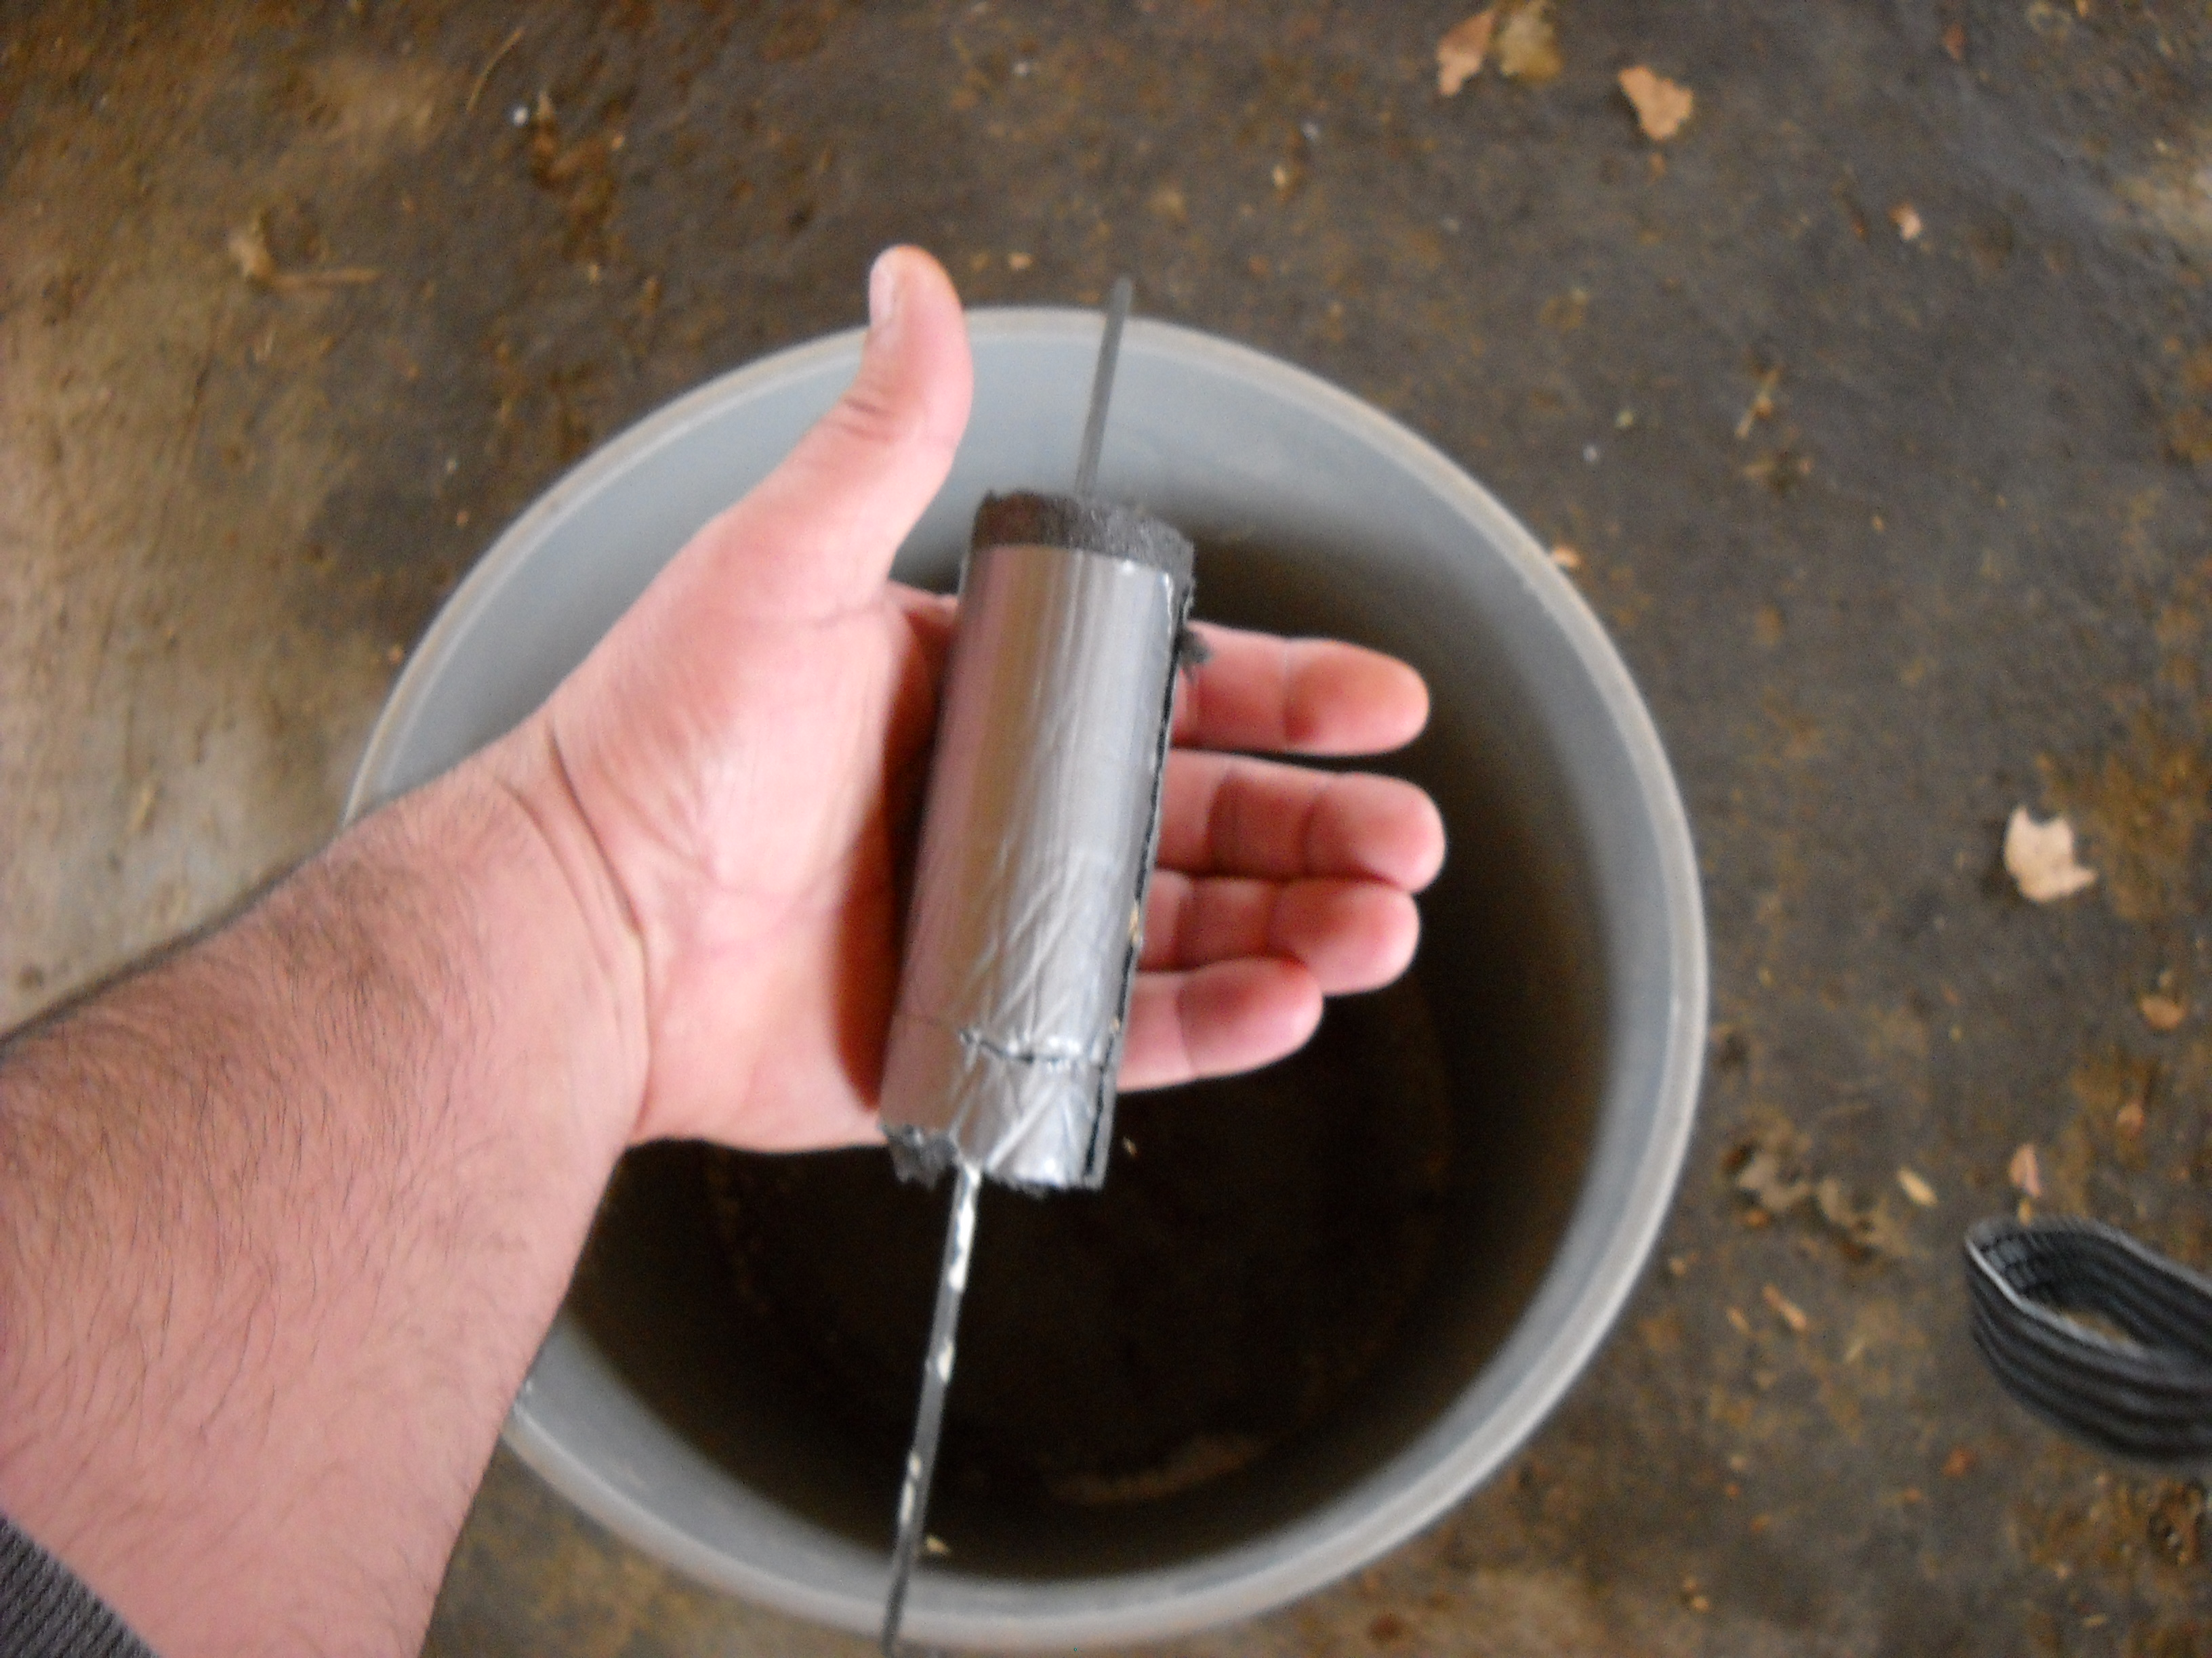
Universal Design in Livestock Handling.
- Accessible
Smooth transitions
Task lighting
Outdoor lighting
Easy to use gates
Larger handles on tools and buckets
Notes:
Notice: 1. Smooth transition areas from compacted stone base to concrete
2. Feeding can be done from outside the pen / stall

Slide 23
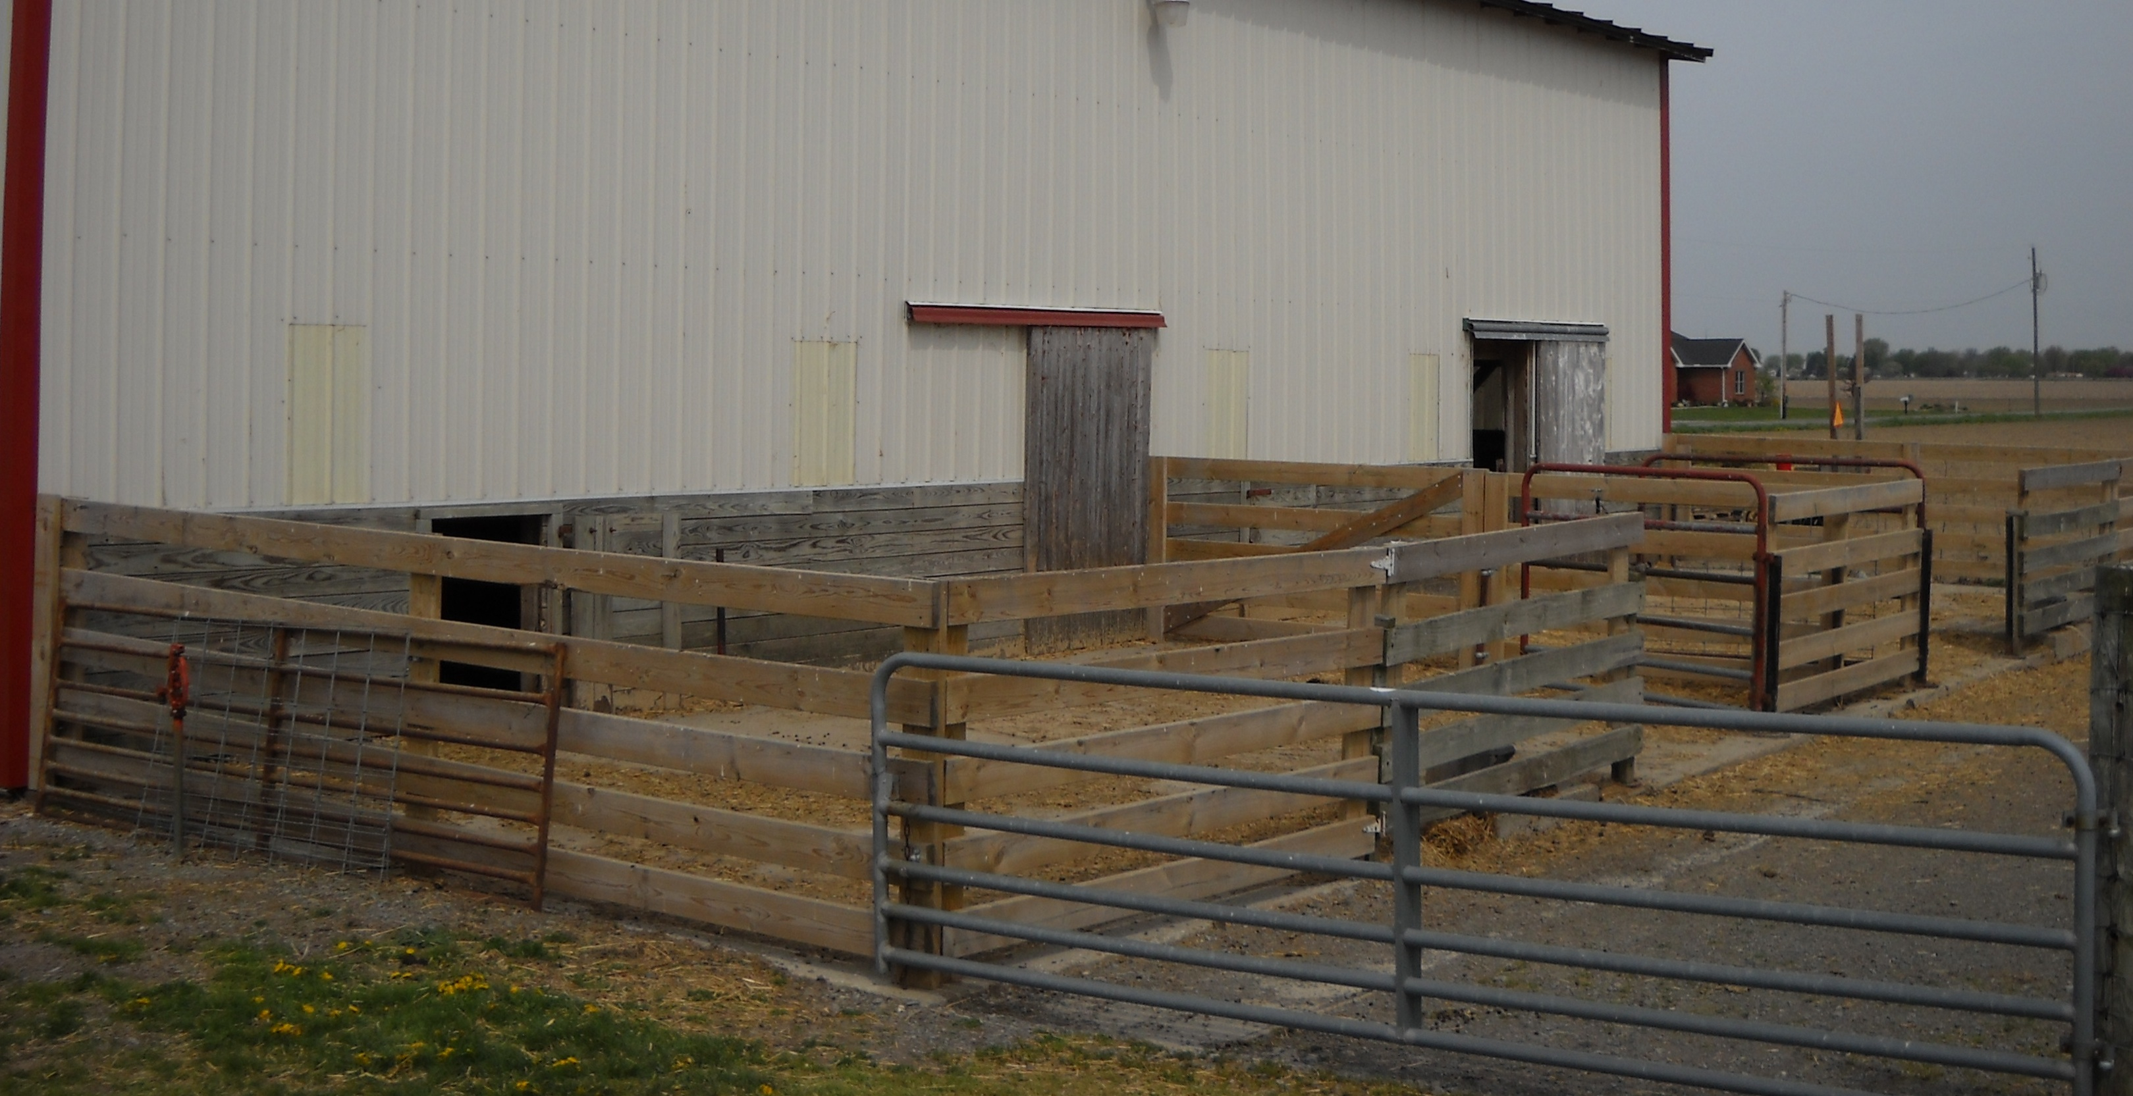
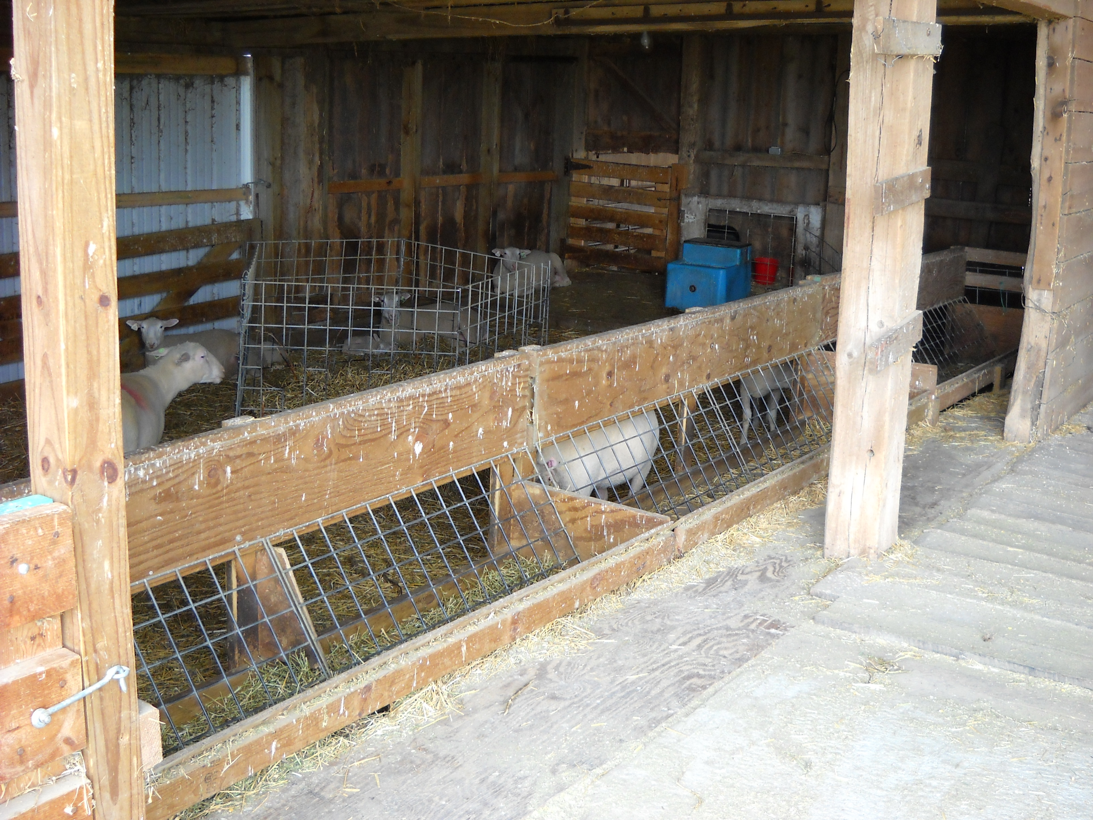
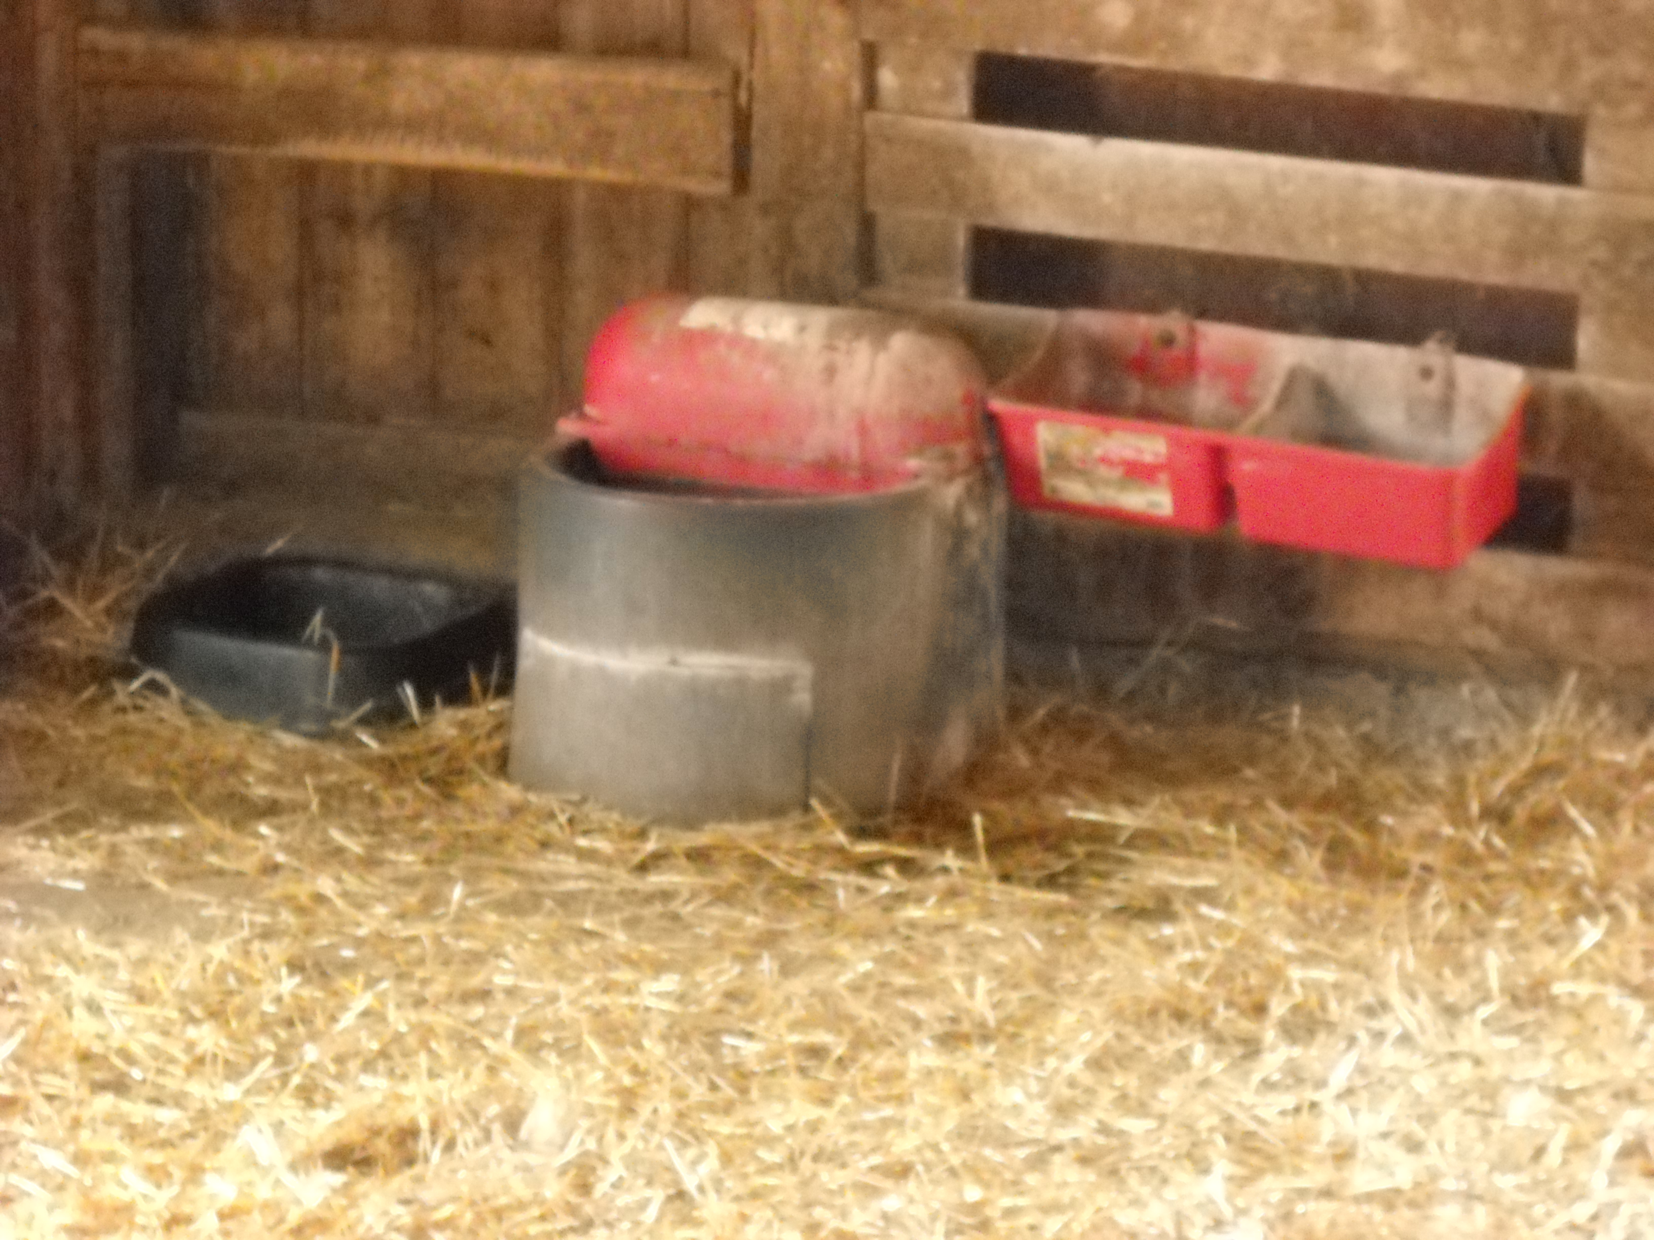
Universal Design in Livestock Handling.
Corral or handling area
  Easy to load / use
  Safe
Accessible feeders
Automated systems
Flexible storage
Ergonomic tools
Hand rails
Notes:
Notice: 1. Smooth transition areas from compacted stone base to concrete
2. Feeding can be done from outside the pen / stall

Slide 24
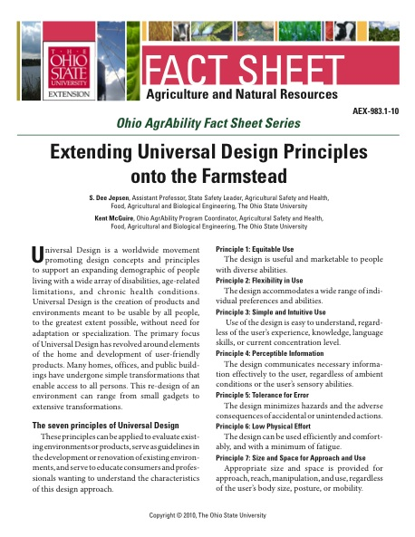
For more information
Ohio AgrAbility Fact Sheet Series is available at:
www.agrability.osu.edu
www.ohioline.osu.edu

Slide 25
For more information
Ohio AgrAbility Program
Kent McGuire - Program Coordinator
The Ohio State University
Dept. of Food, Agriculture & Biological Engineering
590 Woody Hayes Drive
Columbus, Ohio 43210-1057
Email: agrability@osu.edu
Phone: 614-292-0588
Fax: 614-292-9448
www.agsafety.osu.edu

Slide 26
References
Association for the Advancement of Retired Persons. Universal Design Home Modification. www.aarp.org/universalhome. Retrieved Feb 21, 2010.
Adaptive Environments Center, Inc. Universal Design. www.adaptenv.org/universal. Retrieved Feb 21, 2010.
Breaking New Ground Resource Center (2005). Conducting Agricultural Worksite Assessments – A User’s Guide for Professionals Assisting Farmers and Ranchers with Physical Disabilites. (3rd ed.). Purdue University.
Center for Universal Design. North Carolina State University. www.design.ncsu.edu/cud. Retrieved Feb 21, 2010.
Connell, B. R., Jones, M., Mace, R., Mueller, J., Mullick, A., Ostroff, E., & Vanderheiden, G. (1997). The Principles of Universal Design. (Version 2.0). NC State University, The Center for Universal Design.
Price, C. A. (2001). Elements of Universal Design / Home Modification. Ohio State University, Department of Human Development and Family Science.
Universal Design Community Education Project (2002). Universal Design – Implementing Home Modifications. The Ohio State University College of Food, Agricultural, and Environmental Sciences, The Ohio State University College Human Ecology, The OSU School of Allied Medical Professions, and The Ohio Department of Aging.
Yearns, M. H. (2004). Universal Design for Better Living. Iowa State University, Department of Human Development & Family Studies.

