Slide 1
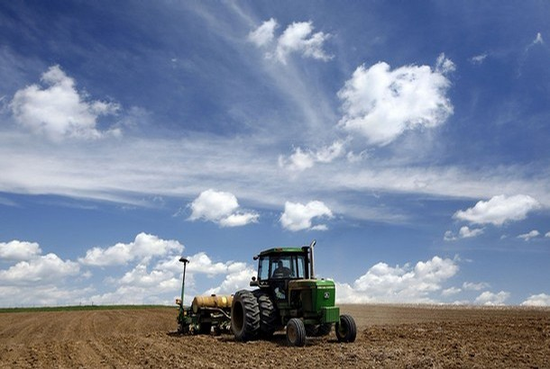
National AgrAbility Project
Amber D. Wolfe AgrAbility Project Coordinator Arthritis Foundation - Indiana Chapter

Slide 2
Arthritis Foundation, IN Chapter Heartland Region 615 N. Alabama Street, Suite 430 Indianapolis, IN 46204 317-879-0321 800-783-2342 info.in@arthritis.org www.arthritis.org
US- 42 Chapters
10 Regions
The mission of the Arthritis Foundation is to improve lives through leadership in the prevention, control, and cure of arthritis and related diseases.
The Indiana Chapter of the Arthritis Foundation:
Trains instructors in “Life Improvement Series” programs
Tai Chi, Aquatics, Exercise, and Self-Help programs
Holds public education forums to increase arthritis awareness
Secures funding for research
Provides information at health fairs
Conducts presentations and community outreach programs
Notes:
Osteoarthritis
Rheumatoid Arthritis
Gout
Fibromyalgia
Lupus
Exercise
Nutrition
Work

Slide 3
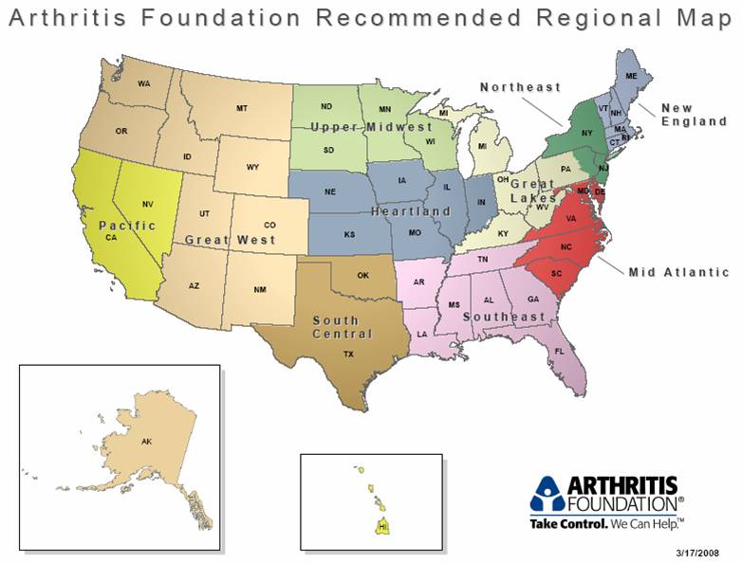

Slide 4
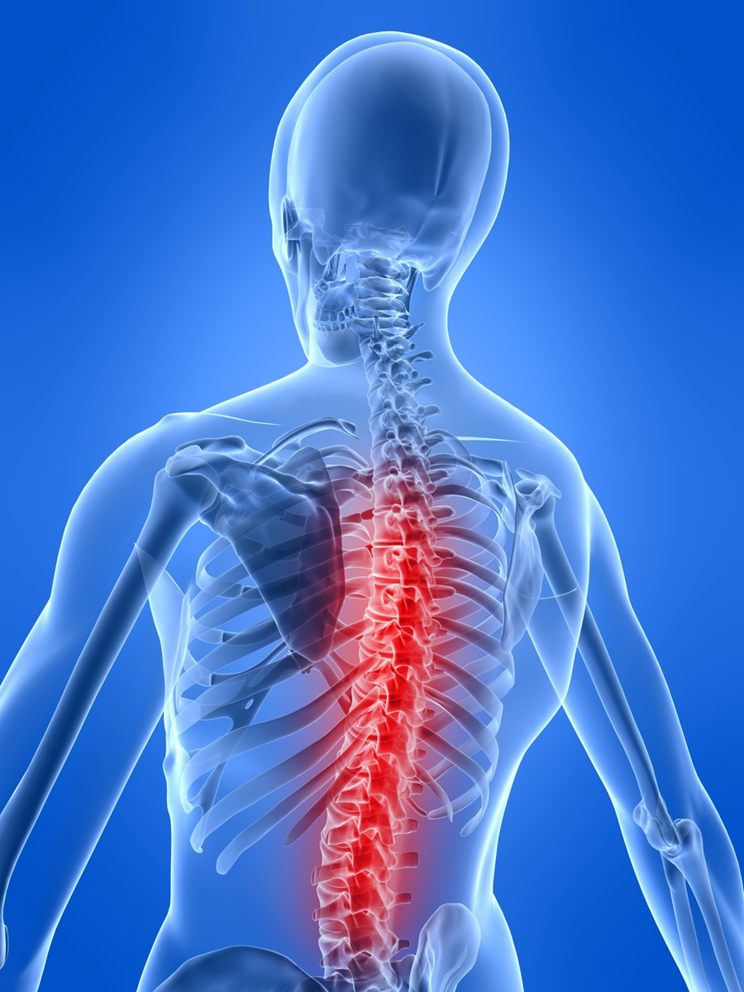
Arthritis Defined…
The term arthritis refers to an “inflammation of a joint”. It is used to refer to over 100 rheumatic diseases that are characterized by problems in and around joints.
The inflammatory types of arthritis cause systemic problems, such as fatigue, that interfere with the physical work that is necessary in the business of farming.
Rheumatic Diseases/ Autoimmune Diseases The body attacks itself (joints) causing inflammation, pain and degeneration of the connective tissue. Most are chronic and have no cure.

Slide 5
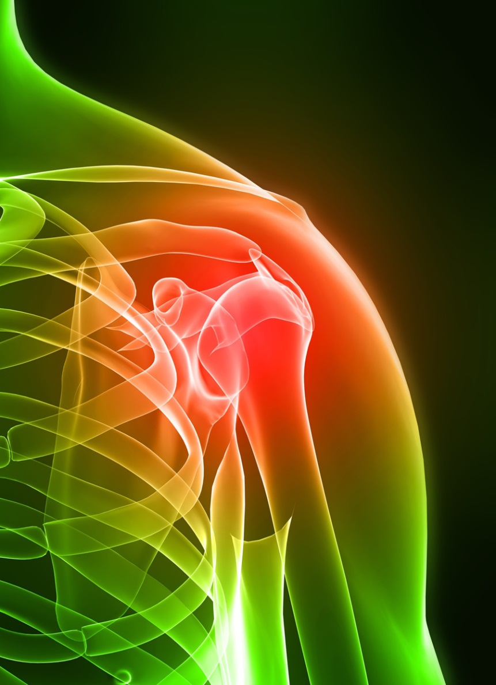
Arthritis: A Nation In Pain
50 Million people in the US have doctor diagnosed Arthritis.
Osteoarthritis- 27 million
Rheumatoid Arthritis- 1.3 million
Gout- 3 million
Fibromyalgia- 5 million
More than half of the individuals who have arthritis are younger than 65 years old.
Affects women twice as often as men.
Nearly 300,000 children are affected by arthritis.
Arthritis is second only to heart disease as a cause of work disability.

Slide 6
Many agricultural workers do not know they may be at risk of developing osteoarthritis.
With the average age of the American farmer climbing above 57, increasingly more farmers will find tasks difficult to complete.
Notes:
The Arthritis Foundation- Indiana Chapter is very happy to be a part of the AgrAbility Program, both on a state and national level!
AgrAbility Partnerships
Arthritis Foundation- Indiana Chapter and the Indiana AgrAbility Project (over 10 years)
Arthritis Foundation- Indiana Chapter and the National AgrAbility Project (since 2008)
The Indiana AgrAbility project is managed by Purdue University’s Breaking New Ground Resource center which has been helping farmers in Indiana with disabilities since 1979. This is the same center that is currently managing the national project.

Slide 7
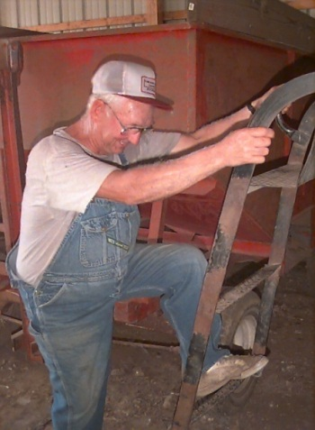
When A Farmer Has Arthritis
Farmers and ranchers with arthritis are faced with many obstacles that limit their ability to continue farming. Like farming, arthritis is often a 24-hour, 7-day a week occupation.
As hard as it is for a farmer to change routine, life-style changes can be beneficial. And not all change has to use technology. Technology is not the cure all!
Pain, fatigue, and stiffness are effects of arthritis that can limit a farmer and rancher in a variety of ways.
Arthritis may prevent farmers and ranchers from completing a specific task, hinder the progress of daily activities, or even leave them feeling completely overwhelmed.
From simple physical tasks – getting on the tractor, loading feed – to social activities, arthritis can interfere with one’s life.
Notes:
7

Slide 8
Agricultural Awareness
Common Occupational Risk Factors
and Sources of Joint Stress in Farming Situations
Being over weight
Kneeling/Squatting/Climbing/Jumping (grain bins, ladders, milking, etc.)
Heavy Lifting (feed bags, water buckets, etc.)
Frequent Bending/Twisting/Turning (heights of weight benches, storage, tool locations, etc.)
Persistent awkward postures
Compression of weight bearing joints by lifting in awkward positions
Walking long distances over uneven ground
Driving for long periods of time (particularly with exposure to whole-body vibration) in tractors and utility vehicles
Weather exposure – cold and hot
Vibrations from lawn care machinery, stress on joints from weed eaters, trimmers, etc.
Ranch work- horseback riding, roping, farrier work
Livestock care- chutes, medical attention, breeding
Repetitive forceful work is considered to both aggravate and accelerate development of osteoarthritis and aggravate other forms of arthritis.
Notes:
8

Slide 9
Arthritis Foundation AgrAbility Projects
Print Materials and Multimedia Materials (DVD, CD)
Arthritis and Agriculture Website- www.arthritis-ag.org
Arthritis Community of Interest
Community Health Fairs, Auctions, County and State Fairs, Rural Health Conferences
Farmer Scholarship- AgrAbility National Training Workshop
Public Service Announcements
Arthritis and Ag Workshops
“Growing Pains” Newsletter
AARL Conference- May 2011

Slide 10
Amber Wolfe
AgrAbility Project Coordinator, Arthritis Foundation-Indiana Chapter
615 N. Alabama Street, Suite 430 Indianapolis, IN 46204
317-879-0321, extension 212, 1-800-783-2342
awolfe@arthritis.org
www.arthritis-ag.org
Facebook and Twitter

