Slide 1
How Accessible Gardening Can Increase Gardener’s Capacity
Inetta Fluharty, ATP
Mary Slabinski, MSW, LGSW
West Virginia AgrAbility
2011 National AgrAbility Training Workshop
Indianapolis, Indiana
November 9, 2011

Slide 2
What is accessible gardening?
Accessible- overall aim is to be inclusive; designed with the intention that as many people as possible (regardless of ability) are comfortable using designed item
Accessible gardening- garden design, tools & techniques match what gardener is capable of & how a gardener gardens

Slide 3
Why accessible gardening?
Alternative to traditional gardening
Techniques being implemented in ag production (on large scale)
More user-friendly for more people (universal design)
Prevent secondary injuries
Increase safety/ergonomics

Slide 4
So how can I make accessible gardening work?
Access-orize!
Reshape traditional gardening to fit:
What clients can do
How they can do it
In the most comfortable way
Notes:
Accessible gardening is just matching how you garden with what you can do and how you can do it. It takes physical barriers out of gardening and reshapes traditional gardening to fit how a person can garden and in the ways that are most comfortable for the gardener. It creates gardens that people of all ages and abilities can enjoy.

Slide 5
Design Basics
Who will use it?
What is garden being used for?
Why is gardening being used?
Notes:
Accessible gardening aims to be inclusive, meaning that designs try to make gardening as comfortable as possible for as many people as possible.
Accessible gardening aims to appeal to the masses but is also applicable to individuals. In regards to clients your organization serves, the first step in designing an accessible garden is to look at and ask your clients what about gardening interests them, what are their capabilities in terms of gardening, what activities do they struggle with, etc.

Slide 6
Design Basics
Some more questions to ask:
What can clients do (in terms of gardening)?
What is challenging for them to do?
What assistive devices do they use, e.g. wheelchairs, eyeglasses, hearing aids, etc.
How will gardening be adapted to fit what clients can and cannot do?
What techniques/adaptations will be most comfortable?
Notes:
In general, what is the goal of having the garden? In some cases, it is as simple as a person no longer being able to garden as he/she always did. In other cases, it may be to add a new activity, to use gardening as a way to teach life skills (caring for something, starting a business), or as a rehabilitation opportunity.

Slide 7
Case Example
Your client is experiencing general effects of aging, e.g. unsteady walking, tires quickly, and uncomfortable doing a lot of bending and stooping. Your client has a traditional garden. The client wants to garden and would garden more if it were easier.
Notes:
I find it easier establishing a context in order to explain specific components of designing an accessible garden. This case example establishes who is using the garden, what the garden is being used for (recreation), and its purpose (enjoyment). Client can still garden (capability) but mobility and movement is challenging. This answers a lot of the questions from the previous slides.

Slide 8
Case Example (Cont’d)
How will gardening be adapted to fit what clients can and cannot do?
What techniques/adaptations will be most comfortable?
Notes:
These questions still need to be answered in order for the garden to continue to meet the clients’ needs.

Slide 9
Case Example (Cont’d)
Some suggestions on issues to address…
Walkways: balance and general getting around is difficult
Elevating garden beds/plants: minimize stooping and bending
Smaller dimensions for growing areas: tiring easily
Notes:
Walkways that are hard, smooth and wide make walking easier for everyone. Concrete and brick are good materials for this purpose. Walkways should be three feet wide to accommodate wheelchairs. Watch out for slope of walkway- 5and 8%
Elevate- this brings the garden to the gardener. It not only cuts down on bending and stooping, but prevents injury. It is easiest on your body to do work that is placed between your waist and shoulders.
By narrowing growing areas, like garden beds, it is easier to reach all spots of the area. Narrower areas also cut down on garden maintenance because you are not weeding open areas, and plants have a chance to completely fill the whole area with its canopy- cutting out weeding and keeping the soil moist for longer. A general measurement is to make the growing area the width of two of the gardener’s arm lengths. This allows the gardener to reach the center comfortably and from each side.
Container gardening is also an alternative.

Slide 10
General Accessible Gardening Techniques
Raised Beds
Vertical Gardening
Sensory Gardening
Bale Gardening
Container Gardening
Notes:
The previous case example should help get you in the mindset of thinking how to accommodate gardening to meet your clients’ needs. The components of the previous case were used because they not only show common adaptations but also make gardening more comfortable for everyone, no matter a person’s capabilities. There are several accessible gardening techniques and designs. Those listed are not specialized to any specific individual but are quick ways to meet the masses.

Slide 11
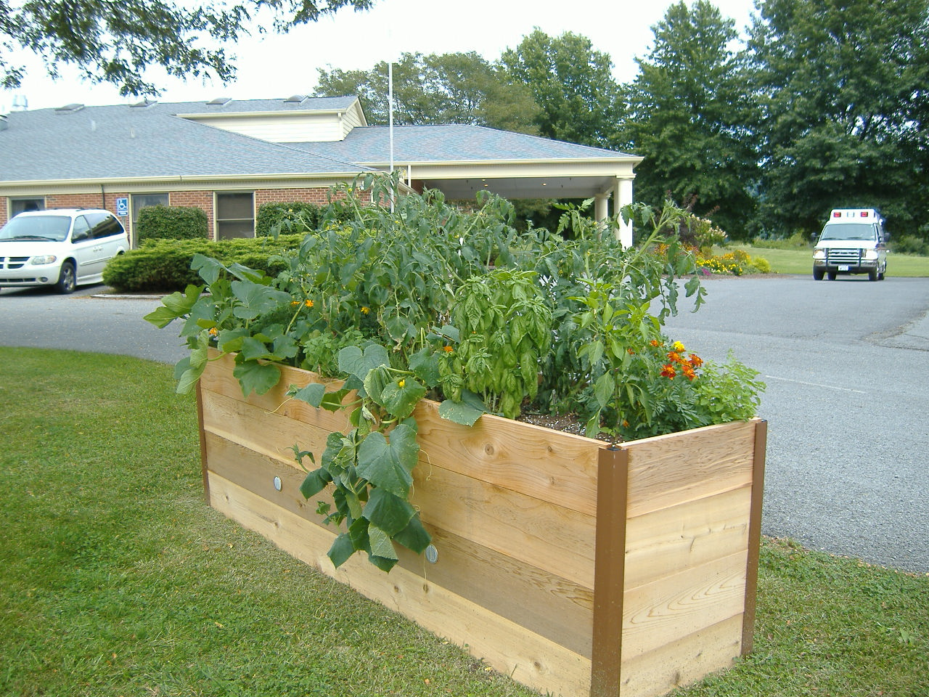
Raised Beds
Brings the garden up to a comfortable height for the user
Built to any dimension that is comfortable for the user
Can be anywhere from six inches to waist height
Notes:
Raised beds are one way to minimize bending, reaching and stooping. A raised bed is usually a rectangular box that sits on the ground and holds soil. Dimensions can be short, long, low, high- whatever fits you. General measurements:
4-5 feet wide so gardener can reach any spot in the bed comfortably and without having to step into it
Height of the bed should not be so high that your arms are working at an uncomfortable height. Keep arms between your waist and shoulder to keep from tiring easily and prevent injury.
Elevated raised beds are useful for people who want to sit while gardening.
Remember to consider water source and walkways when determining the bed’s location.

Slide 12
Vertical Gardening
Puts plants and most garden chores at eye-level
Takes most bending and stooping out of gardening but not all
Structure on which plants grow on is extremely important:
Strong enough materials & anchored in the ground securely so as to be able to support plant
Match the structure to plants’ characteristics
Notes:
This may be an option when you have limited space. This technique does not take all the stooping and bending out of traditional gardening especially if you are planting directly in the ground. Where this technique does take out the bending is when plants are mature. This may be an option for perennials- where you are planting only once.
However, this method may be a good option if you have limited space and increases plant health and pest tolerance by keeping plants off the ground.
In the best interest of the plant, make sure structures on which plants are to grow are solid, can support the plant’s weight, and matches what the plant wants to grow on.
Arches are great for heavier plants, like vines, and any plant that climbs
Plants with tendrils do well on trellises and tripods, like pole beans
Plants that twine, like peas, need wire or string to twist around
Make sure plants are growing where you want them to. Some plants like ivy are known to cause damage to walls and gutters because of their weight and roots.

Slide 13
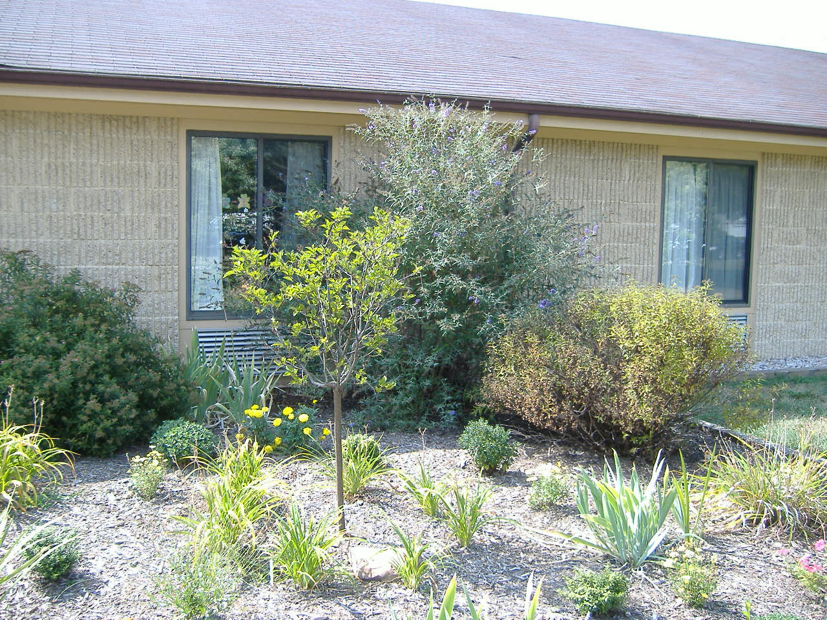
Sensory Gardening
Goal of sensory designed gardens is to bring out the parts of a garden that people can experience through their senses.
Use different parts of the garden to focus on different senses
Not limited to plants. Include using different walkway materials, fountains, chimes, etc.
Notes:
Sensory design is a way for people to enjoy and experience a garden through their senses. Everyone can enjoy your garden because it can bring out sensory experiences and people can relate to at least some of the five senses. This technique is also used for educational purposes because it encourages people to explore, touch, smell, taste plants.
Different parts of the garden may highlight different senses.
taste- fruit, vegetables, herbs but also…sweet-honeysuckle and carnations; sour- clover; bitter- marigolds and acorns; tangy- mums and dill.
Sight- contrast of colors through plants and insects; movement, shapes
Smell- lilac, herbs and spices are strong smells; lavender is refreshing; honeysuckle is calming
Touch- lambs ear is soft and fuzzy; oat grass and fennel are tickly; cactus are prickly; add walls or status for smooth, ridged, etc.
Some plants make sounds when wind blows, use vibrations, add fountains

Slide 14
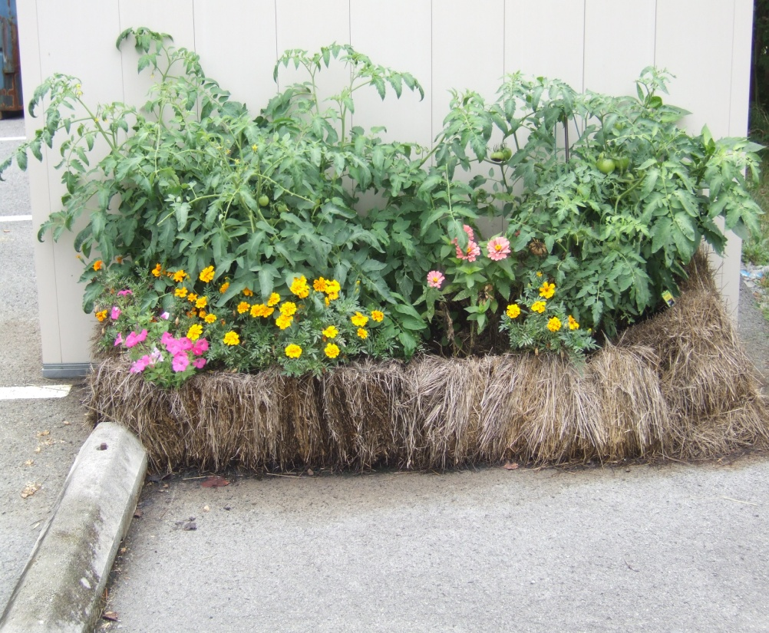
Bale Gardening
Eliminates digging, tilling and working with soil in general
Bale gardening is easier on your hands and wrists
Does take some prep
Notes:
Most plants can grow in bales. Tomatoes, peppers, herbs, squashes, cucumbers, and flowers all do well. One characteristic to consider is height. Bales cannot give tall plants the support they need to stay upright. You can still grow plants like corn and sunflowers if you use a very strong staking system.
Bales that provide the best support for any garden are tightly bound with synthetic twine because they will not fall apart as quickly as those that are loosely bound.

Slide 15
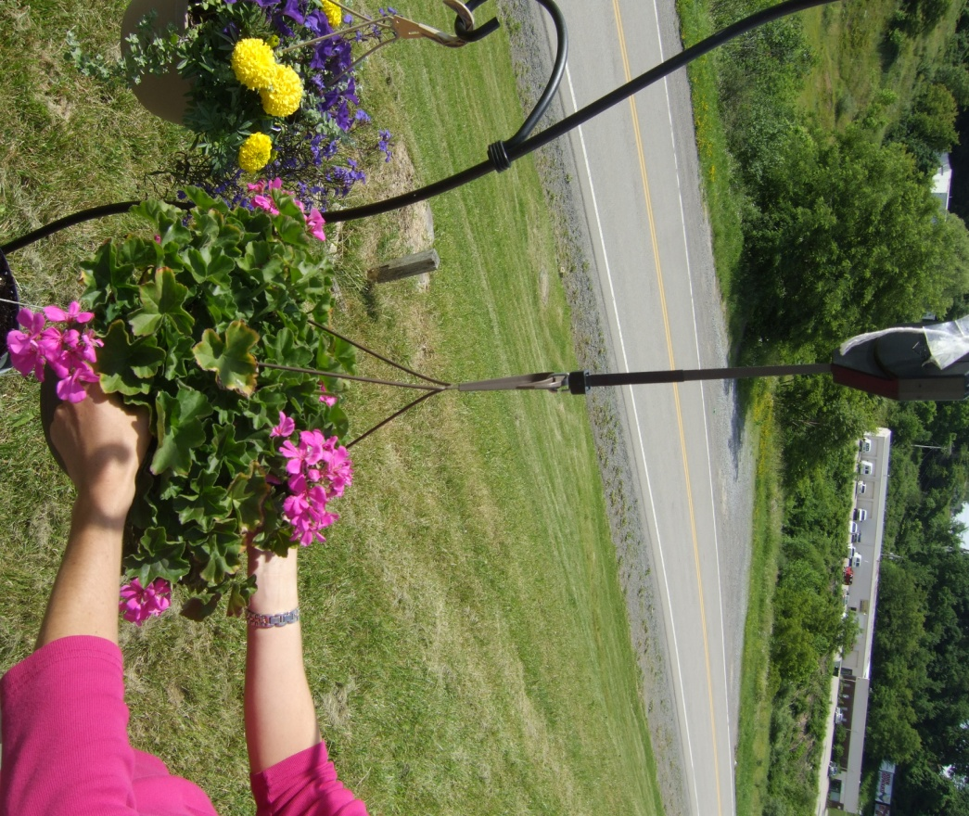
Container Gardening
Takes away digging, bending and kneeling
Brings the garden to you
Selecting containers:
One third as tall as the plant you want to grow
One ‘good-sized’ hole for every gallon of soil
Compact vegetables, like lettuce, do well on hanging baskets or pot
Bush varieties do best in container with 18” diameter
Short-rooted vegetables do well in containers 1x4feet and 8” deep
Deep-rooted vegetables do well in containers 2”x3” and 8” deep
Notes:
Container gardening lets you put the garden where you want it. You still have to consider the plants’ needs in this technique. For instance, sunny loving plants may not grow as well in rooms or on porches that face north as shade-loving plants may grow.
Most plants will grow in containers. Most any container can be used. What you choose depends on how you want your containers and garden to look.

Slide 16
A little on ergonomics…
Looks at how to do a task in the safest and most efficient way
Design tools and machinery to fit how a person naturally moves their body
Notes:
Ergonomics looks matching the physical demands of a task with the capabilities of the person doing the task. The goal is to find the most efficient way of doing a task that also has the least amount of impact on a person’s body. This match is important because it can lower the risk of injury; improves work efficiency; and increases job satisfaction.

Slide 17
Ergonomics & Gardening
Focuses on choosing the right tool for the gardening chore
Focuses on choosing the tool that best fits the gardener
Notes:
You know you have the right tool for the job when you do not have to adapt the tool. The tool fits you well, matches your height and fits your grip, when it feels comfortable and natural when using.

Slide 18
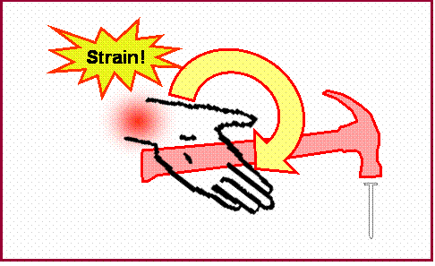
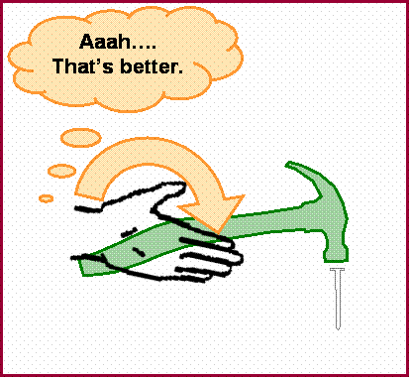
Matching Tools to You
Curved handle allows better wrist position and decreases stress on the tendons and joints

Slide 19
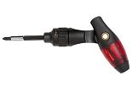
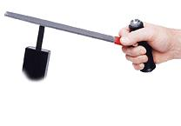
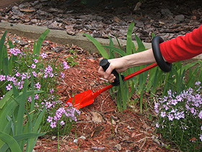
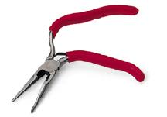
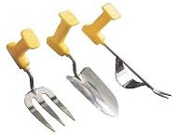
Matching Tools to You to You
“Pistol-grip” tools allow for better grip and neutral wrist position
ratcheting
screwdriver
file handle
pliers

Slide 20
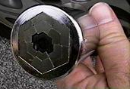
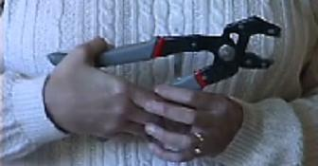
Matching Tools to You
Avoid excessive repetitions and force by:
Getting ratcheting tools
Switch hands routinely while working

Slide 21
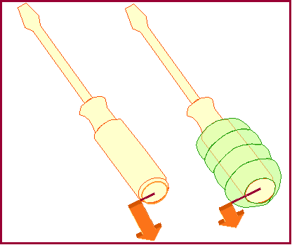
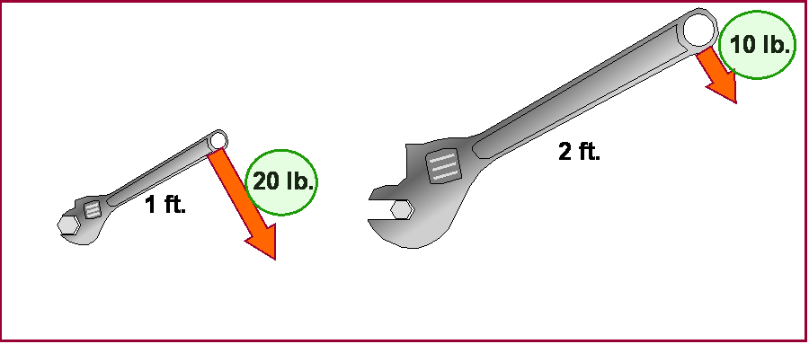
Matching Tools to You
Use tools with larger and longer handles
Use jar grippers/openers
Avoid excessive thumb movements
Vice-grips
Avoid using the strong arm all the time
Use non-slip cushioning
Notes:
Occupations requiring extensive hand use should be modified to decrease the risk of overuse injuries such arthritis. People with arthritis experience decreased grip strength, decreased ROM of the hand, and often rely on the strong arm to complete tasks. Using the strong arm for all activities increases the risk for an injury occurring to that extremity. Modifications must be made to reduce the strength needed to perform tasks such as opening jars, increasing the handle size, and even increasing the length of the handle. Vice-grips are good to use when a firm grip is needed on small objects. As shown in the picture, a wrench with a longer handle requires less force to perform the same task.

Slide 22
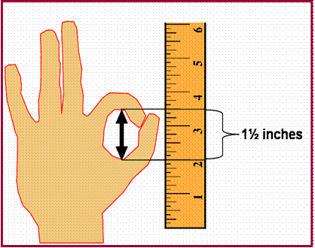
Matching Tools to You
Determine the ideal gripping diameter
Use the “OK” method.
Ask the person to make the “OK” sign
using the thumb and index finger.
Measure the inside diameter of the “O”
formed by the thumb and index finger.
Notes:
Determine your ideal gripping diameter to reduce the forces generated by the hand and decrease the risk of overuse injuries.

Slide 23
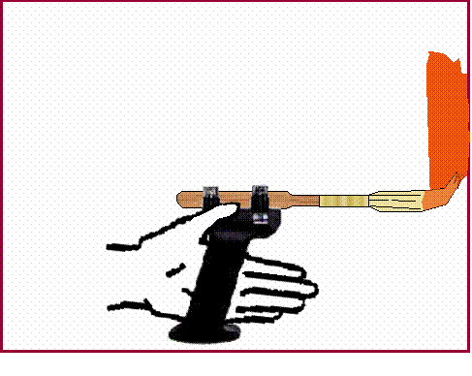
Matching Tools to You
Maintain neutral positioning
Reduce vibration
Frequent rest break
Modification of tools
Notes:
It is important to maintain neutral wrist positioning during activities to decrease the forces placed on the tendons and nerve in the carpal tunnel. Vibrating tools should be modified because the vibration of the tools may cause an inflammation of the tendons and nerve. Frequent rest breaks will help prevent the occurrence of irritation and inflammation. Modification of tools to reduce vibration and encourage neutral wrist positioning.

Slide 24
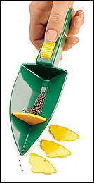
Assistive Technology in the Garden
Hand held ‘click-seeders’ use vibrations to plant seeds
Foam tubing around tool handles give a wider & easier grip
Notes:
When matching tools to gardeners, we often turn to assistive technology to ensure that we are following ergonomic principles. Assistive technology is any device that helps you do things that would be difficult to do without the device. Many ergonomically designed tools are considered assistive technology. Accessible gardening oftentimes incorporates AT into gardening and considerations.

Slide 25
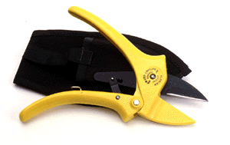
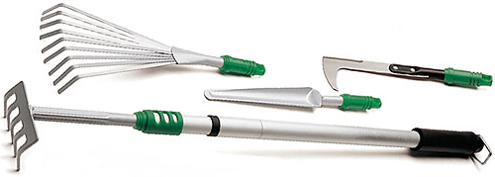
Assistive Technology in the Garden
Ratchet-cutting pruner works like an auto jack, multiplying strength
Telescoping tools are small sized tools on long handles so work can be done in small spaces without stooping

Slide 26
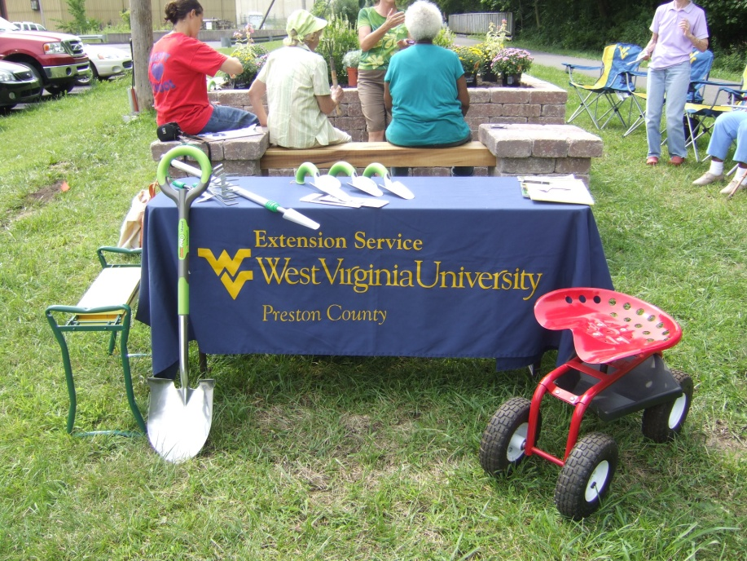
What is Green Thumbs/Healthy Joints?
A community service opportunity to promote accessible gardening, health, and arthritis awareness in community spaces
Notes:
Bureau for Public Health provides money for community gardening projects through mini grants. WV AgrAbility administers program. Provides assistance in grant writing, project ideas, support during projects and reporting. Originally, money was only awarded to Master Gardener groups to promote joint health through accessible gardens to older adults. The program has now expanded to any community group, nonprofit etc. that is interested in using accessible gardening to promote health and joint health in their communities.

Slide 27
Contact Information
Inetta Fluharty, ATP
Northern West Virginia Center for Independent Living
304-771-8747
Ifluharty@wvagrability.org
Mary Slabinski-Schmidt, MSW, LGSW
Center for Excellence in Disabilities at WVU
304-293-4692 x 1125
mslabinski@hsc.wvu.edu

