Slide 1
LaVona S. Traywick, PhD, MA, CFLE Assistant Professor—Gerontology Jessica Vincent, BS, CHES Arkansas AgrAbility Coordinator

Slide 2
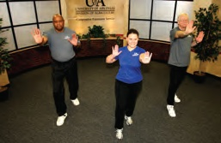
New Exercise Recommendations
Adults/Senior Adults minimum 150 minutes per week
10 minute increments
4 Types of exercise
Balance Exercises
Endurance or Aerobics
Strength Training or Weight Lifting
Stretching or Flexibility Exercises

Slide 3
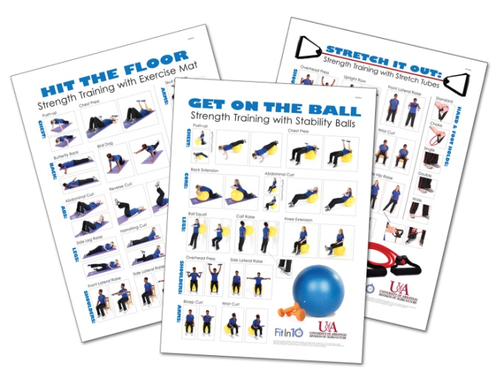
Resources Available through Arkansas Extension
Fact Sheets
Exercise Recommendations
Balance
Endurance
Strength Training
Stretching
Eating Healthy
Fit in 10 DVD
Exercise Posters
Stretch It Out
Hit the Floor
Get on the Ball

Slide 4
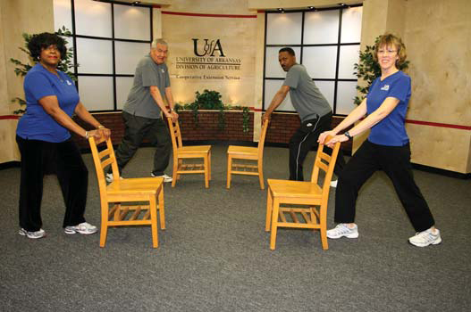
Types of Exercise
Balance
Endurance
Strength
Stretching

Slide 5
Types of Exercise
Balance exercises help prevent a common problem in older adults: falls.
Some balance exercises build up your leg muscles while others work on your stability.
balance exercises
endurance exercise
strength training
stretching or flexibility exercises

Slide 6
Balance Exercise: Forward toe touch/arm reach

Slide 7
Balance Exercise: Seated arm reach

Slide 8
Balance Exercise: Toes Raises

Slide 9
Balance Exercise: Seated Toes Raises

Slide 10
Types of Exercise
Endurance exercises increase your breathing and heart rate.
They improve the health of your heart, lungs, and circulatory system.
They improve your stamina for your activities of daily living.
balance exercises
endurance exercise
strength training
stretching or flexibility exercises

Slide 11
Moderate Intensity Endurance Exercise Walking fast Doing water aerobics Riding a bike on level ground or with few hills Playing doubles tennis Pushing a lawn mower
Endurance Exercise
Vigorous Intensity Endurance Exercise
Jogging or running
Swimming laps
Riding a bike fast or on hills
Playing singles tennis
Playing basketball

Slide 12
Types of Exercise
Strength training builds your muscles, which makes you stronger
Increases metabolism
Helps maintain your weight
Helps keep blood sugar in check
Helps prevent & treat osteoporosis
balance exercises
endurance exercise
strength training
stretching or flexibility exercises

Slide 13
Strength Training: Overhead Press

Slide 14
Strength Training: Side Arm Raise

Slide 15
Strength Training: Chair Squat

Slide 16
Strength Training: Seated Quad Set

Slide 17
Types of Exercise
Stretching exercises help keep your body flexible by stretching your muscles and the tissues that hold your body’s structures in place.
Help recover from injuries
Help prevent injuries from happening in the first place
balance exercises
endurance or aerobic exercise
strength training
stretching or flexibility exercises

Slide 18
Stretching: Shoulder Stretch

Slide 19
Stretching: Overhead Arm Stretch

Slide 20
Eating Healthy as You Age
Combined with exercise, eating nutritious foods in the right amounts can help keep you healthy.
Research has shown that behaviors such as eating a healthful diet and being physically active are more influential than genetic factors in helping you avoid the deterioration associated with aging.

Slide 22
LaVona S. Traywick, PhD, MA, CFLE Assistant Professor—Gerontology Jessica Vincent, BS, CHES Arkansas AgrAbility Coordinator

