Slide 1
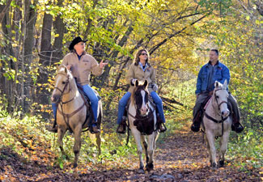

Slide 2
Ready to Ride Continuing an active lifestyle with horses after an arthritis diagnosis
Amber Wolfe
AgrAbility Project Coordinator
Arthritis Foundation
National AgrAbility Partner

Slide 3
Session Learning Objectives
Understand the affects that arthritis has on those who breed, raise, and train horses, use horses for ranch work, and those that own horses for recreational purposes.
Identify methods of changing routines to manage arthritis pain, as well as identifying types of assistive technology available for the equine industry.
Discuss the positive healthy effects that can be gained from riding and working with horses.

Slide 4
The horse industry is a very large and important part of our national, state and local economies. It is diverse, involving agriculture, business, sport, gaming, entertainment and recreation.
One out of every 63 Americans are involved with horses.
With the majority of horse owners living in rural areas (over 70% of horse owners live in communities of 50,000 or less) and working in rural occupations, they are just as likely to be affected by arthritis and its related diseases as a farmer involved in production row crops or other large livestock.

Slide 5
Approximately 4.6 million people are involved in the horse industry in some way, either as owners, employees, service providers or volunteers.
There are 9.2 million horses in the U.S., including horses used for racing, showing, competition, sport, breeding, recreation and work. This includes horses used both commercially and for pleasure. “Other” activities include farm and ranch work, rodeo, carriage horses, polo, police work, informal competitions, etc.
The industry employs 701,946 people directly. Some are part-time employees and some are seasonal so this equates to 453,612 full-time equivalent jobs.

Slide 6
Possible Difficulties
Understand the affects that arthritis has on those who breed, raise, and train horses, use horses for ranch work, and those that own horses for recreational purposes.

Slide 7
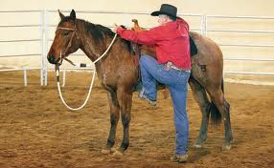
Mounting and Dismounting

Slide 8
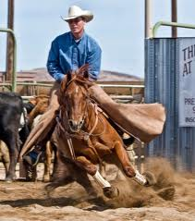
Weight
Shifts
and
Shock
Absorption

Slide 9
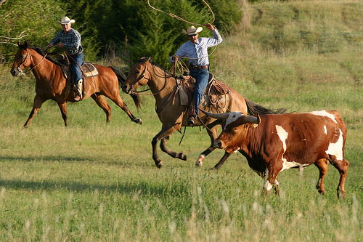
Extreme Movements, Grip Force

Slide 10
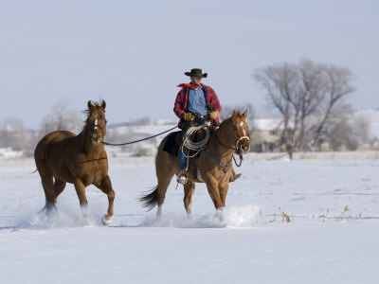
Extreme Climates and Long Hours
(poor posture)

Slide 11
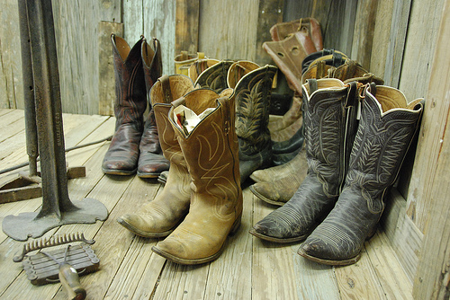
Footwear

Slide 12
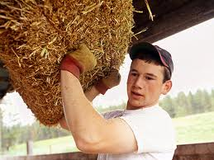
Heavy
Lifting

Slide 13
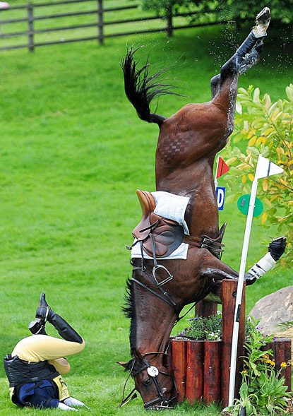
Accidents
and
Injury

Slide 14
Modifications and AT
Identify methods of changing routines to manage arthritis pain, as well as identifying types of assistive technology (AT) available for the equine industry.
Easy modifications to routine include feeding schedule changes, hours spent in the saddle, determining the time of day to ride, etc.
Proper stretching is important.

Slide 15
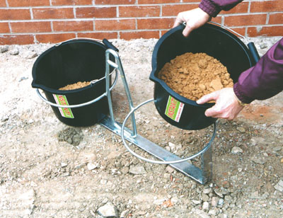
Bucket Carriers and Slings

Slide 16
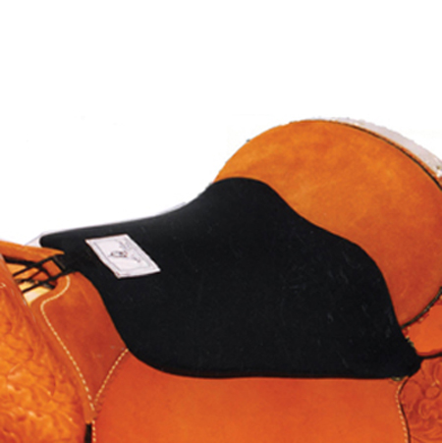
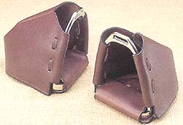
Comfort AT-
Stirrup
Covers and Seat
Covers

Slide 17
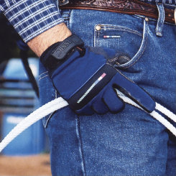
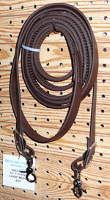
Protective AT-
Riding Gloves and Textured Reins

Slide 18
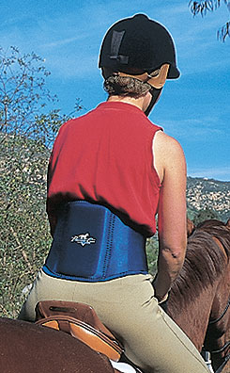
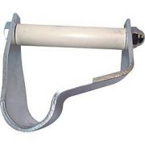
Ergonomic and Support AT-
Foot Positioning Stirrup
and Back Brace (also wrist braces)

Slide 19
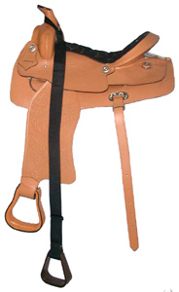
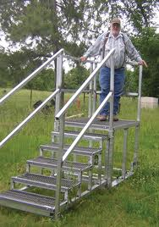
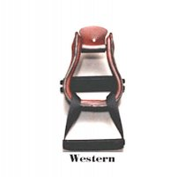
Mounting Aids

Slide 20
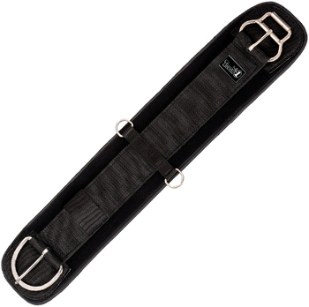
Easy Pull Girth

Slide 21
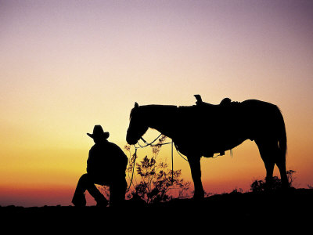
Benefits
Discuss the positive healthy effects that can be gained from riding and working with horses.

Slide 22
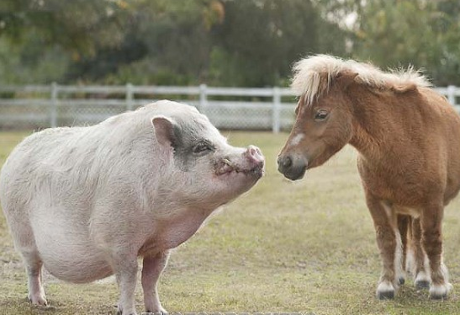
“I think the secret to looking skinny is longer legs.”

Slide 23
Weight Loss
General Horseback Riding (moderate pace)- 270 calories burned per hour
Relative to bicycling at 10 mph for one hour
Relative to gardening for one hour
Relative to 45 minutes of aerobic exercise
All projections are based on a 150-pound person of average height
Pro Health- Exercise Weight Loss Calculator

Slide 24
General Health
Riding is the only sport that works all of the muscles in the body at the same time
More Flexibility in Tendons and Ligaments
Stronger Muscles
Improved Eye-Hand Coordination
General Improved Well-Being
Stimulates Internal Organs
Promotes Digestion
Prevents Memory Loss

Slide 25
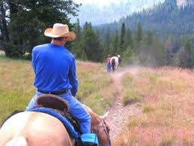
Stress Relief and Relaxation
Lowered stress has been proven to lower the incidence of arthritis flare-ups and recurrence.

Slide 26
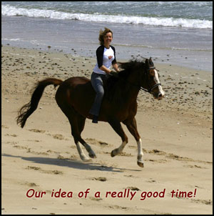
Enjoyment

