Slide 1
AgrAbility: The Goodwill Connection

Slide 2
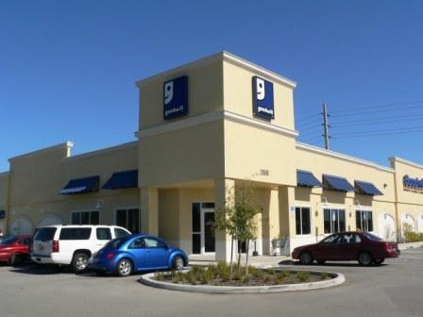
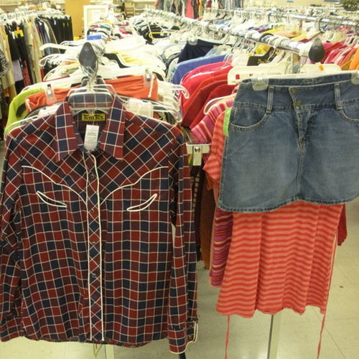
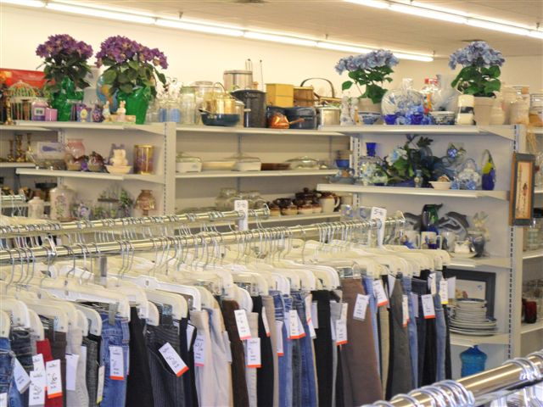
When you hear Goodwill, is this what you think of?

Slide 3
The Retail Engine is What Fuels Us!
The fact that people thing of shopping and donating when they think of Goodwill is what keeps us going.
The retail stores are a part of a social enterprise that provides revenue to support thousands of programs – the ones you might not see, until you or someone you know needs them.

Slide 4
Goodwill Beyond the Store Doors
Goodwill is a network of 165 independent, community-based Goodwill.
Each Goodwill affiliate offers customized job training, employment placement and other services to people who have disabilities, lack education or job experience, or face barriers to employment.
Each local Goodwill is a flexible and sustainable social enterprise that funds job training, employment placement services and other community programs through the sale of donated goods in retail stores and online.
Goodwills also generate revenue by contracting with businesses and government to provide a wide range of commercial services including packaging and assembly, food service, document imaging, shredding, contact center operations, sewing and more!
Across the enterprise, in 2011, Goodwill assisted 4.2 million individuals connect with employment opportunities through programs to assist individuals in overcoming their barriers.
79 million donors assisted provided donated merchandise for resale to assist Goodwill in providing services.

Slide 5
Independent, Community-Based Organizations With a Mission
Goodwill works to enhance the dignity and quality of life of individuals and families by strengthening communities, eliminating barriers to opportunity, and helping people in need reach their full potential through learning and the power of work.
Independent Goodwill Affiliates can have specialty areas, serving specific populations with barriers such as:
Blindness and Visual Impairment
Traumatic Brain Injury
Developmental Disability
Mental Illness
Deafness or Hearing Impairement
Criminal Background
And many, many more!

Slide 6
Goodwill of the Finger Lakes
One of the 165 Goodwill Affiliates. Located in Upstate New York.
Our priorities include:
Specialized focus on Vision Rehabilitation and Vocational Rehabilitation for individuals who are blind and visually impaired.
Job training and work experience opportunities for individuals with other barriers to employment.
Information and Referral Services through our AIRS Accredited 2-1-1 Contact Center
24/7 Crisis Management and American Association of Suicidology Accredited Suicide Prevention Hotline
Our Social Enterprise includes:
11 Retail Locations
Manufacturing (SkillCraft Brand of PostIt Notes, sewing for US Military, Soap Packaging, etc.)
Contact Center serving State, Federal and Commercial Contracts
Food service division which provides 1200+ meals daily to senior centers and day care centers

Slide 7
Our Priorities as an AgrAbility Partner
Connect AgrAbility and 2-1-1, insuring all AgrAbility programs are represented in their region’s 2-1-1 contact centers, and that 2-1-1 is a number given to clients to meet their needs.
Provide after-hours and weekend coverage for the National Project telephone line, offering live answer 24/7. Our 2-1-1/LIFE LINE telecounselors will provide information & referral services or counseling servces as necessary.
Networking Initiatives, working to develop strong networks between AgrAbility Projects and their regional Goodwills and other contacts to enable seamless and efficient client services.
Bringing Goodwill experience in areas such as mental health, visual impairments and traumatic brain injury to AgrAbility teammates through educational initiatives
Regional Conference Coordination
Continued penetration of the Goodwill enterprise with education about AgrAbility and agricultural issues

Slide 8
Help Us Help You …
Your state or region may have multiple Goodwill affiliates. We can assist you in gaining information about services and programs provided by each, as well as contacts within those organizations.
Goodwill affiliates employ individuals within their enterprises with expertise in several disabilities. If you have a need to learn more about a disability or barrier with which you have had limited experience, let us know! We can find someone to assist.
Is AgrAbility hosting events, helping people, or doing something in your region that you need help publicizing? We have access to over 90,000 Goodwill colleagues through email, and our daily e-News, Goodwill Today.
As your Networking Committee coordinators, we would love to hear more about the networks you would like to develop and the connections that are challenging to make so we can collaborate to make connections happen.

Slide 9
Questions?
Your National AgrAbility Project Goodwill Team:
JoBeth Rath, Project Coordinator
585.447.9015 585.402.2059 (cell) jbrath@abvi-goodwill.com
Dawn Miner, Project Coordinator
585.243.6173 585.794.8943 dminer@abvi-goodwill.com
Judy Gillis, Project Assistant
585.327.5517 jgillis@abvi-goodwill.com

