Slide 1
Cultivate a Partnership: AgrAbility and Occupational Therapy
Anna Lewandowski, OTD, OTR/L
St. Anthony Regional Hospital
Carroll, Iowa
*Featured guest speaker, Rod Peterson

Slide 2
Session Objectives
Participants will be able to:
Identify the role occupational therapy can play in farmers’ (with & without disabilities) overall health
Recognize the benefits of a partnership with occupational therapy students & AgrAbility
List possible programming ideas for your respective state AgrAbility project

Slide 3
What is Occupational Therapy?
Occupational therapy:
“therapeutic use of occupations…including everyday life activities…to support participation, performance, & function in all environments”
“determine how the components of the workplace can facilitate a healthy and efficient environment or one that could cause injury or illness” (AOTA, 2004)
includes a “holistic perspective, in which the focus is on adapting the environment to fit the person”
Notes:
In a nutshell, occupational therapy can best be described as “the job of living.” Any sort of daily occupations fall under the scope…occupational therapy practitioners aim to keep individuals safe while performing their occupations to the best of their ability. If we need to adapt the task or environment to achieve this goal, then that’s what we do!

Slide 4
Occupational therapy and farming
Farming includes…
Occupation/work
Routine
Environment
Motivation
Hobby
Way of life!
Notes:
These are terms we use in OT. We look at a person’s daily occupations, their routines, habits & roles…how does the environment play a part in how a person performs his/her daily occupations. If farming is a person’s meaning and motivation, then we strive for that person to continue farming safely for as long as possible.

Slide 5
AgrAbility Priorities
Education
Networking
Assistance
Marketing

Slide 6
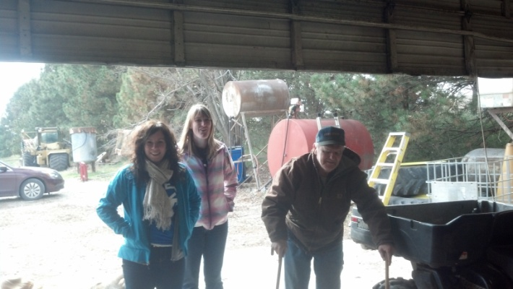
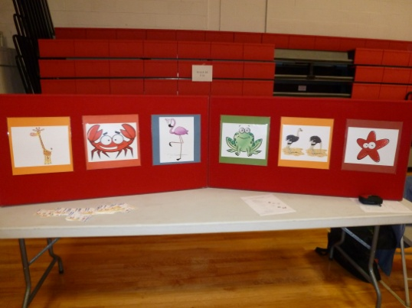
My experience with Nebraska AgrAbility
Notes:
I wanted to briefly touch on how my 16-week rotation was spent, targeting the priorities of AgrAbility (well, all except for marketing!) Here are a few pictures of some of my projects!

Slide 7
My experience
Assistance
On-site farm visits
Education
Safety Days presentations to youth
Train-the-trainer sessions
MRASH Conference
Video to display at events
Notes:
Throughout my 16 weeks I was able to travel with Rod & Del to AgrAbility clients, some were follow-up visits and some were initial visits for new clients. These were always rewarding experiences as I could tie so many similarities to the goals of occupational therapy and AgrAbility. Despite injury and illness, we long to see farmers continue farming-plain and simple. Rod & Del were the experts related to assistive technology on the farm. I was the student, eager to learn more, who really only had a health/medical perspective to it all.

Slide 8
(Continued)
Networking
Interview with NTV
Successful Farming article
Marketing
Notes:
Networking-promoting AgrAbility to the public, from an OT perspective. Talking about the importance of prevention…but this piece could be expanded so much more. OT students and faculty have an entirely different networking cohort. They can spread the word to various healthcare providers while at work, state and national conventions.
I didn’t get to focus so much on the marketing side of things!

Slide 9
View from a healthcare provider
Assessing similarities/differences among AgrAbility clients and local farmers
Most common location of pain
Chores that elicit pain
Notes:
My experience-I wanted to hit a little bit on one of my projects. I was interested in determining some similarities and differences among farmers with and without disabilities.

Slide 10
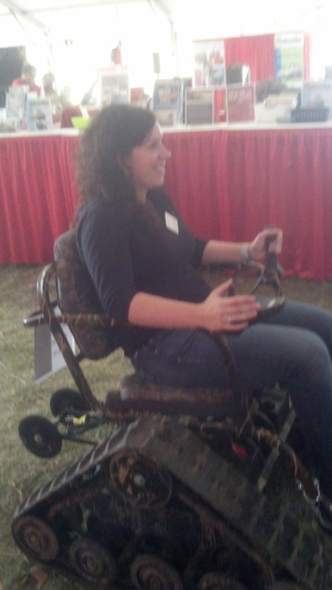
My experience with Nebraska AgrAbility
AgrAbility’s mission correlates with occupational therapy!
This collaboration has the potential to benefit OT students and faculty
Rotation opportunities
Future practice in rural health
Providing a different knowledge base
Notes:
There are a lot of potential possibilities for a successful partnership between state AgrAbility projects and occupational therapy programs. My student experience allowed me to decide what I wanted to focus on for 16 weeks. AgrAbility is an amazing resource for OTs in all healthcare settings (hospitals, rehab centers) and working with Nebraska’s program truly benefited me to spread the word not only to my classmates but also my professors.

Slide 11
Link between OT and AgrAbility
Primary prevention of injuries and/or musculoskeletal symptoms
Assistive technology
Ex: built-up handles for five-gallon buckets
Educational opportunities
Safety Days
Notes:
In some situations, there are tools/devices that we as OT students/practitioners are aware of that are typically used in the home setting but could also apply to the farm setting.

Slide 12
OT students & faculty have so much to offer AgrAbility!
Latest, most current research (evidence-based practice)
Health/medical perspective to educational and assessment opportunities
Possibility for secondary conditions
Lesson plans for future use with youth
Networking to a different crowd
Students
Other healthcare providers/colleagues
Two-way educational street
Notes:
Students are educated on the most up-to-date research while they are in school, and are required to collect continuing education credits every 2 years upon becoming licensed in a specific state.

Slide 13
Programing Possibilities
Encourage health & wellness to farmers at fairs/events
Invite students to on-site farm assessments
Collaborate with OT students
Activity analyses of farm chores
Notes:
OT student collaboration-develop more comprehensive assessments, activity analyses of specific farm chores

Slide 14
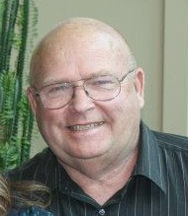
The other perspective…
Rod Peterson
Nebraska AgrAbility

Slide 15
Accredited OT and OTA programs
http://www.aota.org/Educate/Schools/EntryLevelOT/Doctoral.aspx
http://www.aota.org/Educate/Schools/EntryLevelOT/38119.aspx
http://www.aota.org/Educate/Schools/EntryLevelOT/38117.aspx

Slide 16
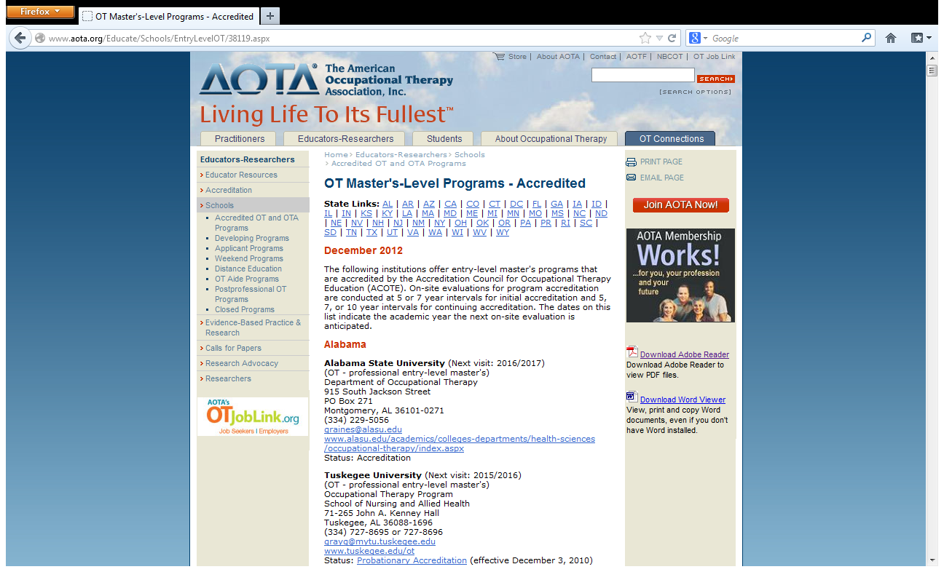

Slide 17
Questions, comments, etc.?
Anna Lewandowski, OTR/L
aelewandowski@stanthonyhospital.org

