Slide 1
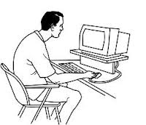
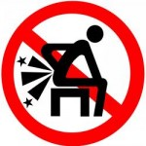
Lower Back Disorders & Prevention
By: Nathan Winter MS OTR/L, CEAS

Slide 2
Introduction
If you have lower back pain, you are not alone. Nearly everyone at some point has back pain that interferes with work, routine daily activities, or recreation.
In fact Americans spend at least $50 billion each year on low back pain.
Fortunately, most occurrences of low back pain go away within a few days. Others take much longer to resolve or lead to more serious conditions.

Slide 3
Types of Pain
Acute or short-term low back pain lasts from a few days to a few weeks. Most acute back pain is mechanical in nature — the result of trauma to the lower back or a disorder such as arthritis. Pain from trauma may be caused by a sports injury, work around the house or in the garden, or a sudden jolt such as a car accident or other stress on spinal bones and tissues. Symptoms may range from muscle ache to shooting or stabbing pain, limited flexibility and/or range of motion, or an inability to stand straight.
Chronic back pain is measured by duration — pain that persists for more than 3 months is considered chronic. It is often progressive and the cause can be difficult to determine.

Slide 4
What structures make up the back?
The back is an intricate structure of
Bones (Starting at the top, the spine has four regions)
the seven cervical or neck vertebrae (labeled C1 - C7),
the 12 thoracic or upper back vertebrae (labeled T1 - T12),
the five lumbar vertebrae (labeled L1 - L5), which we know as the lower back, and
the sacrum and coccyx, a group of bones fused together at the base of the spine.
The lumbar region of the back, where most back pain is felt, supports the weight of the upper body.
muscles
other tissues
The spaces between the vertebrae are maintained by round, spongy pads of cartilage called intervertebral discs that allow for flexibility in the lower back and act much like shock absorbers throughout the spinal column to cushion the bones as the body moves.
Bands of tissue known as ligaments and tendons hold the vertebrae in place and attach the muscles to the spinal column.
The centerpiece is the spinal column, which not only supports the upper body’s weight but houses and protects the spinal cord..

Slide 5
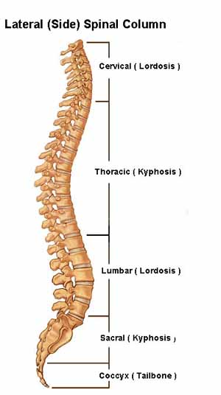
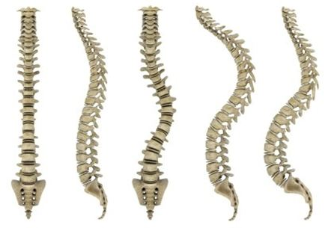
Curvatures of the Spine (Normal & Abnormal)

Slide 6
What causes lower back pain?
Age
bone strength and muscle elasticity and tone tend to decrease. The discs begin to lose fluid and flexibility, which decreases their ability to cushion the vertebrae.
Trauma
sprain, strain, or spasm in one of the muscles or ligaments in the back. If the spine becomes overly strained or compressed, a disc may rupture or bulge outward. This rupture may put pressure on one of the more than 50 nerves rooted to the spinal cord that control body movements and transmit signals from the body to the brain. When these nerve roots become compressed or irritated, back pain results.
Degenerative Conditions
arthritis or disc disease, osteoporosis or other bone diseases, viral infections, irritation to joints and discs, or congenital abnormalities in the spine.
Other Conditions
Obesity, smoking, weight gain during pregnancy, stress, poor physical condition, posture, and poor sleeping
It is important to note: scar tissue created when the injured back heals itself does not have the strength or flexibility of normal tissue. Buildup of scar tissue from repeated injuries eventually weakens the back and can lead to more serious injury.

Slide 7
Who is most likely to develop low back pain?
Nearly everyone has low back pain sometime.
Men and women are equally affected.
It occurs most often between ages 30 and 50.
Low back pain unrelated to injury or other known cause is unusual in pre-teen children.
a backpack overloaded with schoolbooks and supplies can quickly strain the back and cause muscle fatigue.
The U.S. Consumer Product Safety Commission estimates that more than 13,260 injuries related to backpacks were treated at doctors’ offices, clinics, and emergency rooms in the year 2000.
To avoid back strain, children carrying backpacks should utilize proper lifting techniques, and carry the weight on both shoulders.

Slide 8
Can back pain be prevented?
A combination of exercises that don't jolt or strain the back, maintaining correct posture, and lifting objects properly can help prevent injuries.
Avoid heavy lifting, contact stress (repeated or constant contact between soft body tissue and a hard or sharp object, such as resting a wrist against the edge of a hard desk or repeated tasks using a hammering motion), vibration, repetitive motion, and awkward posture.
Applying ergonomic principles — designing furniture and tools to protect the body from injury — at home and in the workplace can greatly reduce the risk of back injury.
The use of wide elastic belts that can be tightened to “pull in” lumbar and abdominal muscles to prevent low back pain remains controversial. Many studies have found no statistically significant difference in either the incidence of workers’ compensation claims for job-related back injuries or the incidence of self-reported pain among workers who reported they wore back belts daily compared to those workers who reported never using back belts.

Slide 9
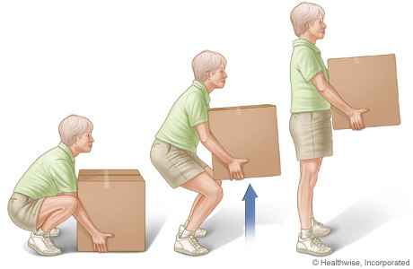
Proper Lifting Technique

Slide 10
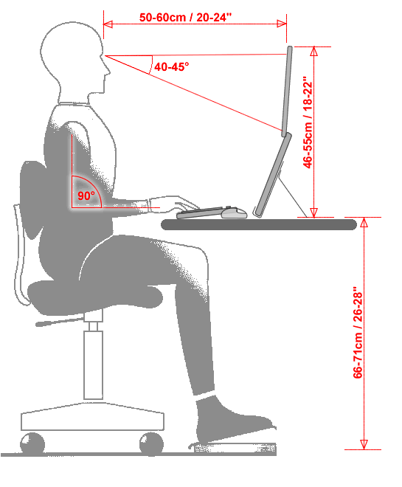
Proper Ergonomics

Slide 11
Questions ???

