Slide 1
Cancer Survivorship and AgrAbility
April 2013
Beth Hunter, PhD, OTR/L, Cardinal Hill Rehabilitation Hospital
John Hancock, MS, University of Kentucky AgrAbility
Robin Stroud, OTL Cardinal Hill Rehabilitation Hospital

Slide 2
Learning Objectives
An understanding of cancer survivorship issues
Long term health problems that cancer survivors need to be aware of
Three case studies of KY AgrAbility working with cancer survivors

Slide 3
What is Cancer Survivorship
NCI Definition:
An individual is considered a cancer survivor from the time of diagnosis, through the balance of his or her life.
Family members, friends, and caregivers are also impacted by the survivorship experience and are therefore included in this definition.
Major survivorship issues:
physical, psychosocial, and economic issues of cancer
the ability to get health care and follow-up treatment
late effects of treatment
second cancers
quality of life

Slide 4
Background on Survivorship
Based on cancer incidence rates in 2002-2004, approximately 40.9% of men and women born today in the United States will be diagnosed with some type of cancer.
Of the 1.4 million individuals diagnosed with cancer in 2006, an estimated 65% of them will survive at least 5 years following their diagnosis.
The direct effect of cancer and its treatment often result in physical impairments that can substantially decrease quality of life.

Slide 5
Cancer as a Chronic Illness
Cancer has many courses:
It may be caught early and with minimal treatment be considered “cured.”
It may be caught late or be a particularly hard to treat cancer and result in a fairly quick death.
Significant advances have been made in cancer care, so that even when cure is not possible, many cancers can be controlled and managed for long periods of time. Many physicians consider patients being treated for some types of cancer as living with a chronic condition- much like people with diabetes or high blood pressure.

Slide 6
Cancer and Agriculture
There are a number of factors that connect cancer and agriculture. Two big ones are:
Farmers are aging
Farmers are exposed to potentially toxic environmental/occupational hazards (chemicals, sun)

Slide 7
Aging Farmers and Cancer
Cancer has been called the disease of elderly people; advancing age is associated with an increased risk of cancer.
Nearly 60% of cancer diagnoses and 70% of cancer deaths occur in individuals aged 65 or above. This is expected to rise as the aging population grows over the next 40 year.
Nationally, agricultural census figures show that the fastest-growing group of farmers and ranchers is the segment over 65. Between 2002 and 2007 this group grew 22%.
New Mexico tops the list of states with the highest percentage of older farmers and ranchers, at 37 percent, followed by Arizona, Texas, Mississippi and Oklahoma.

Slide 8
Environmental Hazards
The good news: Farmers in many countries, including the United States, have lower overall death rates and cancer rates than the general population.
The bad news: Farmers have increased rates of Hodgkin's disease, multiple myeloma, leukemia, melanoma and cancers of the lip, stomach, brain and prostate.
Melanoma and lip cancers are probably due to farmers' exposure to ultraviolet radiation in sunlight,
Pesticides were a likely cause of some of the other cancers; other possible causes are fertilizer in drinking water; fuels and oils; fumigants, and animal cancer viruses.

Slide 9
Cancer and Disability
Many cancer survivors report declines in their physical functioning, including basic body mobility and engagement in work and leisure activities
Common functional impairments include loss of motor control, cranial nerve deficits, cognitive and speech problems, swallowing problems, and sensory loss
Cancer survivors often face functional and psychosocial problems.

Slide 10
Bottom Line-Survivorship
Our population of cancer survivors is growing
In agricultural populations there may be some cancers that are more common than in the general population
Aging is one of the risk factors for being diagnosed with cancer
Cancer can cause many types of disability both from the disease and the treatment

Slide 11
Case Studies
Three case studies:
Donnie- survivor of a Wilm’s tumor (childhood cancer)
Larry- survivor of oral cancer
William- survivor of tumor of the spinal cord

Slide 12
Donnie- Wilm’s Tumor
48 year old male- Cancer survivor since 4yo
Family farm- 1200 acres- corn, soybeans, tobacco, beef cattle
His brother David is an Extension Agent in KY and that’s how Donnie learned about AgrAbility
Physical Issues: sever curvature of the spine and limited muscle development supporting the back from radiation- Had a kidney removed during cancer treatment- Had a bowel resection from ischemia- now reports arthritis in his back and a torn rotator cuff in one shoulder.
Pain- average 4/10 but can be 8-10/10

Slide 13
Pediatric Cancer
Children with cancer treated with chemotherapy and/or radiation therapy may be at increased risk for developing a second primary cancer or secondary health problem (heart, lung, bone, muscle).
A number of studies are examining suspected or possible risk factors for childhood cancers, including early-life exposures to infectious agents; parental, fetal, or childhood exposures to environmental toxins such as pesticides, solvents, or other household chemicals; parental occupational exposures to radiation or chemicals

Slide 14
Wilm’s Tumor
Wilms tumor is the most common form of childhood kidney cancer. The exact cause of this tumor in most children is unknown.
Wilms' tumor most often affects children ages 3 to 4 and becomes much less common after age 5.
Surgery to remove the tumor is scheduled as soon as possible. Surrounding tissues and organs may also need to be removed if the tumor has spread.
Children whose tumor has not spread have a 90% cure rate with appropriate treatment.
Long-term bone, muscle and potentially lung problems are common.

Slide 15
Donnie and AgrAbility
Identified Challenges:
Back pain and weakness
Limited mobility and endurance
Needs:
Easier access to tractor
Better seating in all vehicles/machinery
Machinery to lessen physical work (i.e. soil samples)
AgrAbility/Voc Rehab Services:
Initial eval- AgrAbility/OT
Connecting with Voc Rehab
Provided safety and health educational materials (joint protection, energy conservation tips, etc.)
Custom seat molding
Automated soil sample equipment

Slide 16
Recommendations
Donnie has the potential to remain an independent farmer and with the following recommendation to increase his productivity and endurance to farm full-time. The following assistive technology and equipment are recommended:
1. Three custom molded seat cushions and back cushions –
The reason for three custom seating systems one for each tractor/truck they will be fabricated in two pieces to decrease the wt. of each piece, but will be heavy to haul up into tractor while climbing steps, the cushion that will go in the Toyota will be able to transfer to the UTV. The custom seating will provide the proper back support Donnie needs and will decrease his pain allowing him to work longer and take fewer rest periods.
2.A seed tender
The purpose of the seed tender will allow Donnie to increase independence with self- filling loading seed and planting This will decrease the need of Donnie to climb on and off tractor and decrease/maintain pain level and increase productivity.
3. A Soil Sampler
A Soil Sampler eliminates the need for Donnie to climb on/off the UTV, bend/stoop to collect soil samples. This device will allow Donnie to remain on the UTV and increase the number of soil samples collected in a day by 100% and have increased accuracy and quality of samples. Therefore decreasing Donnie’s pain, productivity time in completing task and improving on the quality of crops in the long run.

Slide 17
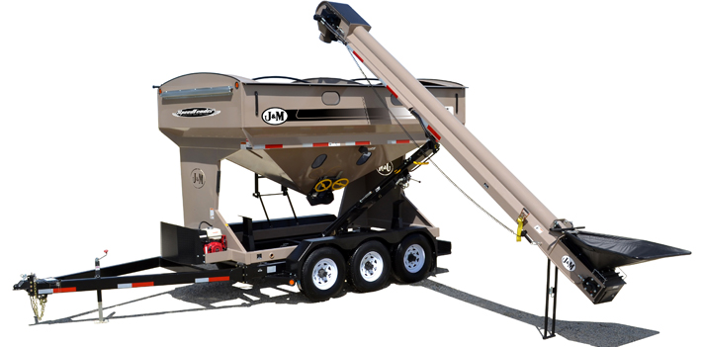
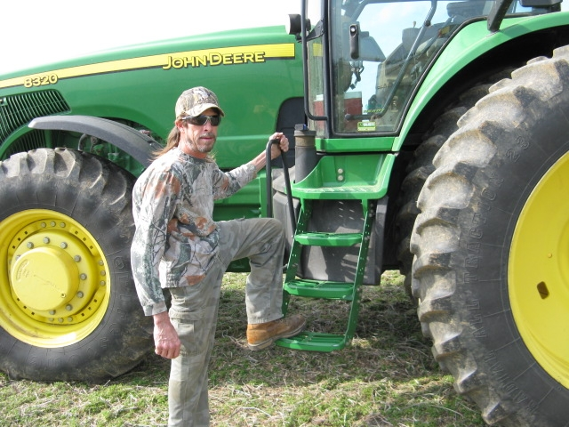
J&M Speed Tender and Wintex 1000 Soil Probe

Slide 18
Larry- Oral Cancer
68 year old male
700 acre cattle farm
His daughter learned about AgrAbility and connected her father
Physical Issues Since Treatment for Cancer:
Heat effects himby depleting his energy and skin sensitivity to the sun as a result of the radiation exposure from cancer treatment
Pollen, dust and wind all effect his ability to breath and increases coughing he becomes choked since the resection of his throat
The radiation killed off the hair in his nose/throat decreasing a natural filtration to the elements, Cold and wind increase pain in his ear from the way the surgery and treatment from the cancer.
As a result of the surgery the vision in his left eye was affected in that the eye lid does not close all the way causing dry eye and blurred vision.
Voice negatively affected by the radiation

Slide 19
Oral Cancer
Approximately 42,000 people in the US will be newly diagnosed with oral cancer in 2013 with most over the age of 60 and 60% being male.
About 75 percent of oral cancers are linked to modifiable behaviors such as tobacco use and excessive alcohol consumption.
Other factors include poor oral hygiene, irritation caused by ill-fitting dentures and other rough surfaces on the teeth, poor nutrition, and some chronic infections caused by bacteria or viruses.
People with oral cancer may be treated with surgery or radiation therapy and some receive chemotherapy

Slide 20
Oral Cancer
Common problems:
Postoperative disfigurement of the face, head and neck
Complications of radiation therapy, including dry mouth and difficulty swallowing
Other metastasis (spread) of the cancer
Significant weight loss (often use a feeding tube)
Trouble Swallowing- If there's a chance that swallowing will become too difficult for you, your dietitian and doctor may recommend another way for you to receive nutrition. For example, after surgery or during radiation therapy for oral cancer, some people need a temporary feeding tube.
Breathing Problems- The nasal mucous membranes become dried out by abnormal exposure to the oral environment, causing chronic irritation. Nasal and sinus secretions may collect in the defect area. Environmental factors can make this problem worse (dust, humidity, cold, etc.)

Slide 21
Larry and AgrAbility
Identified Challenges:
Breathing problems/exposure problems
Speaking/voice problems
Needs:
Protection from elements on farm
Communication enhancement at stock yard job
AgrAbility/Voc Rehab Services:
Initial eval- AgrAbility/OT
Connecting with Voc Rehab
Provided safety and health educational materials (energy conservation tips, respiratory tips etc.)
Tractor with an enclosed tractor cab with HVAC system
Power shift transmission and self-leveling loader –decrease energy use
Portable voice amplifier megaphone with head set for stock yard job

Slide 22
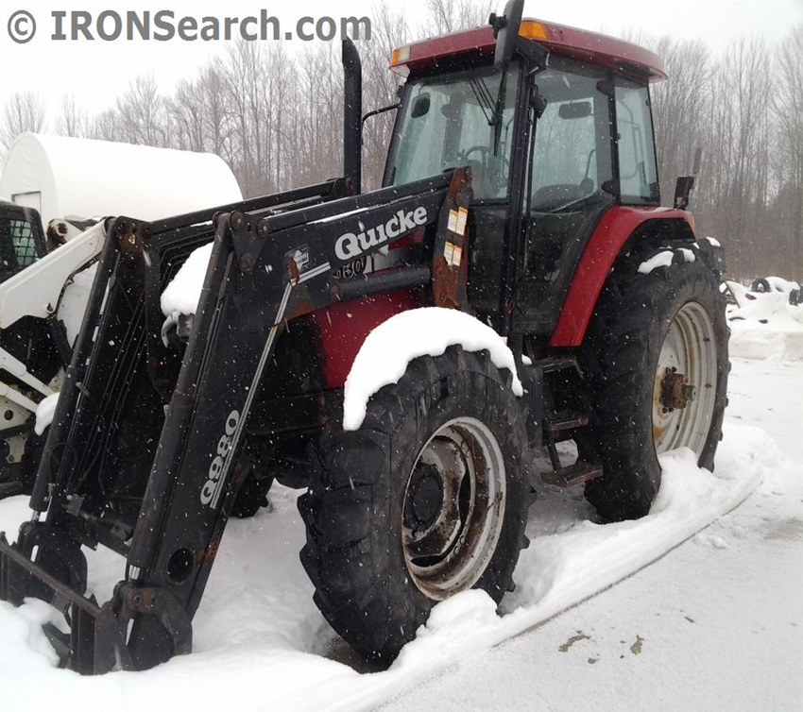
Covered Tractor Cab and Wireless Microphone system

Slide 23
William and Spinal Tumor
Mid-60’s, male
Primary job- surgeon
Cattle farmer (700 acres)
His daughter is the Extension Program and Staff Development person for the state. She connected her father with AgrAbility
Physical issues: lost his right eye and he has some loss of peripheral sensation in both legs with left foot drop, and some neuropathy in his hands.

Slide 24
Spinal Tumor: Arachnoid cyst
While a definitive cause is unknown, most arachnoid tumors are present at birth and believed to be the result of developmental abnormalities.
If the tumor grows large enough it can put pressure on surrounding parts of the brain and spinal cord, resulting in the onset of symptoms.
The tumor can be removed with surgery
Most common symptoms include:
Headaches
Nausea and/or vomiting
Seizures
Behavioral changes
Hearing and vision problems
Vertigo
Balance problems while walking or standing
Weakness or paralysis on one side of the body

Slide 25
William and AgrAbility
Identified Challenges:
some loss of peripheral sensation in both legs with left foot drop
some neuropathy in his hands.
limited visions, especially peripheral vision (due to loss of one eye)
difficulty with lifting and carrying due to poor balance/mobility due to the loss of sensation in his legs
significant fatigue throughout the day
Needs:
Needed help with his cattle feed systems and transportation around farm
Cattle handling equipment
AgrAbility/Voc Rehab Services:
Initial eval- AgrAbility/OT
Connecting with Voc Rehab
Feeding: Camera/monitor system for feeding, hay elevator, more automated feed system, automatic gates, utility vehicle to get around the farm
Handling: lighting, power gates, head catch system, camera system, mirrors and lighting in barn, hydraulic levers for head catch system
Also received Voc. services for his job as a surgeon

Slide 26
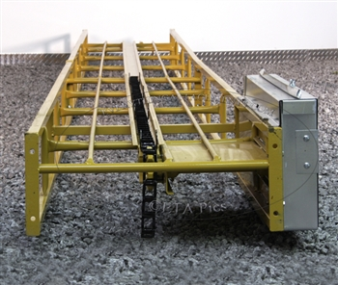
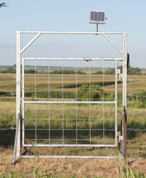
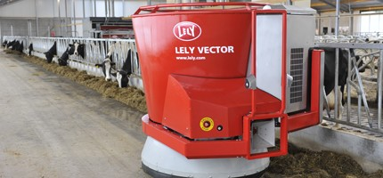
Camera monitoring system, hay elevator, electronic gates,etc.

Slide 27
Thank You!
Questions or Comments?

