Slide 1
Ranching with a disability
NTW PRESENTATION APRIL 2013
TANA BECKSTEAD, AGRABILITY OF UTAH

Slide 2
RANCH
Primarily Western US and Canada
Large farm
Raise one kind of crop or animal
Typically a family operation

Slide 3
Ranchers wear many hats NOT just a cowboy hat.

Slide 4
Cattle
Alfalfa-Hay
Barley-Wheat

Slide 5
THE RANCH- OXFORD MOUNTAIN

Slide 6
The RANCH HANDS
Doug, Tana, Wiley, Savannah & Hazen Beckstead

Slide 7
“The 4 Seasons” by Hazen Beckstead hangs in our local FSA office

Slide 8
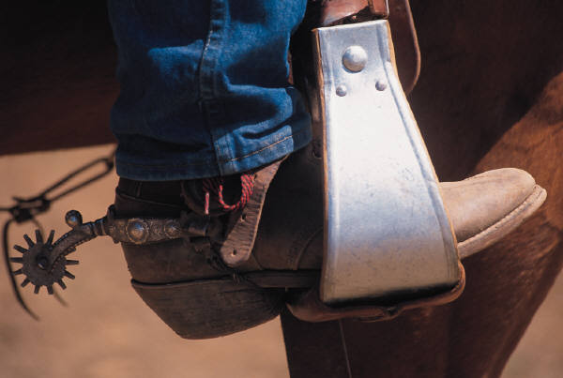
cattle ranching with a disability
Riding horses
Feeding livestock
Livestock handling

Slide 9
cattle ranching with a disability
Riding horses

Slide 10
Horses – # 1 tool of working cowboys

Slide 11
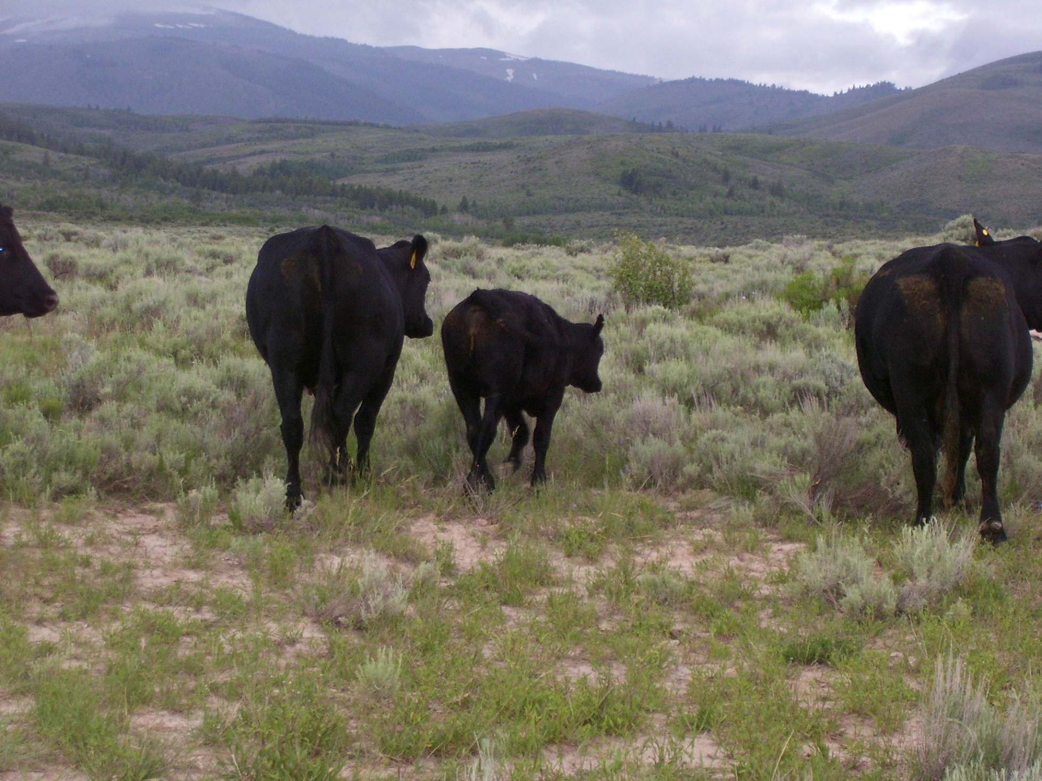
Transporting new calves
Doctoring sick animals
Rough terrain
Branding

Slide 12
Results in long days in a saddle working around livestock:
Joint & back issues
Rope burns
Weather
Physical terrain

Slide 13
Assistive Technology - Tack
Head restraint
Back support
Handle instead of horn
Quick release latch
Memory foam seat
High back
Bell stirrups

Slide 14
Assistive Technology - Tack
Gloves
Armitas or chinks (long fringe chaps)
Leggings
(shot gun chaps)

Slide 15
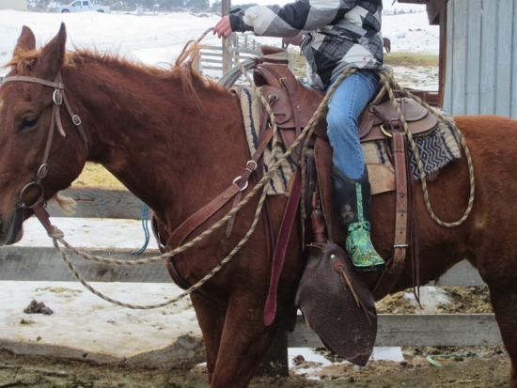
Assistive Technology - Tack
Tapederos or “taps”
(covered stirrup)

Slide 16
Assistive Technology - Tack
“Get down” with nose band

Slide 17
cattle ranching with a disability
Riding horses
Feeding livestock

Slide 18
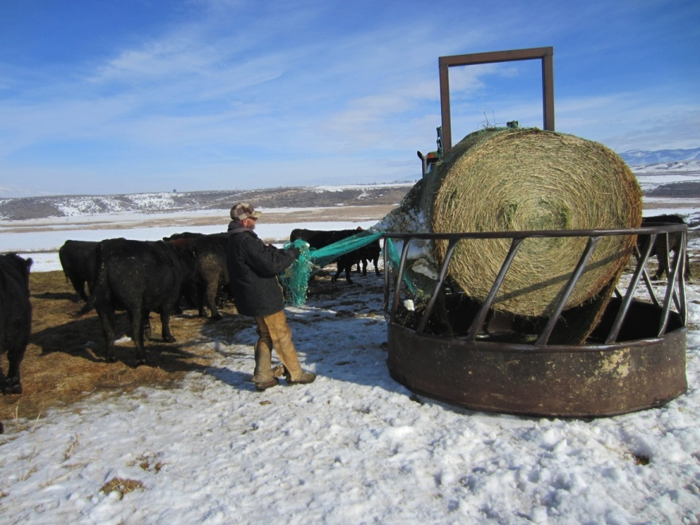
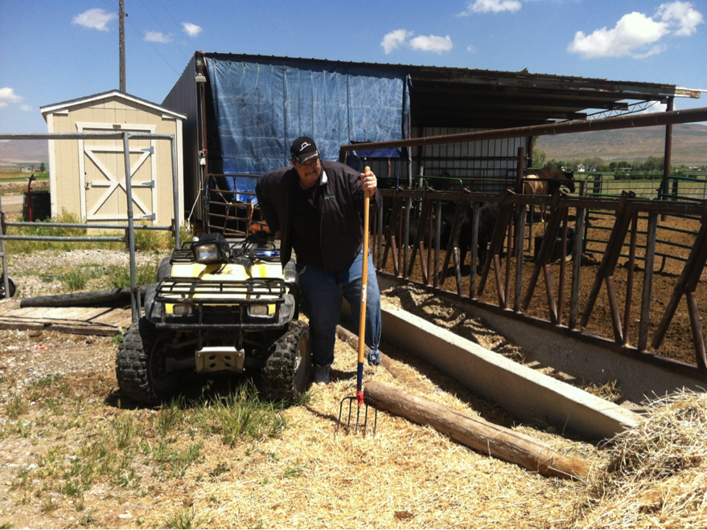
Feeding
1-ton round bales
3x4 bales

Slide 19
Assistive Technology - Feeding
Bale roller on flat bed pickup
Bale roller on tractor

Slide 20
cattle ranching with a disability
Riding horses
Feeding livestock
Livestock handling

Slide 21
Assistive Technology – Livestock Handling Equipment
Calf table
Climbing on calf table

Slide 22
Assistive Technology – Livestock Handling Equipment
“Nord fork”
Horse and rope do the work

Slide 23
Assistive Technology – Livestock Handling Equipment
Waiting to “fork” a calf

Slide 24
Assistive Technology – Livestock Handling Equipment
Branding and vaccinations

Slide 25
Assistive Technology – Livestock Handling Equipment
Rubber inner tubes attached to forks

Slide 26
Assistive Technology – Livestock Handling Equipment
Protective mama cows
Extra help

Slide 27
Assistive Technology – Livestock Handling Equipment
Self catching head catch
Restrained for birthing assistance

Slide 28
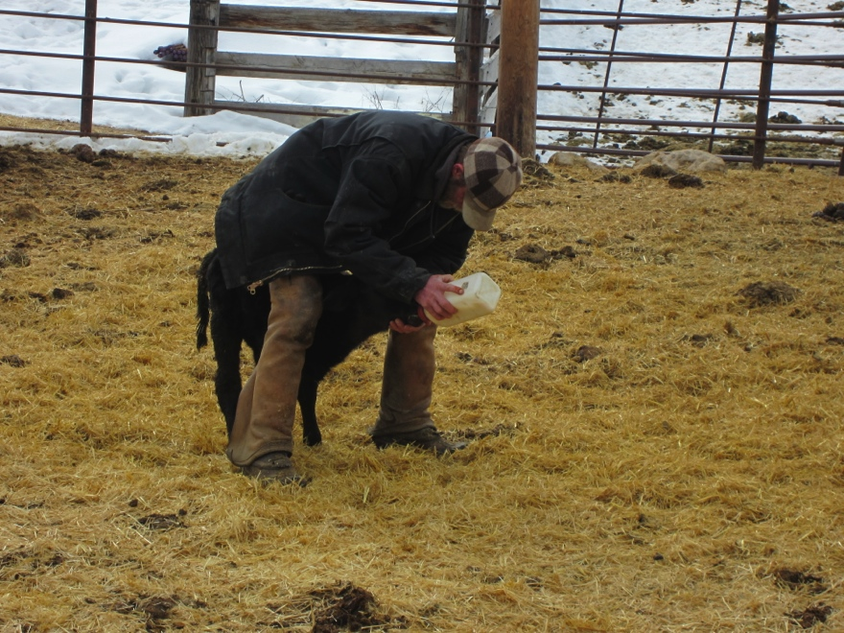
Assistive Technology – Livestock Handling Equipment
Calf puller
Calf warmer
Bottle-feeding

Slide 29
Assistive Technology – Livestock Handling Equipment
Manual squeeze chute
Hydraulic squeeze chute

Slide 30
Assistive Technology – Livestock Handling Equipment

Slide 31
Assistive Technology – Livestock Handling Equipment
Cattle guards

Slide 32
Ranching – traditionS & A WAY OF LIFE
HERITAGE
COWBOYS
HORSES
FAMILY

Slide 33
SO GOD MADE A COWBOY
On the 8th day God made the farmer, but he was not done... He looked down on the wilds of his untamed earth and said, “I need someone who will never be broken”.
And so his greatest work began. First he filled their belly full of guts and hearts full of try, then he called them a Cowboy…….
Poem by
Kalyn M. Waters
of South Dakota

