Slide 1
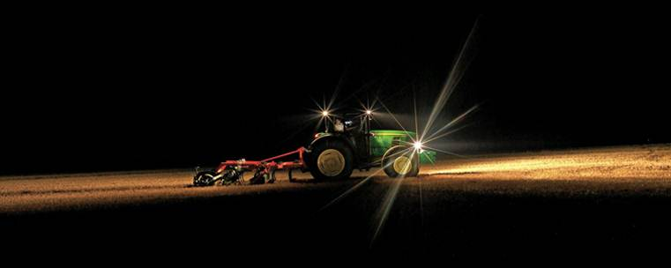
Lighting for Health and Safety in Agricultural Settings
www.deere.co.uk
Robert Stuthridge Ph.D., CPE
Project Ergonomist, National AgrAbility Project, Purdue University
www.agrability.org

Slide 2
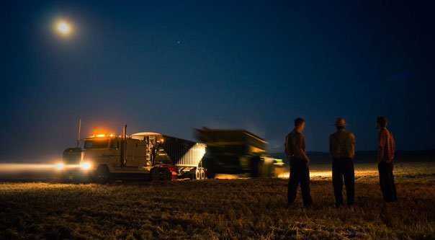
Overview
Importance of proper lighting
Lighting problems
Visual performance
Visual disorders
Visual task demands
Types of lighting
Standards and guidelines

Slide 3
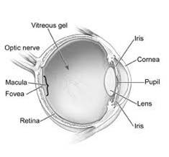
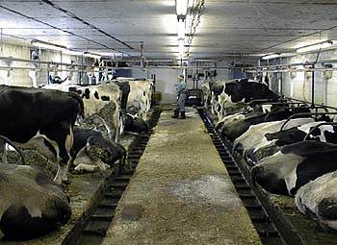
Importance of lighting
People receive about 85% of our information through sight.
Light is essential to sight.
Visibility influences posture: head, neck, and trunk.
Affects visual fatigue/eyestrain.
Critical to safety: Highlights machinery or moving objects.
Trips and falls: 40% of falls in a geriatric care hospital were due to poor lighting (Pinto, et al., 1997).
Affective (psychophysiological): alertness, mood.

Slide 4
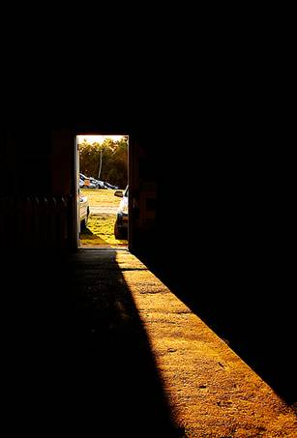
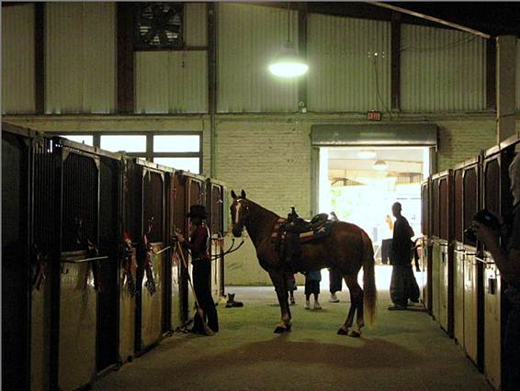
Lighting problems: Gloomy light
Insufficient light for the task/user.
Reduced visual distance; postural effect;
Risk for collisions, trips, slips and falls.
Entering a dimly-lit building from sunlight or strongly lit areas – temporary blindness (light adaptation).

Slide 5
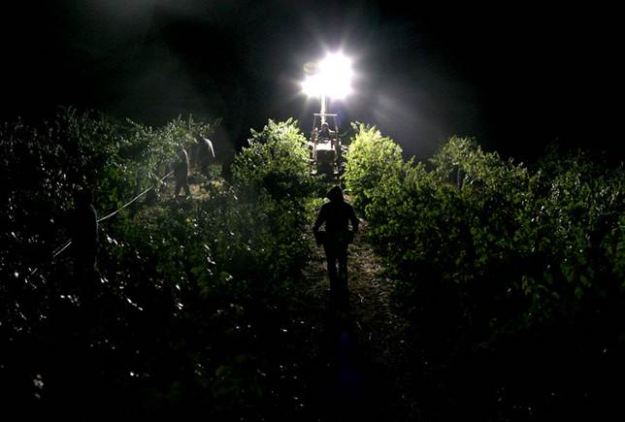
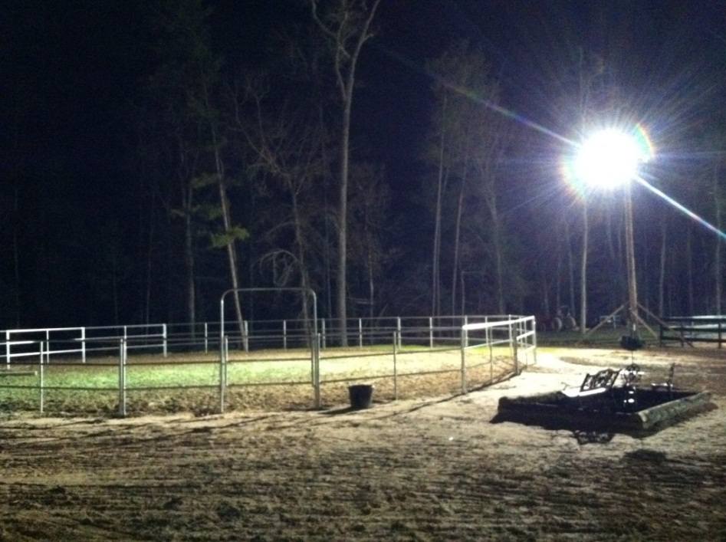
Lighting problems: Glare
Glare – light source is excessive or too bright for the user.
Disability glare: Sources of illumination can disable people with conditions such as corneal edema, lens opacities, various forms of maculopathy, and dry-eye problems (Grosvenor, 2013).
In ergonomics, “disability glare” describes loss of visual information that occurs when a bright light source renders less brightly-lit ambient surroundings invisible, and the task (e.g. walking, driving) unsafe to complete. E.g., “oncoming un-dipped headlamps at night,” or an unshielded bright light source outside a farm building.
Unshielded lights on a farm close to public roads should be shielded to reduce risk of disability glare for passing drivers.

Slide 6
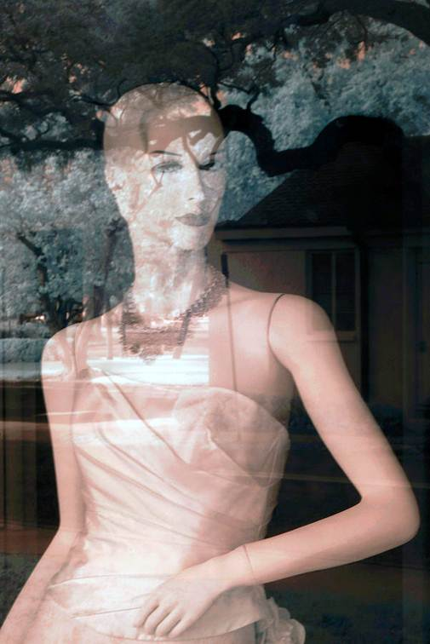
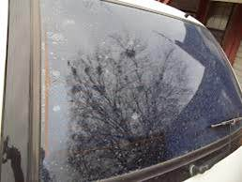
Lighting Problems: Specular glare (reflections)
Task obscured.

Slide 7
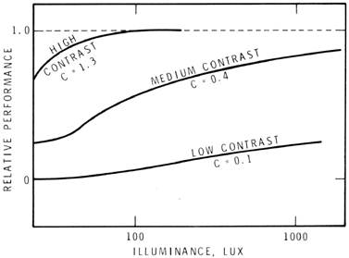
Lighting problems: Poor contrast
Contrast = relationship between the brightness of an object and its background.
Insufficient contrast makes it hard to distinguish an object from its immediate background.
Increased Illuminance does not compensate for insufficient contrast.
Relation of performance, contrast and illuminance. National Research Council, Canada. 1972
Average contrast should be above 0.5 (10:3:1 object, ground, background).

Slide 8
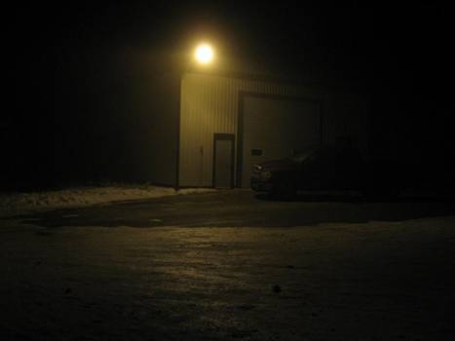
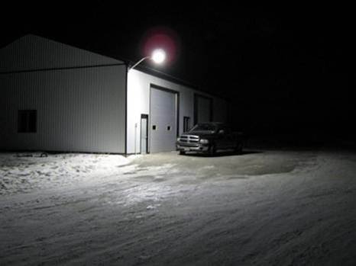
Lighting problems: Color inaccuracy
Poor color rendition. Color of an object depends on the color of the light falling upon it.
An object may absorb or reflect certain colors.
Sunlight or “full spectrum” lighting give most accurate color rendition.
Low pressure 200w sodium vs. 60w LED
www.newledlight.com.cn

Slide 9
Lighting Problems: Flicker
Flicker = rapidly changing intensity. People perceive light flashing up to about 50 flashes/sec. (50 Hz) - most sensitive to 10-25 Hz range.
Sensory system can still detect flicker at much higher rates than 50Hz.
Eye strain/headaches.
Electronic ballasts >20kHz results in fewer health problems.
Combine fluorescent lamps with natural daylight if possible.
To eliminate flicker:
Use energy-efficient electronic ballasts. These convert 60 Hz power to 20,000 - 60,000 Hz. The resulting flicker frequency cannot be detected by the human eye.
Replace bulbs regularly. Old bulbs flicker more and are not as bright.
Ensure all parts of light fixtures, especially ballasts, are functioning properly.
Another method: mix tubes>>>

Slide 10
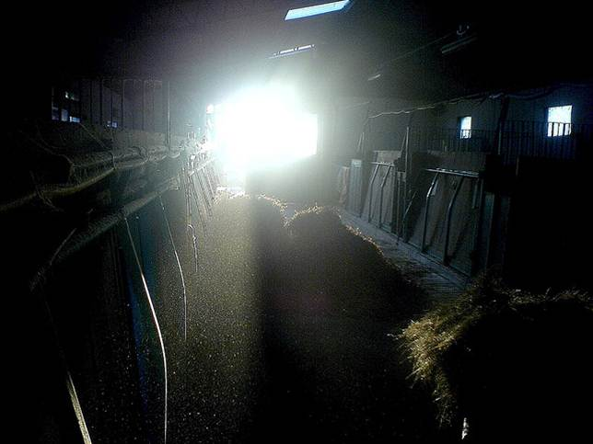
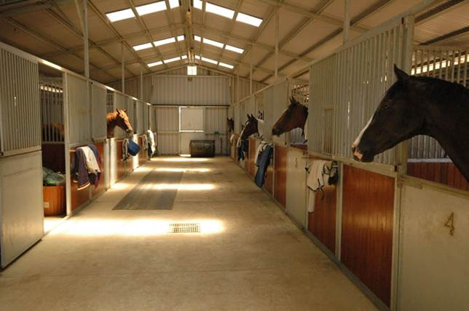
Lighting problems: Shadows
Strongly directional lighting may create strong shadows.
Combine directional and diffuse lighting to eliminate strong shadows.
Light sources behind a worker can cast shadows on the task.

Slide 11
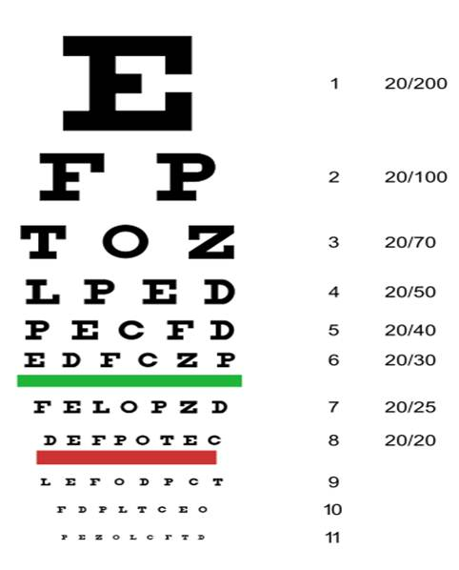
Visual performance: Acuity
Acuity = acuteness or sharpness of vision. Tested using a Snellen Chart .
At 20 feet, a human eye with nominal performance is able to separate lines that are one arc minute apart (equivalent to lines spaced 0.068 inches apart).
20/20 vision is nominal performance for human distance vision. 20/40 is half as good , and 20/10 twice as good as nominal performance.
Typically declines with age.
Acuity is highly dependent on accommodation of the eyes.

Slide 12
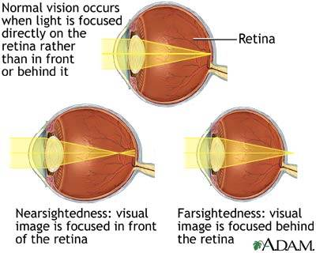
Visual performance - Accommodation
Accommodation is normal when the lens flattens to focus far images on the retina, and bulges to focus near objects.
Nearsightedness (myopia) is where the lens remains bulged, preventing proper focus of distant images.
Farsightedness (hyperopia) is where the lens remains too flat, preventing proper focus of near images.
Age relatedness.
http://health.allrefer.com

Slide 13
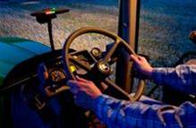
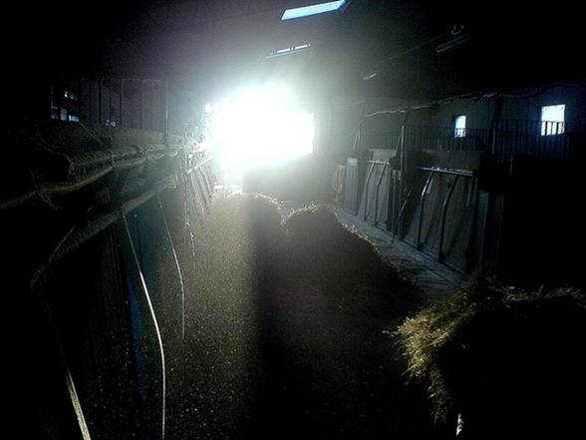
Visual performance
Dark adaptation –
pupil dilates. Admits more light.
Visual purple builds up in retina. Cones lose sensitivity. Rods predominate. Color discrimination declines.
Dark adaptation typically takes 30 minutes or more.
Light adaptation takes a few seconds or minutes at most.
Contrast sensitivity - declines with age – this results in reduced capacity to perceive fine detail in a visual object (Grosvenor, 2013).

Slide 14
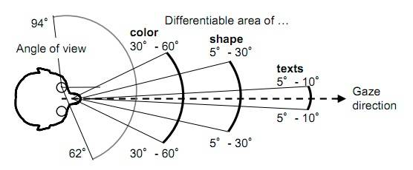
Visual performance – Field of view
Acuity of portions of visual field
http://www.technologyreview.com
Age & field of view: 900 people aged 52-102 years: "Whereas standard field extent changes very little with age, attentional field size decreases dramatically, accompanied by enormous increases in variability. 25% of the oldest age group had no peripheral fields under conditions of divided attention.“ http://www.pacificu.edu/optometry/ce/courses/16554/agingeyepg3.cfm#attentional

Slide 15
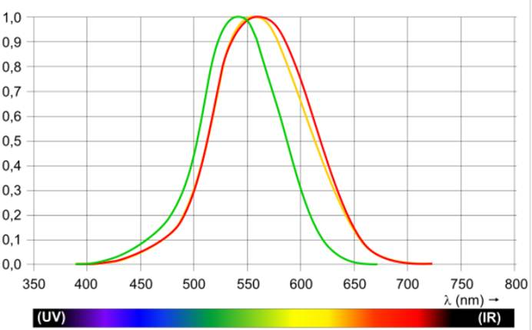
Color blindness
Color blindness changes the sensitivity of the eye as a function of wavelength.
Red/Green or Blue/Yellow commonly problematic.
Protanopia, peak response shifts toward short-wave part of the spectrum (c. 540 nm).
Deuteranopia, peak response shifts upward to about 560 nm. No sensitivity to light of wavelengths >670 nm.
Cataracts shift maximum of sensitivity to the red part of the spectrum and narrow the range of perceived wavelengths.
Protanopic (green) and deuteranopic (red) luminosity functions.
The standard photopic curve is shown in yellow.
Source: http://en.wikipedia.org/wiki/Luminosity_function#Color_blindness

Slide 16
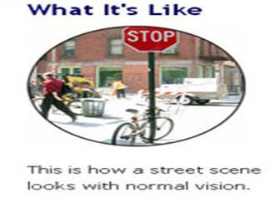
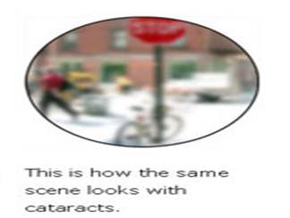
Cataracts
Cataract: yellow-brown pigment is deposited, clouding the lens.
Obstructs light and impairs focusing.
Most common cause of blindness globally (51% – WHO).
Causal factors:
Aging, diabetes, hypertension, radiation, including X-Rays, UV-B light, toxins, blunt trauma, excessive heat (e.g. furnace work), genetics, skin diseases (e.g. eczema, atopic dermatitis, ichthyosis), Smoking (2x to 3x risk), drugs (corticosteroids, quetiapine, haloperidol, miotics, triparanol), Iodine deficiency, many other causes
Problems associated with cataracts:
Impaired color perception, reduced contrast, driving, reading, recognizing faces, coping with glare.
Post surgery 90% achieve only 20/40 vision.
www.lighthouse.org

Slide 17
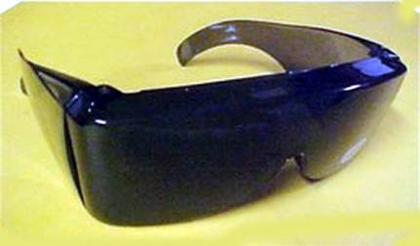
Cataracts: Lighting needs
The American Foundation for the Blind has suggested "Ways to Help Individuals with Cataracts":
Use bright primary colors with high contrast,
Provide reading materials that have high contrast, such as large black print on white or light yellow paper, a minimum of 18 point,
If printing, use black felt-tip pens on white paper for highest contrast,
Adjust window shades to reduce direct sunlight, and
Wear sunglasses and a hat when outdoors on sunny days. Blue filter sunglasses post surgery.
http://www.pacificu.edu
Lighting:
Incandescent lamps or "warm" fluorescents may cause less glare than "daylight" fluorescents, but may not render color so well. Incandescents less efficient, radiate more heat - a problem if positioned close to user's face or body.
Key is to eliminate sources of glare, and provide sufficient task illumination and optimize task visibility.

Slide 18
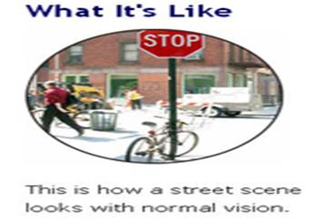
Macular degeneration
Age-Related Macular Degeneration (AMD) = “a progressive retinal disease, usually occurring at age 55 or older, with multiple environmental and genetic factors.” (AMD Alliance International).
Central visual field (macula) is destroyed.
www.lighthouse.org

Slide 19
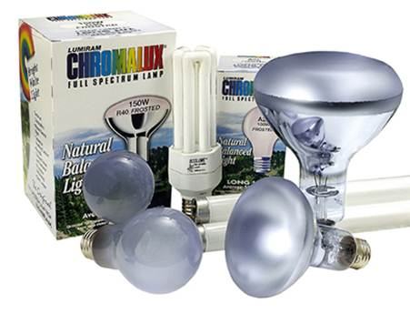
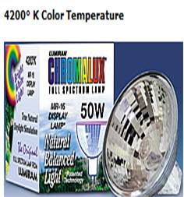
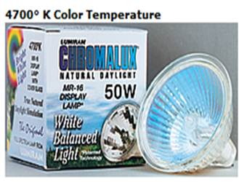
Macular Degeneration: Lighting needs
Chromalux bulbs (60 or 100 watts) – full spectrum lamps may be helpful for some people with macular degeneration.
Halogen lamps, used in the proper fixture, are safe and efficient, can provide high-intensity light in a small space.
High intensity blue light destroys lipofuscin (a molecule that increases in the retina with age), causing oxidative damage. Lighting should not accentuate the blue spectrum if it is of high intensity or endured for long periods.

Slide 20
Glaucoma
Glaucoma - damage to the optic nerve leads to progressive, irreversible vision loss.
2nd leading cause of blindness.
Mainly genetic.
www.lighthouse.org
Primary open-angle glaucoma (c. 3m in USA); Eye’s drainage canals clogged over time.
Angle-closure glaucoma (AKA acute glaucoma, narrow angle glaucoma). Rarer.
Eye pressure usually rises very quickly.
Normal-tension glaucoma the optic nerve damaged even though pressure in the eye is not very high.
http://www.glaucoma.org

Slide 21
Glaucoma: Lighting needs
“Helping glaucoma patients design their lighting” Nelson, P., et al. Heriot Watt University http://www.reading.ac.uk/equal/first_workshop/patricia%20nelson/sld001.htm
Experiment used: 150 lx, 350 lx and Patient preferred lx
Minimize glare
Maximize contrast.
Higher levels of illumination preferred by glaucoma patients.
For glaucoma+cataracts, preferred illumination not as high.
Variable individual preferences. Ideal solution allows user to adjust lighting to optimize contrast and eliminate glare.

Slide 22
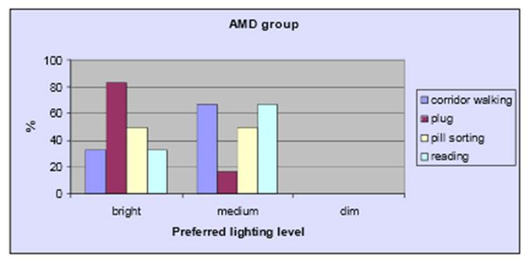
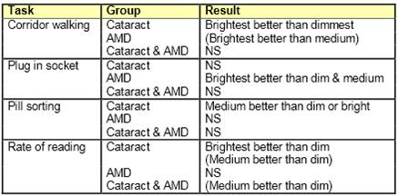
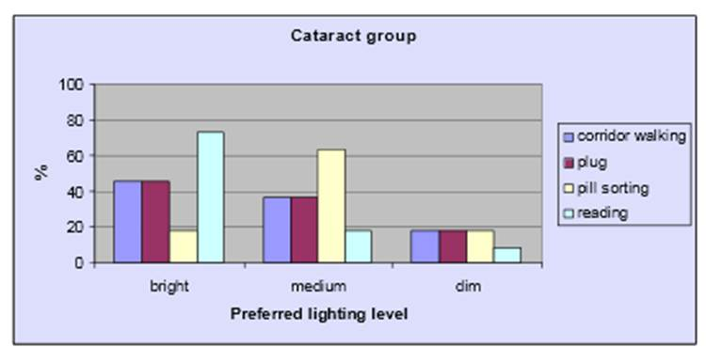
Personal preferences for lighting
People with cataracts and/or age-related macular degeneration varied regarding personal preference for task-lighting levels.
Nevertheless, different illuminance levels (lux = 50-dim/200-medium/800-bright) were generally preferred according to task and visual disorder.
Evans, B.J.W., et al., A pilot study of lighting & low vision in older people. The Institute of Optometry, London
http://freespace.virgin.net/bruce.evans/Lecture%20handouts_files/Lighting%20&%20low%20vision%20poster.pdf accessed 4-1-2013

Slide 23
Cataracts, Macular degeneration, and blue light hazard
Blue light hazard (BLH): “the potential for retinal injury due to high-energy short-wavelength light.” CELMA position paper optical safety LED lighting, July 2011.
At very high intensities, blue light (400-500nm) can photochemically cause irreversible damage to retinal cells, up to blindness. Children are more sensitive to BLH.
Cataracts: Yellowing of lens acts as a natural blue light filter.
Macular degeneration: Blue light can progress AMD, but long-term (not acute) exposure risk. Even then, blue light is not the main risk factor – genetics, diet, smoking, hypertension all greater risk factors.
Alternative light sources which do not emit high levels of blue light are available. These may be chosen in preference to minimize overall exposure to blue light. As with all installations, direct, near-distance viewing of high intensity LED light sources is inadvisable - effective shielding and/or diffusing should be used.

Slide 24
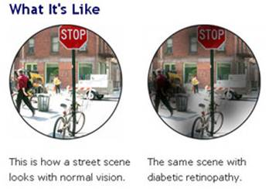
Diabetic retinopathy
Diabetes increases risk for:
Glaucoma,
Premature cataracts,
Diabetic retinopathy.
Diabetic retinopathy is a major cause of blindness in US.
Blood vessels in the retina are damaged and leak.
www.lighthouse.org

Slide 25
Diabetic retinopathy: Lighting needs
As for glaucoma and AMD:
Minimize glare
Ensure sufficient contrast
Allow user to adjust lighting for optimum performance and comfort. Ambient, accent and task lighting.

Slide 26
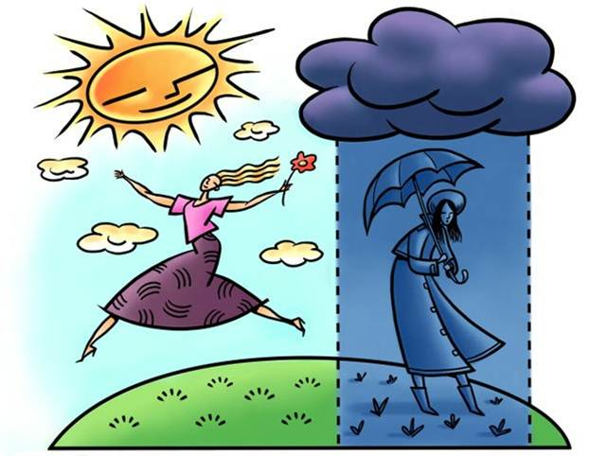
Seasonal affective disorder (SAD)
nbclatino.com
Seasonal affective disorder = depression associated mainly with lower light levels in the winter months.

Slide 27
SAD Symptoms
Symptoms usually build up slowly in late autumn and winter. Similar to other forms of depression:
Hopelessness
Increased appetite & weight gain (cf. other forms of depression)
Increased sleep (cf. other forms of depression)
Reduced energy
Reduced ability to concentrate
Loss of interest in work/other activities
Sluggish movements
Social withdrawal
Unhappiness, irritability
Sometimes becomes long-term depression.
Bipolar disorder or thoughts of suicide possible.
http://www.ncbi.nlm.nih.gov/pubmedhealth/PMH0002499/

Slide 28
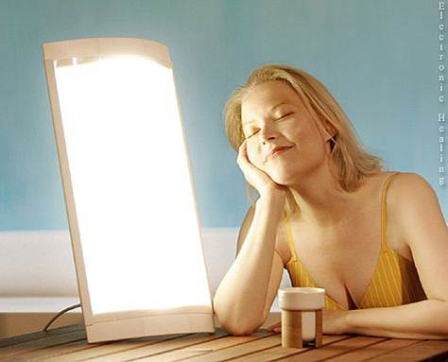
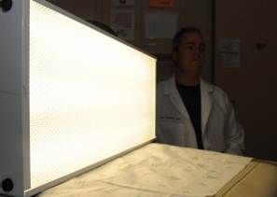
SAD AT
Light therapy: light box (10,000 lux) mimics sunlight.
Start treatment fall or early winter, before symptoms begin.
Follow health care provider's instructions.
Usually early morning, to mimic sunrise.
Sit 2 feet away from light box for c.30 minutes daily. Keep eyes open, but do not look straight into the light source.
Symptoms should improve within 3 - 4 weeks if effective. (PubMed Health, 2012)
Light therapy may be as effective as pharmacological therapies for SAD. Light therapy may also be helpful in alleviating depression (Golden, et al., 2005).
Side effects of light therapy: eye strain and headache, mania, less often. People who take drugs that make them more sensitive to light, such as certain psoriasis drugs, antibiotics, or antipsychotics, should avoid light therapy (PubMed Health, 2012).

Slide 29
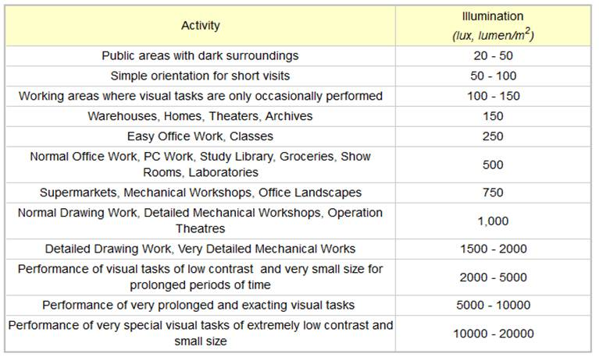
Visual task demands

Slide 30
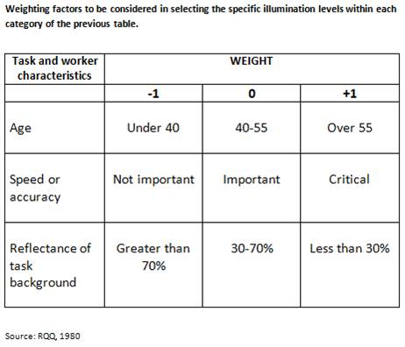
Visual task demands

Slide 31
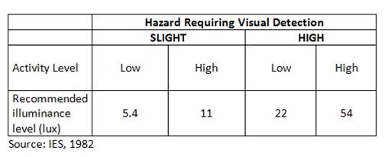
Minimum illuminance for safety

Slide 32
Lighting for safety/performance
Buildings:
Keep lights on during the day to equalize lighting from indoor and outdoor sources.
Position workers so that windows are behind or to the side of them (but illuminate tasks if shadows are problematic). Use blinds or shades to control light during bright daylight hours.
Illuminate floors to at least 300 lux.
Equalize light in rooms and corridors.
Tasks:
Under-counter lighting can increase visibility for work areas.
Illuminate work surfaces to 500-800 lux. Higher for precision work, but avoid glare.
As task lighting increases, also increase room lighting. Don’t use a very bright lamp in a dark room.
Pedestrian routes. Eliminate glare.

Slide 33
Lighting for safety/performance
Vehicle routes. Eliminate direct/indirect glare - no unshielded lamps. Highlight crossing/access points. Overhead hazards – especially power lines. Color/intensity suited to changing weather conditions (e.g., fog). Mark routes using reflective paint, markers.

Slide 34
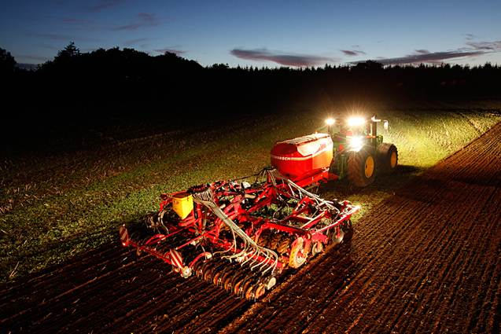
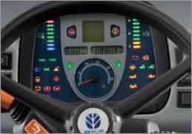
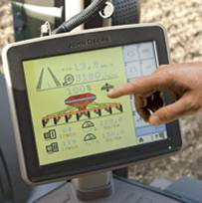
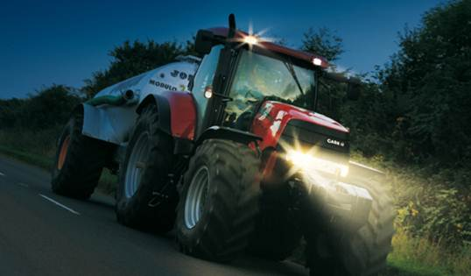
Equipment lighting

Slide 35
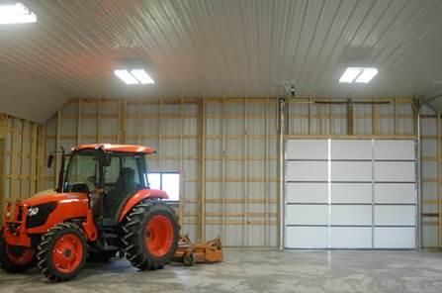
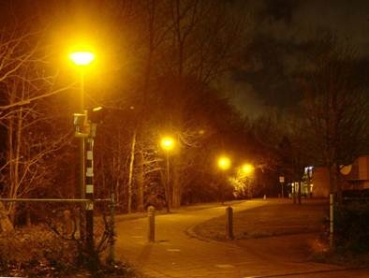
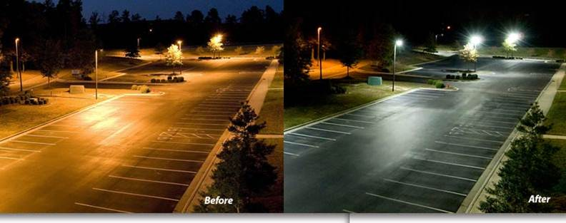
Types of lighting
Sun/moon light
Incandescent
Fluorescent
Low pressure sodium
High intensity discharge (mercury, metal halide, high-pressure sodium)
Light emitting diode (LED)

Slide 36
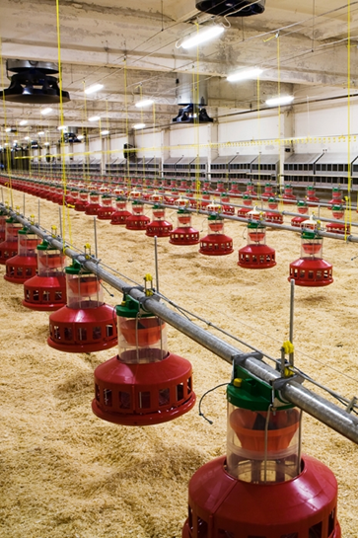
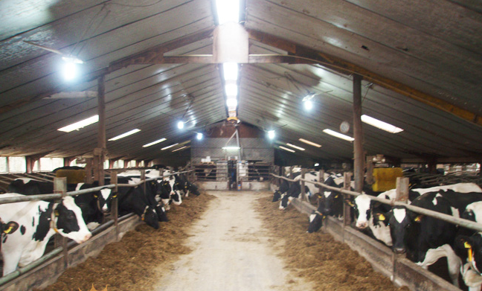
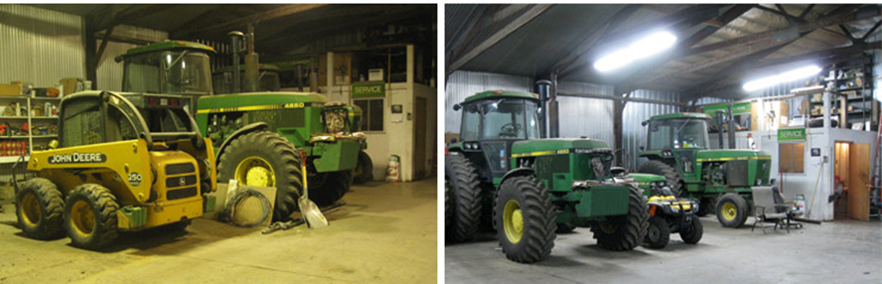
LED Lighting on the farm
http://www.newsunshine.net/news/60W-Dairy-Farm-LED-Lighting-in-Netherlands-39.html
http://www.ozarksecc.com/poultry
http://www.lightsbyhh.com/applications/machine_shed

Slide 37
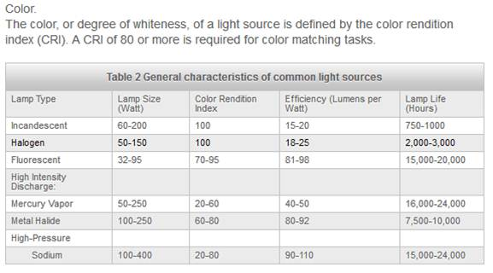
Color and efficiency of artificial lighting
Chastain, J.P., Nicolai:, R. (2007) Dairy lighting system for free stall barns and milking centers http://www.milkproduction.com/Library/Scientific-articles/Housing/Dairy-lighting-system-for-free/

Slide 38
Types of lighting by direction
Indirect - floor standing high pressure lamp shining upward to ceiling or diffuse reflector and covered lamp shining downward into the room (Pinto, et al., 1997)
Direct-indirect – Luminaires with parabolic louvers (silk gloss) mounted with pendulums below the ceiling, and floor standing high pressure lamp shining upward to ceiling or diffuse reflector and covered lamp shining downward into the room (Pinto, et al., 1997)

Slide 39
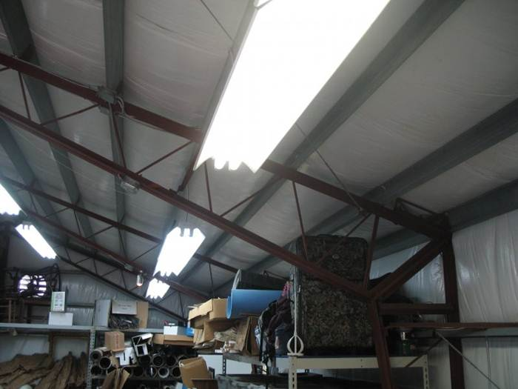
Types of lighting by direction
Direct – ceiling mounted fluorescent lamps or parabolic louvers (silk gloss) (Pinto, et al., 1997)

Slide 40
Types of lighting
Driving: Zones of illumination depend on task, speed, environment and operating conditions.
Instrumentation: should allow dark adaptation – be dimmable; not white – red or green.
Directional lighting of task – must not render the wider work zone invisible.
www.newholland.com
Placement of a visual target in the cab of a tractor affects the orientation of the eyes and, hence, determines the body posture of the operator (Ima and Mann, 2004).

Slide 41
Ag. Lighting Standard: ASABE EP344.3

Slide 42
Other guidance/instruction materials
ASABE. 1993. Lighting for Dairy Farms and the Poultry Industry, ASABE EP344.2, ASABE Standards, 40th edition, St. Joseph, MI 49085-9659. See ASABE EP344.3
“Dairy lighting system for tie stall barns” http://www.milkproduction.com/Library/Scientific-articles/Housing/Dairy-lighting-system/
http://www.intl-lighttech.com/applications/light-measurement-apps/light-measurement-handbook A very useful free online manual for people needing to measure/specify lighting for practical applications.
ASAE EP443.1 FEB04 Color Coding Hand Controls, has been withdrawn and replaced by ASABE/ISO 15077:2008 (Adopted by ASABE October 2008), Tractors and self-propelled machinery for agriculture--Operator controls--Actuating forces, displacement, location and method of operation.

Slide 43
Technical (Detailed) Webinar
Planned for Summer 2013
Detailed guidance and information
Details/signup: http://www.agrability.org/Online-Training/index.cfm

Slide 44
Selected resources
Arditi, A. (2013) Designing for People with Partial Sight and Color Deficiencies. Lighthouse International http://lighthouse.org/accessibility/design/accessible-print-design/effective-color-contrast/
Golden RN, Gaynes BN, Ekstrom RD, Hamer RM, Jacobsen FM, Suppes T, Wisner KL, Nemeroff CB. (2005) The efficacy of light therapy in the treatment of mood disorders: a review and meta-analysis of the evidence. Am J Psychiatry. 2005 Apr;162(4):656-62.
Grosvenor, T. (2013) The Aging Eye: Problems That Affect Acuity and Contrast Sensitivity. Pacific University. http://www.pacificu.edu/optometry/ce/courses/16554/agingeyepg2.cfm#Visual
Ima, C.S. and Mann, D.D. (2004) Ergonomic Concerns with Lightbar Guidance Displays, Journal of Agricultural Safety and Health 10(2): 91−102 2004 ASAE ISSN 1074−7583
Lighthouse International (2013) http://www.lighthouse.org/
National Eye Institute. (2013) http://www.nei.nih.gov/index.asp
National Research Council, Canada (1972) http://archive.nrc-cnrc.gc.ca/eng/ibp/irc/cbd/building-digest-192.html
Pheasant, S. (1991) Ergonomics, Work and Health. Macmillan Press, Basingstoke, pp. 196-211
Pinto, M.R., De Medici, S., Zlotnicki, A., Bianchi, A., Van Sant, C., and Napoli, C. (1997) Reduced visual acuity in elderly people: the role of ergonomics and gerontechnology. Age and Ageing, 1997 26:339-344
PubMed Health. (2012) Season Affective Disorder http://www.ncbi.nlm.nih.gov/pubmedhealth/PMH0002499/
Wilkins, A. J., Nimmo-Smith, I., Slater, A. & Bedocs, L. (1989). Fluorescent lighting, headaches and eye-strain. Lighting Research and Technology, vol. 21, 11-18

