Slide 1
Selecting & Evaluating Suitable Farm/Ranch Enterprises for Individuals with Limitations

Slide 2
Richard J. Brzozowski
Extension Educator – Agriculture
richard.brzozowski@maine.edu
207-791-7155

Slide 3
An Analogy
How is a choosing a meal from a restaurant menu like . . .
selecting a farm enterprise?

Slide 4
Prioritizing your drivers
What is the order of importance to you?

Slide 5
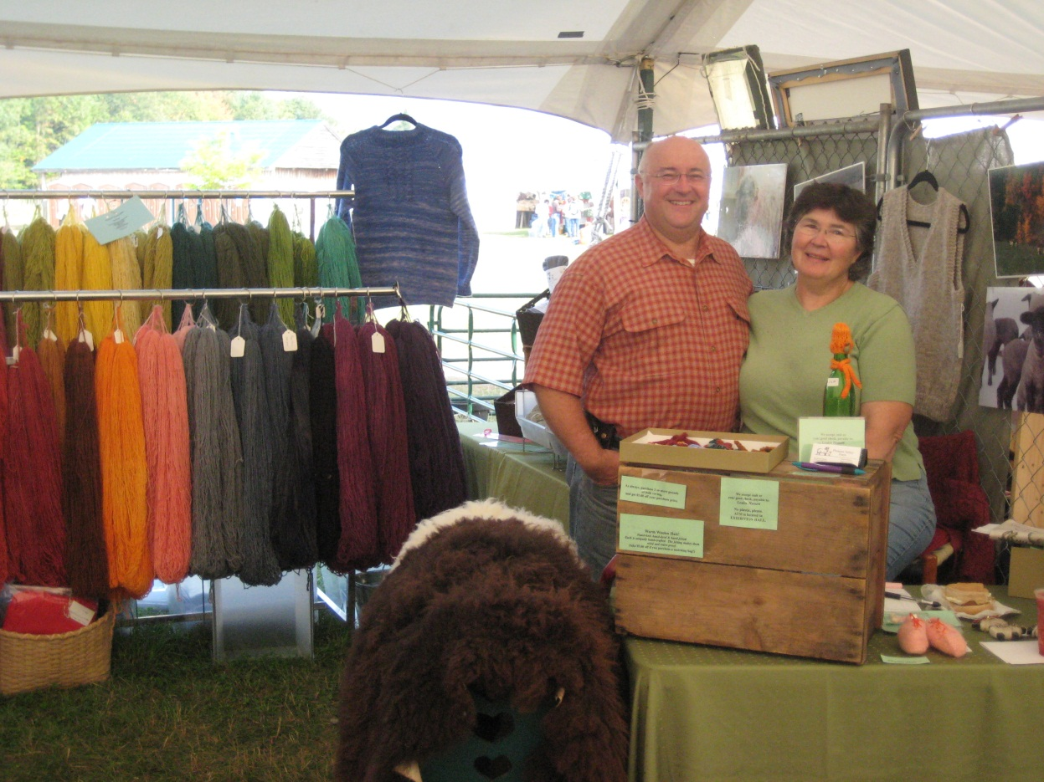
Considering an Enterprise by Type
Animal-based
Plant-based
Service-based
Value-added

Slide 6
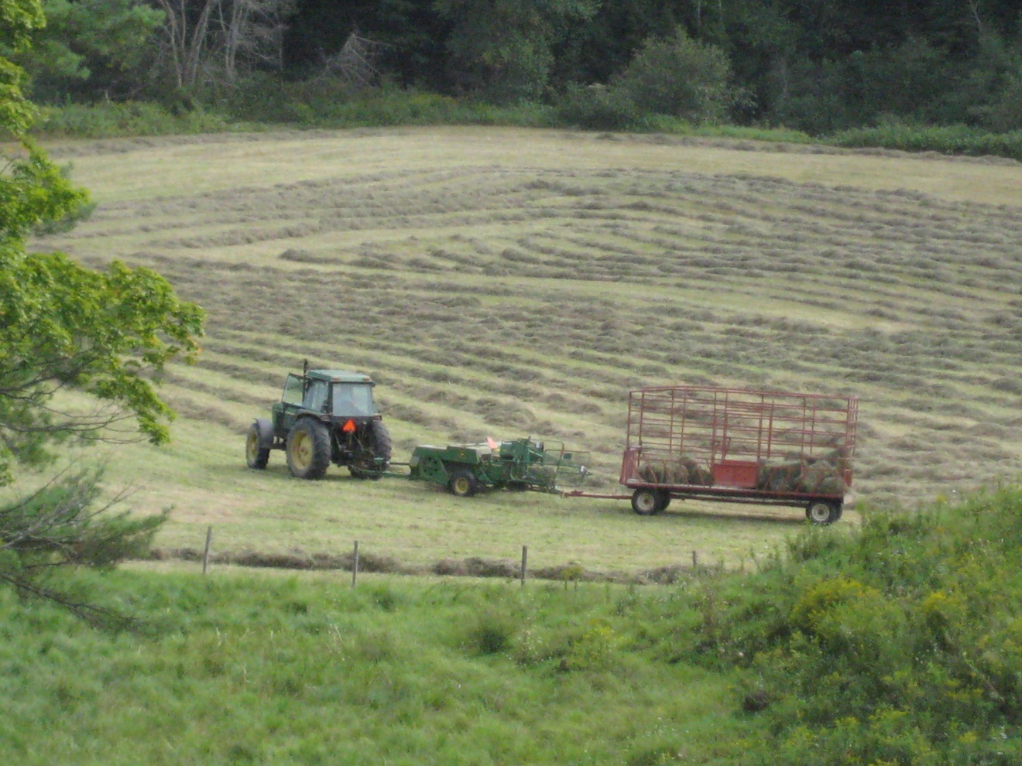
Considering an Enterprise by Size & Scale of Operation

Slide 7
Considering an Enterprise by Work Load & Type of Work
Physical work / Manual labor
Hours/day
Degree of strain
Machine work
Tractors, equipment, labor saving tools
Thinking work
Using your knowledge, solving problems, managing people or resources, etc.

Slide 8
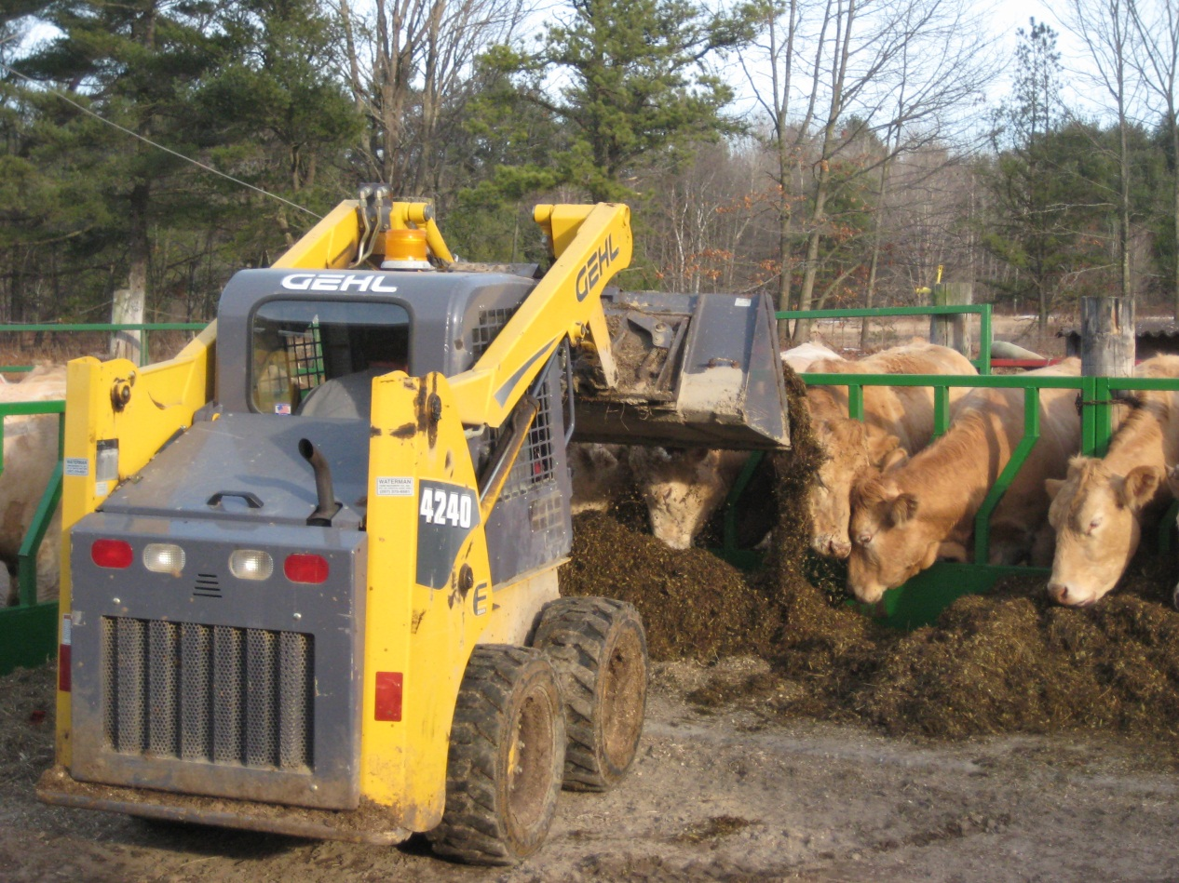
Considering an Enterprise by Resources Needed
Land & Soil
Water
Equipment
Facilities
Labor
Start-up cash

Slide 9
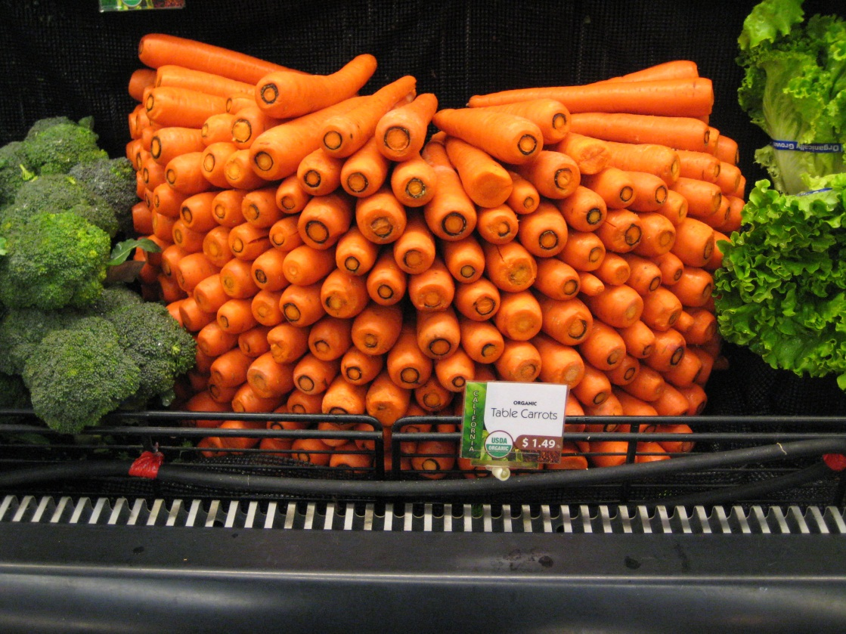
Considering an Enterprise by Production Cycle
How long will it take from start to finish (harvest) for each “crop”?
Weeks
Months
More than one year
Perennial

Slide 10
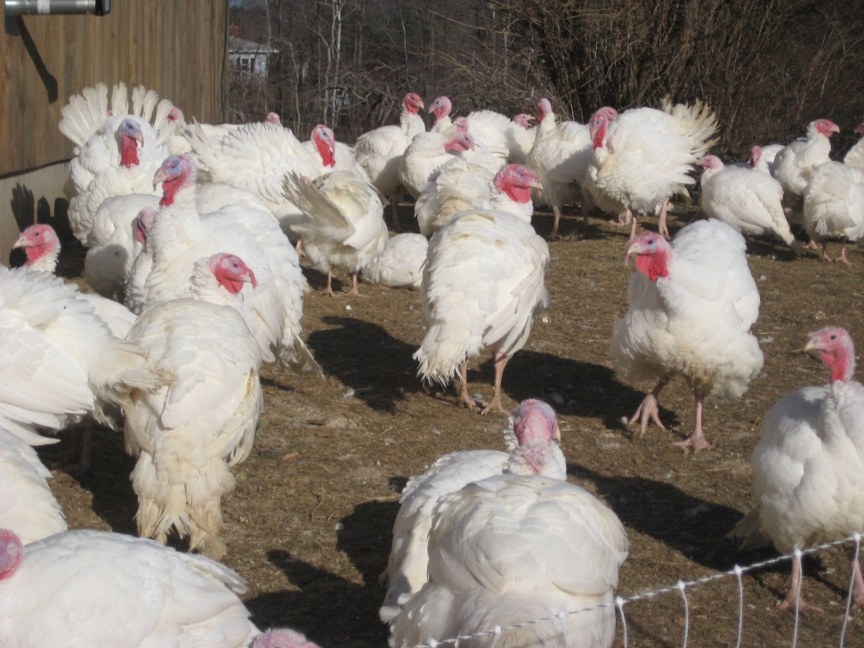
Considering an Enterprise by Potential Income
Short term
Long term
Seasonal or Year-round
Daily
Targeted income

Slide 11
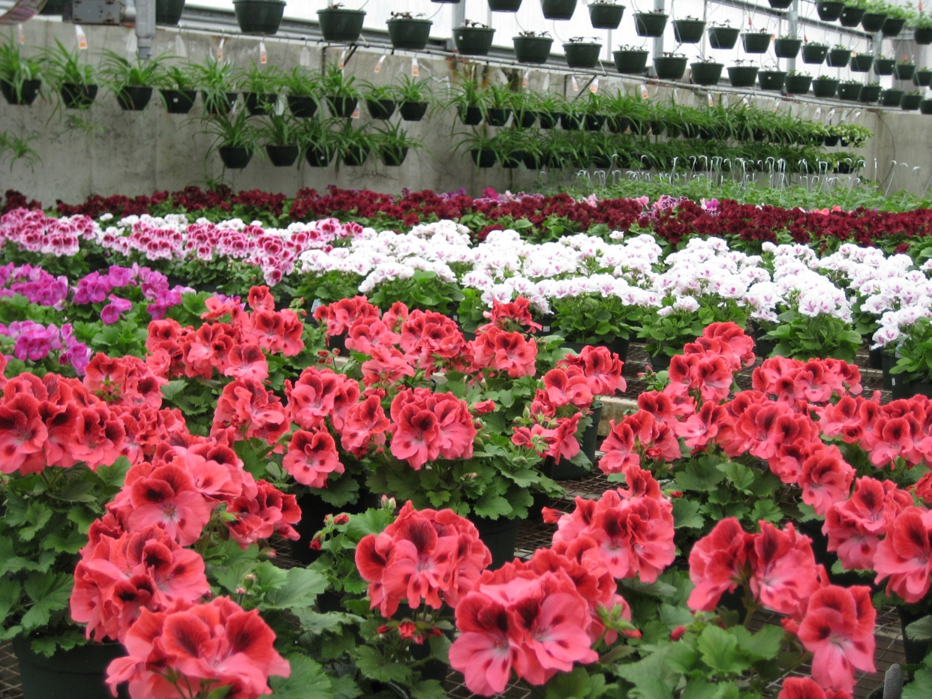
Considering an Enterprise by Likes & Dislikes
Enjoyment
Rewards

Slide 12
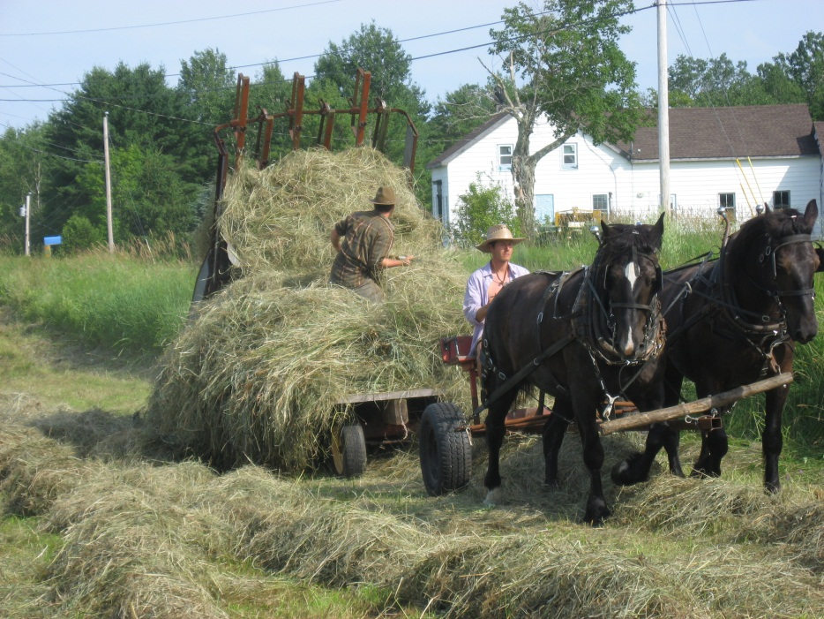
Identifying the Risks. . . beyond your control
What are the risks?
How much am I risking?
How important is timing?
Other . . .

Slide 13
Spreading or Reducing the Risks
Having more than one enterprise
Have more than 1 market outlet
Start off small (and expand with success)
Select a “sure bet” enterprise

Slide 14
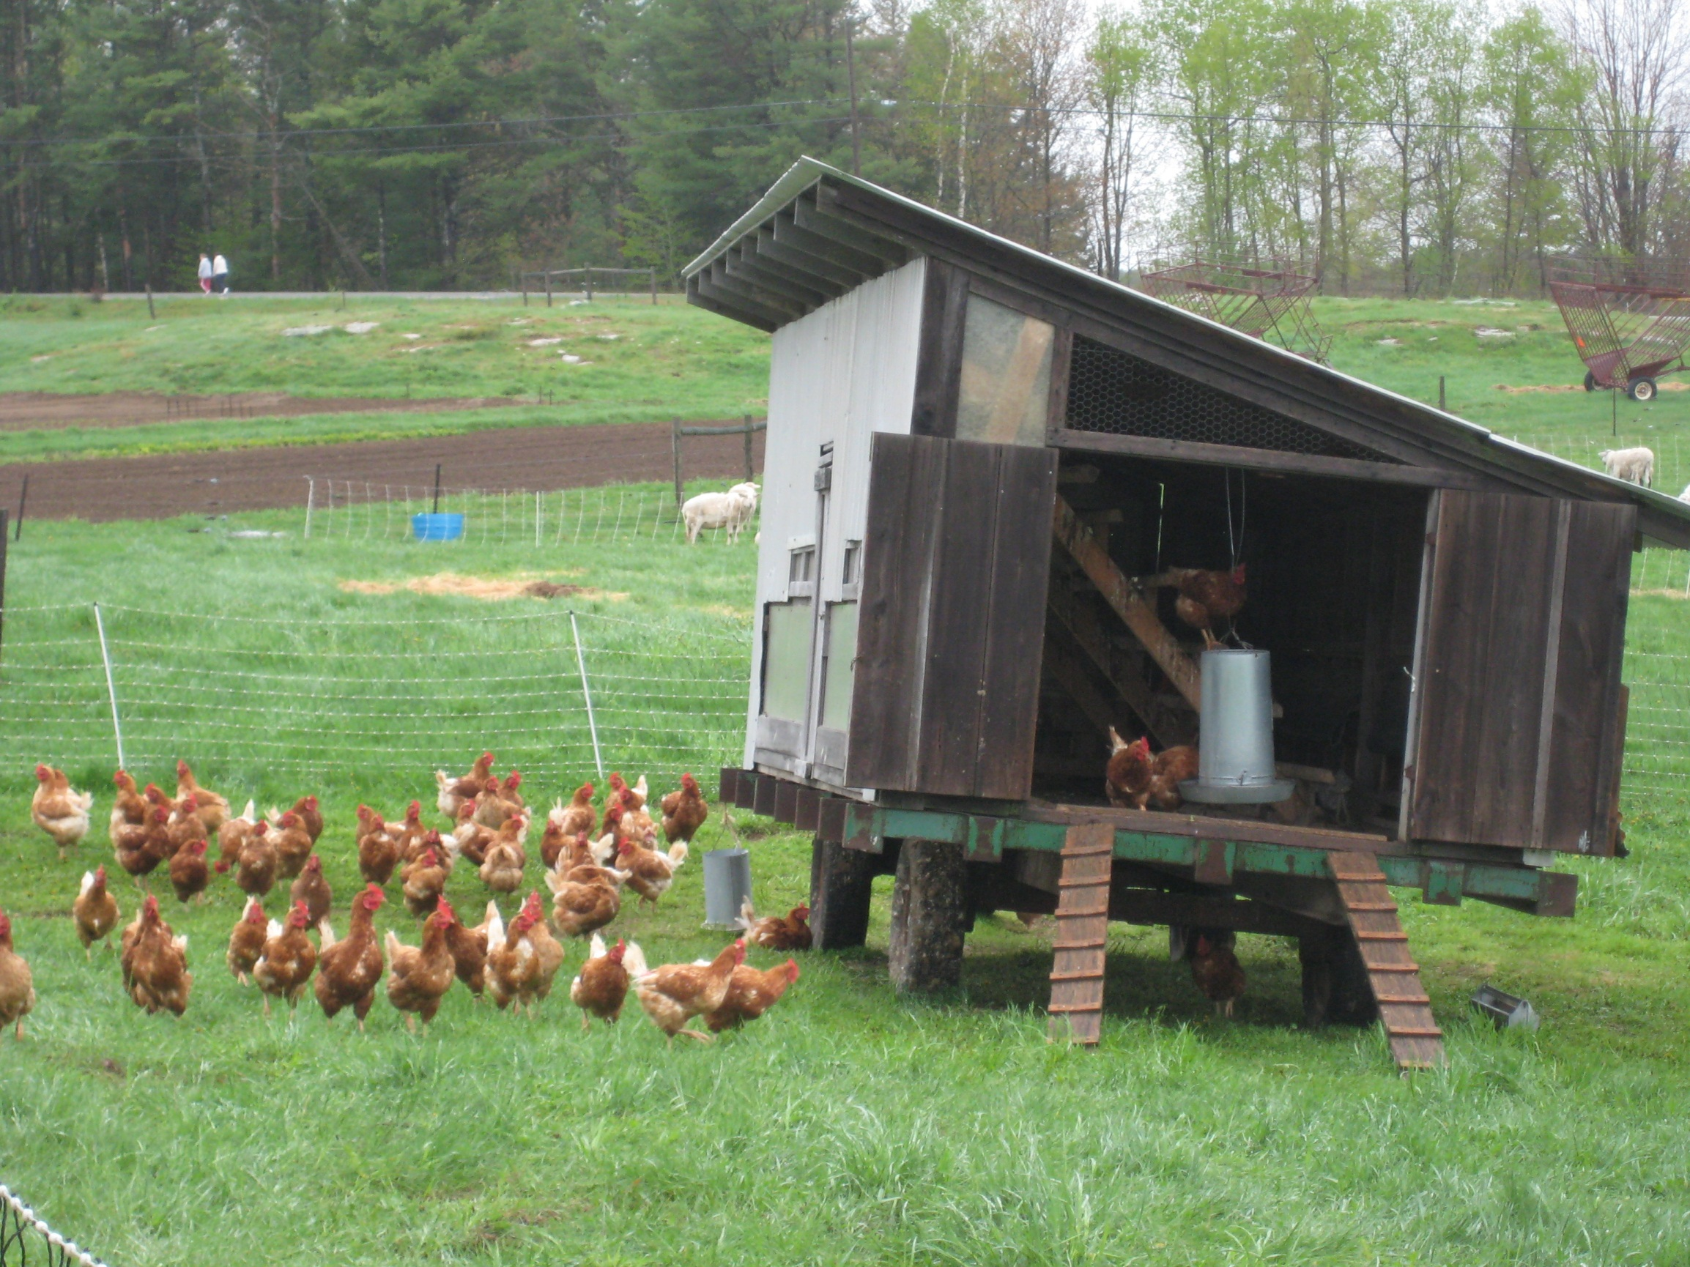

Slide 15
Considering an Enterprise by Demand on Limitations
Identifying abilities & limitations
Identifying demands of the enterprise
When?
What?
How?
Addressing the demands
Hired labor or others
Machinery or equipment
Assistive technology

Slide 16
Possible Sources for Informational Assistance
Cooperative Extension
USDA
Small Business Development Center
ATTRA
Non-Government Organizations
Other farmers/experts

Slide 17
Other Possible Resources
Agencies
Printed materials
Web sites
Videos

