Slide 1
"ASSISTIVE TECHNOLOGY SOLUTIONS™”: A New Paradigm for the Development and Dissemination of Assistive Technology

Slide 2
Jerry Weisman
Assistive Technology Solutions

Slide 3
PEOPLE WITH DISABILITIES NEED ASSISTIVE TECHNOLOGY
1 in 5 people have a disability and 1 in 10 have a severe disability.
Assistive technology effectively increases the independence and the quality of life of people with disabilities.

Slide 4
AVAILABILITY OF ASSISTIVE TECHNOLOGY IS LIMITED.
Only about 5% of devices developed for use by people with disabilities are commercialized and become available for purchase.
Funding to purchase commercially available devices is being reduced with recent reductions in growth of Medicaid and Medicare.
Funds for assistive technology are scarce in developing countries.

Slide 5
AN ABUNDANCE OF INFORMATION EXISTS ABOUT ASSISTIVE TECHNOLOGY DEVICES
Research and development projects, engineering student projects and simply fulfilling the needs of people with disabilities
No mechanism to disseminate this information

Slide 6
THE INTERNET IS BECOMING UBIQUITOUS
2 Billion people accessing the Internet representing more than 32% of the world’s population.
In North America, more than 78% of the population has access to the Internet.
The Internet is fast becoming the “Global Village” Marshall McLuhan predicted.
Social networking and mobile technology, i.e. smart phones, are revolutionizing the Internet.

Slide 7
OPEN SOURCE PORTENDS A NEW INNOVATION PARADIGM
“Software is just the beginning … open source is doing for mass innovation what the assembly line did for mass production. Get ready for the era when collaboration replaces the corporation.”
-- Thomas Goetz

Slide 8
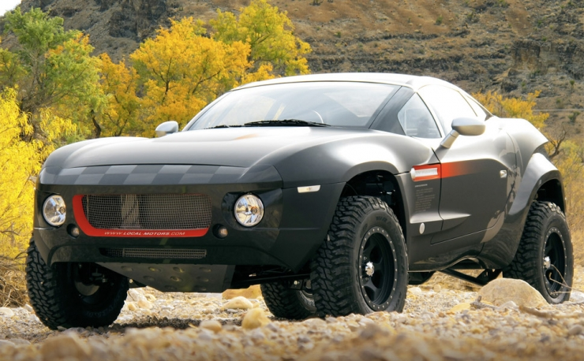
OPEN SOURCE PORTENDS A NEW INNOVATION PARADIGM.
Crowdsourcing
http://www.innocentive.com/
http://www.quirky.com/
http://localmotors.com/
Rally Fighter

Slide 9
FABRICATION RESOURCES
EXIST LOCALLY
DIY
Maker Culture
CNC machining
Factory for hire
3 D Printing

Slide 10
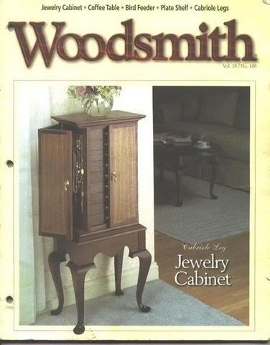
Assistive Technology Solutions
First conceived in 1989
Inspired by “Woodsmith” magazine

Slide 11
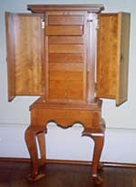

Slide 12
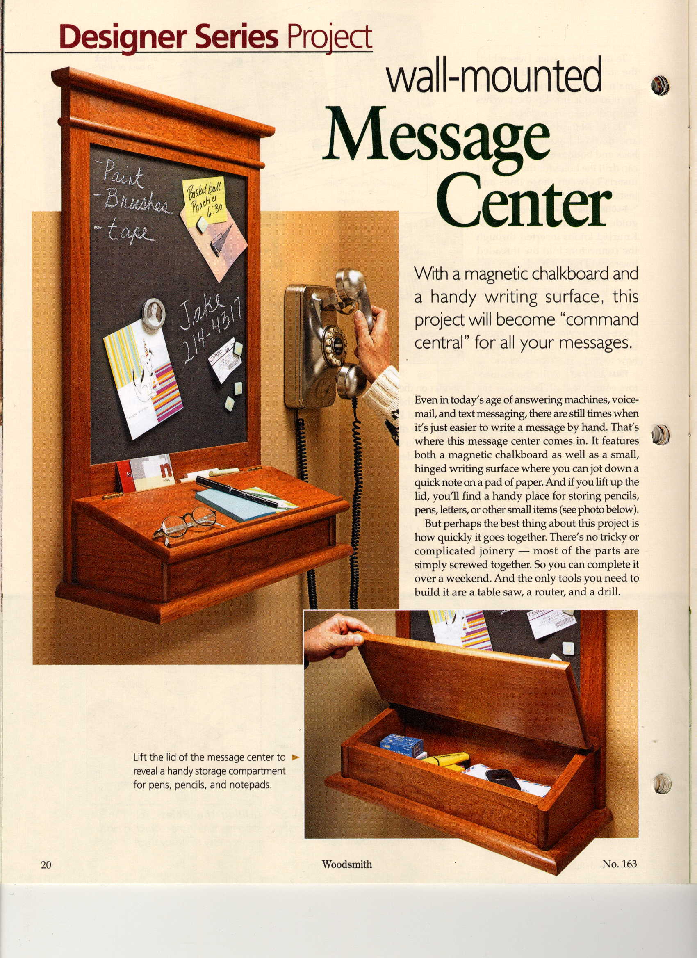
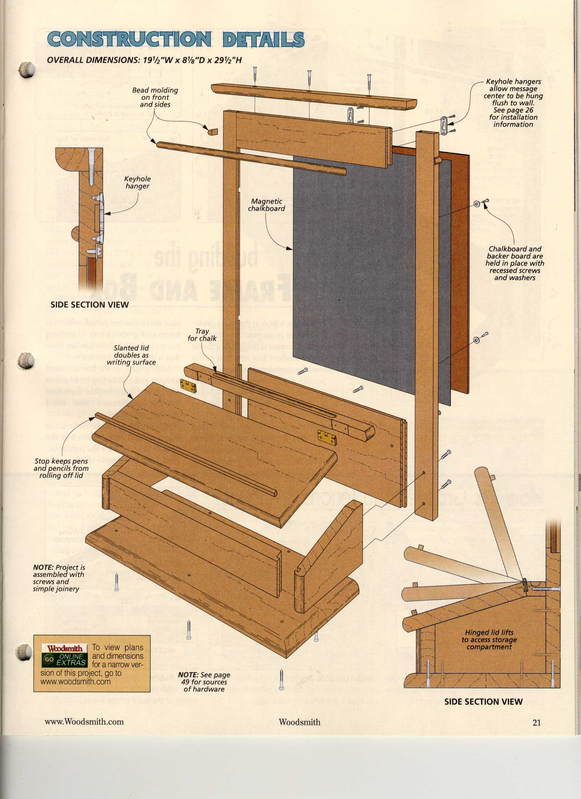

Slide 13
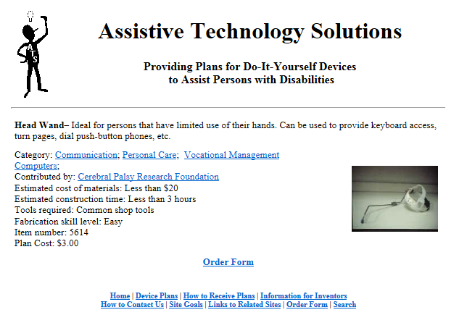
Assistive Technology Solutions
NIDRR funded project

Slide 14
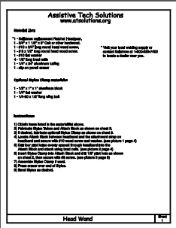
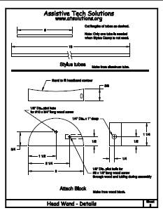
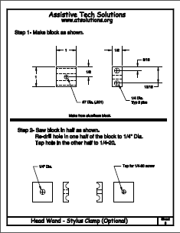
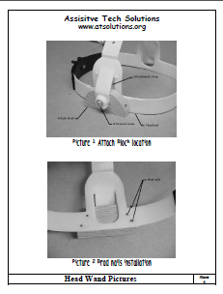
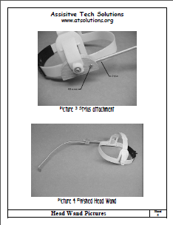

Slide 15
NIH funded R24 grant
www.simbex.com/TREAT

Slide 16
Objectives
Create a community that will foster the innovation of new assistive technology.
Archive information, particularly engineering information, about assistive technology devices.
Be a source of engineering information and fabrication instructions sufficient to replicate assistive technology devices with local fabrication resources.
Create an enterprise functionality that will enable ATS users to sell assistive technology devices that are not likely to become more widely commercially available.

Slide 17
+

Slide 18
Assistive Technology Solutions Website Content
Disseminating Assistive Technology
Assistive Technology “ideas”
Rough plans and instructions
Enterprise Development
Finished, formal (CAD) instructions ($)
Kits ($)
App Store ($)
Finished product store, i.e. “Etsy.com” ($)
Business Model
Online advertising ($)
Donations ($) [501(c )3]
Notes:
This is still in the development phase significantly. ATS will most likely be a 501c3 venture. But at the end of the day ATS is about creating partnerships to share discovery’s, technologies and ideas to a larger online community.

Slide 19
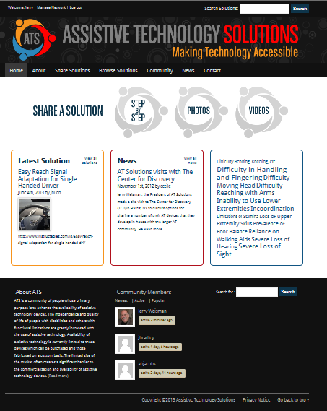

Slide 20
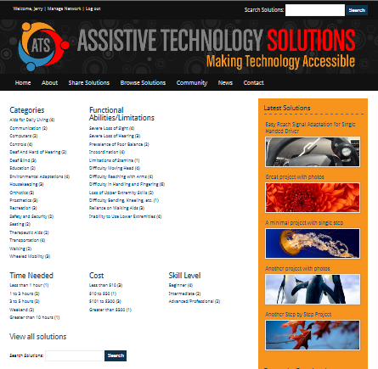

Slide 21
ATS Website Content
Facilitating AT Development
“Community” of stakeholders-Membership
Discussion Groups, Forums
Portfolio of success stories
Facilitate raising capital/funding
Kickstarter.com model
Angel List model <angel.co/>
Innocentive model www.innocentive.com/
Make Projects model http://makeprojects.com/

Slide 22
www.atsolutions.org
Thank you for your attention!
Jerry Weisman
jerryweisman@gmail.com

