Slide 1
Farm to Market – How to plan and market products for the consumer; Adding Value AgrAbility, 2014
Dr. Gregg Rentfrow, Ph.D.
Associate Extension Professor – Meat Science
University of Kentucky

Slide 2
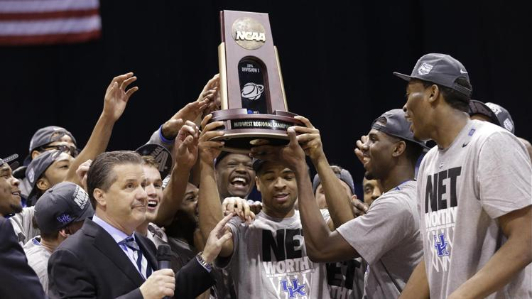

Slide 3
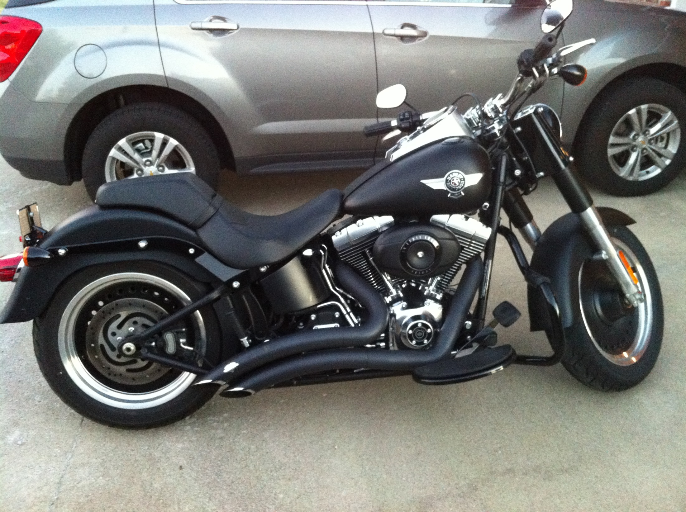

Slide 4
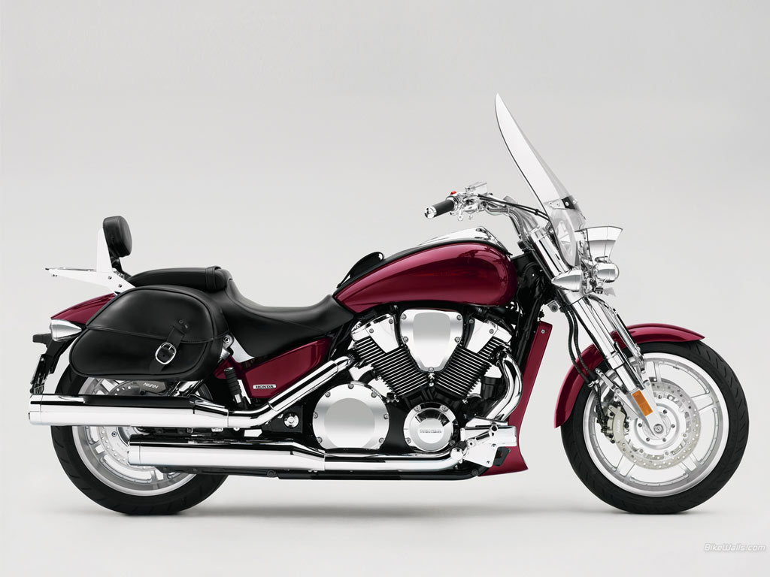

Slide 6
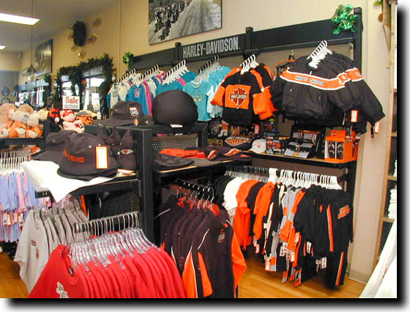

Slide 7
Grocery Store A
Grocery Store B

Slide 8
Whose my customers?

Slide 9
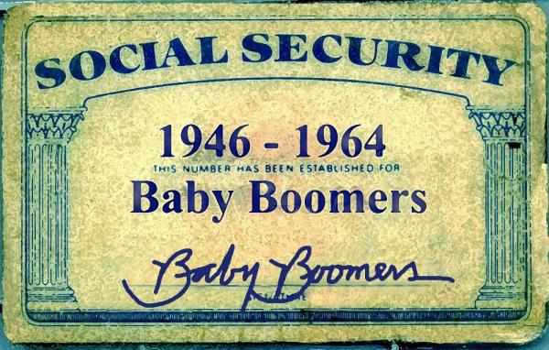
The Generations
Baby Boomers
1945 – 1964
Most money
Delayed retirement
Gen X (MTV Generation)
Late 1960’s to mid 1980’s
More white color than parents
Individually at or slightly below Baby Boomers, but totally higher due to women working
Millennial’s (Boomerangs)
Late 1980’s to early 2000’s
Coming of age
Internet

Slide 10
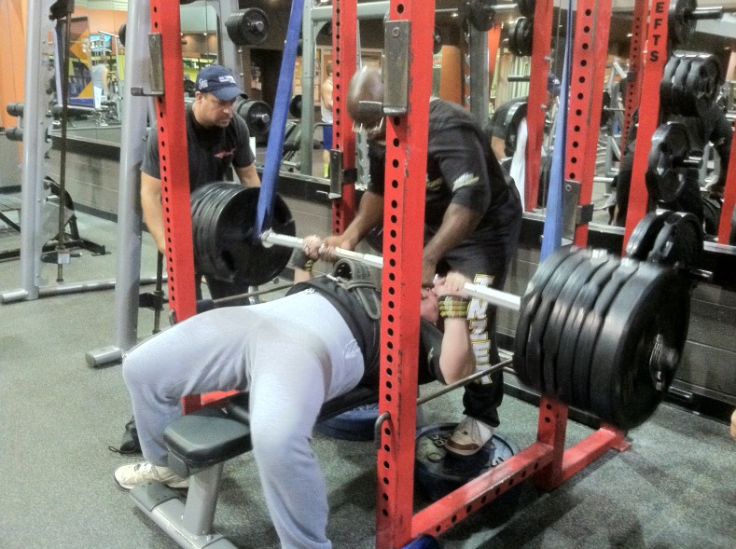
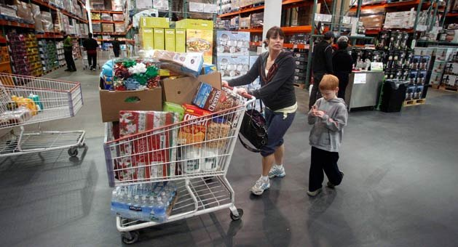
Types of Consumers/Customers
Health Conscious
Seeking “healthy foods”
Label Readers
Ingredients
Nutritional data
Family/Bulk Buyers
Save money
Convenience

Slide 11
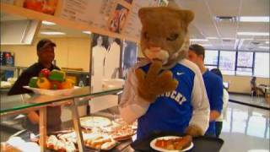
Types of Consumers/Customers
Economy Buyer
Cheap, quality not important
Foodies
Quality extremely important
Rare or unique foods
Food Network
Localvores
Local foods

Slide 12
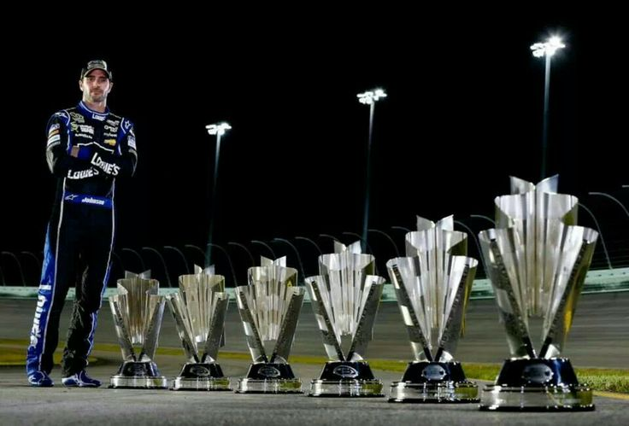
Separating yourself from the pack; Add-Value to your operation!

Slide 13
Kentucky Proud
Easy to sign up, it’s free
http://www.kyagr.com/kyproud
More and more states capitalizing on local programs
Satisfies the Localvore
May satisfy the Foodie
Could for Health Conscious

Slide 14
Organic
Most restrictive
Must follow strict guidelines
No antibiotics, pesticides, only approved medications, no pesticides on pasture ground, fed only organic feed, etc
Periodic third party inspection
Satisfies the Health Conscious & Label Readers
May satisfy the Localvore and the Foodie

Slide 15
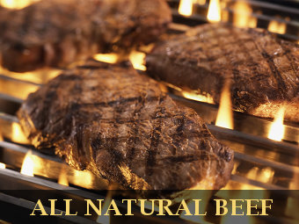
Natural
USDA Definition: Cannot contain added color or artificial ingredients, only minimally processed
Meats – typically not given growth promotants or antibiotics
Satisfies the Health Conscious & Label Readers
May satisfy the Localvore and the Foodie

Slide 16
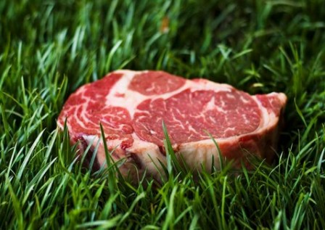
Grass/Forage Finished Beef
Fed Grass or Forage for 90% of their life
Slower growing
Keep in mind the 30 Month Rule
Yellow Fat
Higher in Omega 3 FA & CLA
Flavor Issues
Satisfies the Health Conscious
May satisfy the Localvore and the Foodie

Slide 17
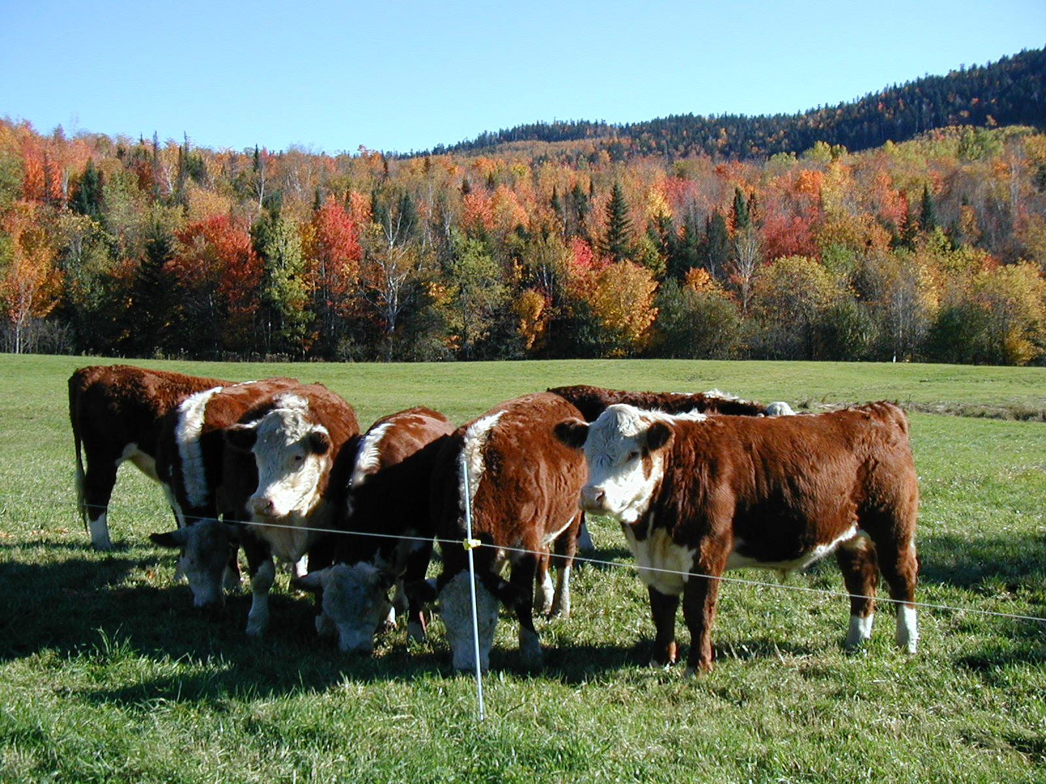
Pasture Raised
Pasture Raised
Fairly new program
Raised on Pasture, not a feed lot
Grain on grass (beef)
Not to be confused with grass-fed
Satisfies Localvores
May satisfy Foodies

Slide 18
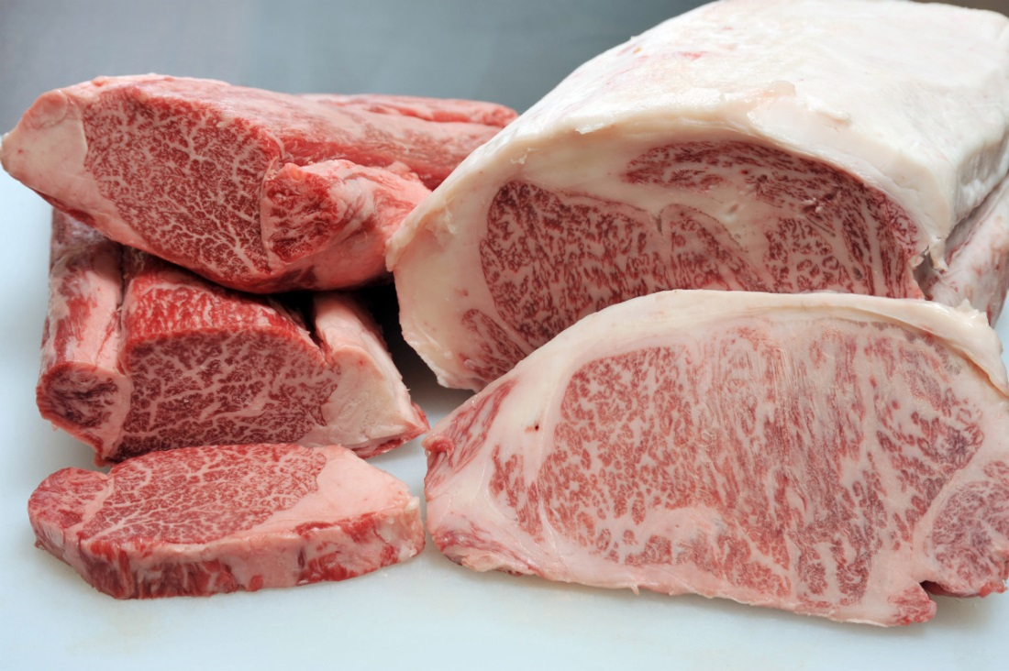
High Quality
High Quality
Starting to gain some recognition
High Quality Grades
Average Choice or higher
Waygu Cattle
American Kobe

Slide 19
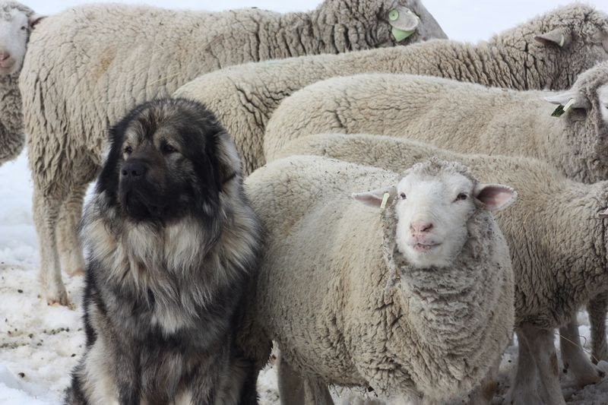
Other ways
Free Range
No solid definition
Poultry
Pigs
Cattle???
Predator Friendly
Did not harm predators stalking your animals

Slide 20
Other ways
Freezer Programs or Shares
Beef or Pork
Vacuum package
Bundling
A few Ribeye steaks, some ground beef, a few roasts
$25, 50$, $75, etc
Vacuum package

Slide 21
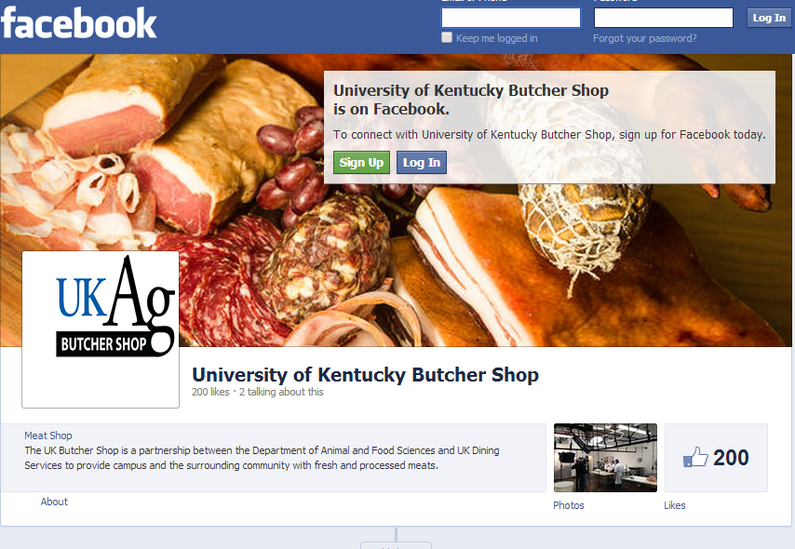

Slide 22
