Slide 1
What I’ve learned from 33+ years raising sheep; that may (or may not) help you work with customers.
Kerri Ebert, Kansas AgrAbility

Slide 2
Objectives
My background
Overview of sheep production in U.S.
Types of sheep
Types of operations
How and why of our personal operation
Advice & pointers
Questions & discussion

Slide 3
Disclaimers
I’m no expert, but I am experienced – 35 years with sheep/33 married to a sheep farmer
I read on the suggested list of sessions that the NTW needed sessions about sheep and goats so I submitted this idea. Then I came to my senses but Kylie wouldn’t let me wiggle out, so here I am.
I grew up raising purebred Simmental cattle; not sheep
The type of sheep we raise may not be the type of sheep your customers raise or want to raise
The message today is from my personal experiences. Your (or your customers’) experiences will vary.
Sheep are great; but…

Slide 4
…our sheep dogs are equally great
Concho – the herding Corgi grand dog
Fluffy – the Great Pyrenees guard dog

Slide 5
My Background
Sheep farmer since 1983
4th generation Kansas farmer
150 ewes, have had as many as 250
K-State Extension Service Employee – 16 years
Extension farm safety
Kansas AgrAbility Project
Kansas Center for Sustainable Agriculture and Alternative Crops & Kansas SARE
Ag association manager – 25 years
Kansas Sheep Association, Kansas Dairy Association & Commission, Kansas Holstein Association

Slide 6
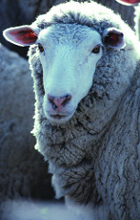
Sheep Basics
Ovine – ovis aries (genus & species) four-legged ruminants
Wool sheep
Meat sheep
With wool
Without wool (a.k.a. hair sheep)
Milk – not so much in the U.S. – but there are some and it might be a good niche market
Photo courtesy of the American Sheep Industry Association

Slide 7
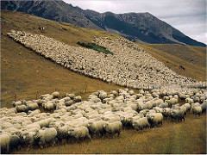
2 Main Types of Sheep in U.S.
Wool breeds
Fine wool (fiber diameter <22 microns), and medium wool (<30 microns)
Used primarily for high-end products such as clothing
Not your typical American sheep; although Rambouillet are very common in Western states
Major fine wool breeds in U.S. are: Rambouillet, Merino, Targhee, Columbia
Photo courtesy of the American Sheep Industry Association

Slide 8
2 Main Types of Sheep in U.S.
Wool breeds - continued
Long wool sheep; bigger diameter, coarse long fibers
Sheep are best suited for cool, high rainfall areas with lots of grass
Breeds in U.S. include: Border Leicester, Lincoln, and Romney
Wool used often for fiber arts, such as hand spinning and weaving
Photo courtesy of the American Sheep Industry Association

Slide 9
2 Main Types of Sheep
Meat breeds
Medium to coarse wool (fiber diameter >30 microns), mid- to short-length fibers
Carpets, upholstery, bulky sweaters
Major meat breeds in U.S. include:, Cheviot, Corriedale, Dorset, Finnsheep, Hampshire, Montadale, Shropshire, Southdown, Suffolk, Texel
Photo courtesy of the American Sheep Industry Association

Slide 10
2 Main Types of Sheep -- addendum
Hair sheep
Gaining popularity in U.S.
No wool, body covered with hair
Meat sheep
Often found in Caribbean and Africa but popularity in U.S. is growing because they don’t have to be sheared.
Katahdin is a hair sheep that leads all sheep breeds in numbers of registrations
Other hair sheep breeds include: Barbados, Dorper, St. Croix
Some hair sheep shed their coat and are considered “improved” breeds
Photo courtesy of the American Sheep Industry Association

Slide 11
Typical Sheep Operations in U.S.
Small farm flocks – Eastern half of U.S.
Show lamb production (club lambs)
Purebred breeding stock – rams and ewes
Specialty wool production – fiber arts
Range sheep – Western States
Flocks can number in thousands of ewes
Fine-wooled, often crossbred

Slide 12
Our operation – Ebert Sheep Farm
Small Farm Flock – 160 acres
150 ewes / 10 rams
6 breeds – Dorset, Horned Dorset, Hampshire, Shropshire, Suffolk, crossbred
Show lambs (club lambs)
Breeding stock
Purebred ewes and rams
Spring lambing
January-March
Fall lambing – white-face ewes only
October

Slide 13
Our farm
Outlined in Yellow = grazing areas, multiple paddocks including:
40 acre pasture
40 acres alfalfa
35 acres sorghum
30 acres brome grass
5 acres sorghum sudan

Slide 14
Sheep Basics
Sheep are natural grazers so as long as they have a flock for company and adequate water and forage they are generally content
Docile – easily tamed, but also easily scared
Social – strong herding instinct
Smaller size makes handling facilities a bit easier than cattle facilities and a bit less expensive
Easy part = grazing/free range
Not-so-easy part
=
Lots and barns (confinement)

Slide 15
Sheep Production in General
Good fencing is mandatory. For pastures we use 47” woven wire with 1 strand of barbed wire on top
Most challenges (after good fencing) come from confinement situations
Easy part = grazing/free range
Not-so-easy part
=
Lots and barns (confinement)

Slide 16
What I’ve learned from 33+ years raising sheep
Good fences are VERY important. We use woven wire pasture fences; 8’X50” cattle panels in lots
Even with good fences, the sheep are always out
Sheep’s favorite color is GREEN and they will go to great lengths seeking green vegetation to eat
Sheep are a lot like people. They are social animals with a strong flocking instinct. Always keep more than one.
Like cattle, sheep have wide field of vision. Can see all around themselves without moving head.
Spook easily; sensitive to high-pitched sounds
Highly developed sense of smell
Instinctually are animals of prey; can exhibit nervous behavior when introduced to new surroundings; will flock together when scared

Slide 17
What I’ve learned from 33+ years raising sheep
If you have wool sheep, you have to shear at least once a year
Typically easier to handle than cattle; but they are surprisingly strong and quick
When handled gently, can become quite docile. Many small flocks would be considered tame.
Regardless of how tame they behave, remember they are animals with animal instincts. They are not human and will not react to stimulation like a human. They will react like an animal.

Slide 18
What I’ve learned from 33+ years raising sheep
Sheep are generally good grazers and respond well to rotational grazing
We graze the entire farm
Handling is made easier with the right equipment
While I am not endorsing or recommending, we use many Sydell products and are pleased with them; lightweight, easy to assemble
Sydell B Corral System
Sydell 5’ double panel, we use them to build lambing pens in the barn.
Sydell equipment photos from Sydell.com

Slide 19
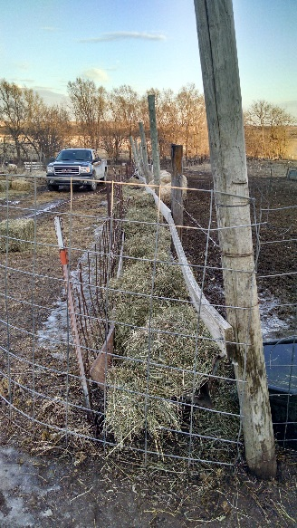
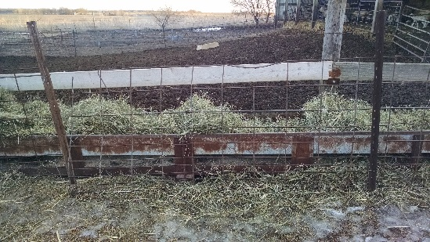
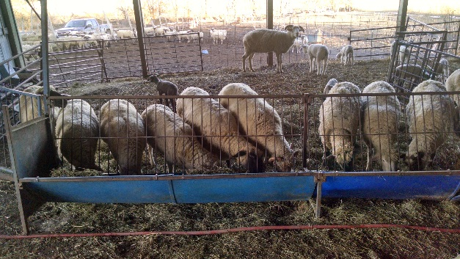
What I’ve learned from 33+ years raising sheep
Fenceline feeders make feeding easy because we don’t have to be in the pen with the sheep for feeding. Translation: we don’t get knocked down as much. We use commercial feeders and feeders made from repurposed hay elevators

Slide 20
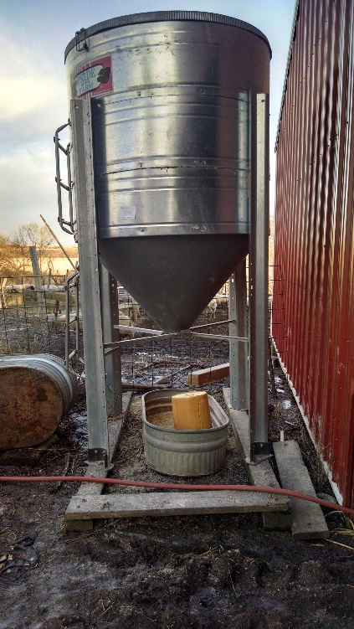
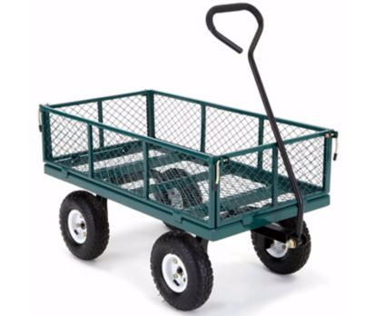
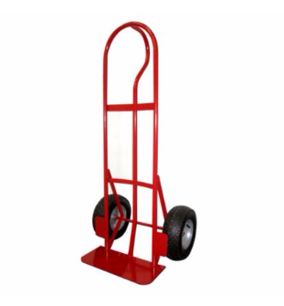
What I’ve learned from 33+ years raising sheep
Let gravity do some of the work for you
Wheels are your friend!

Slide 21
Resources
eXtension – Sheep Community of Practice http://articles.extension.org/sheep
American Sheep Industry Association http://www.sheepusa.org
Sheep 101 & Sheep 201 http://www.sheep101.info
Your state sheep organizations

Slide 22
Questions?

Slide 23
Thank You
http://www.ebertsheepfarm.com/

